Slide 1
FW364 Ecological Problem Solving
Population Regulation
October 9, 2013

Slide 2
Outline for Today
Continue to make population growth models more realistic
by adding in density dependence
Objectives for Today:
Introduce density dependence (modeling style)
Discuss scramble and contest competition
Objectives for Next Monday:
Continue discussion of scramble and contest competition
Introduce Allee effects (inverse density dependence)
Text (optional reading):
Chapter 3

Slide 3
Big Question
How does exponential population growth come to an end?
N_{t} = N₀ λ^{t}
Given 511 muskox in 1964 and our estimate of λ as 1.15,
what would the population size be in:
1974 ? N₁₉₇₄ = N₁₉₆₄ λ¹⁰ = 511 * 1.15¹⁰ = 2,067 muskox
b) 1984 ? N₁₉₈₄ = N₁₉₆₄ λ²⁰ = 511 * 1.15²⁰ = 8,363 muskox
c) 1994 ? N₁₉₉₄ = N₁₉₆₄ λ³⁰ = 511 * 1.15³⁰ = 33,834 muskox (!!!)

Slide 4
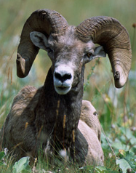
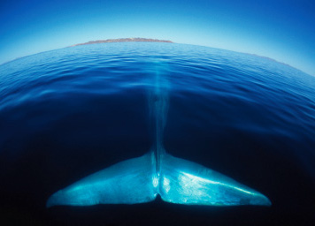
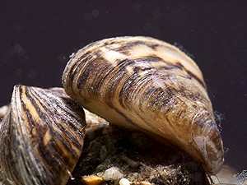
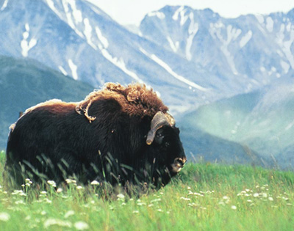
When Exponential Growth Happens
Clearly, a population cannot grow exponentially indefinitely
When is exponential growth applicable?
When resources are not limiting
Often when populations are starting at low abundance
Examples
Populations recovering from disease epidemics
Populations recovering from unsustainable harvest
Invasive species
Introduced species
Blue whales
Bighorn sheep
Zebra mussels
Muskox

Slide 5
Limits to Exponential Growth
Eventually, limits to population growth set in
Two broadly defined limits to population growth:
Density dependent factors
Regulate populations
This lecture and next lecture
Density independent factors
Do not regulate populations
Brief introduction today
Important to distinguish between these limits because:
Handled differently in predictive models
Correspond to different management strategies

Slide 6
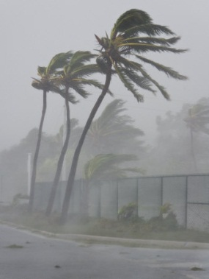
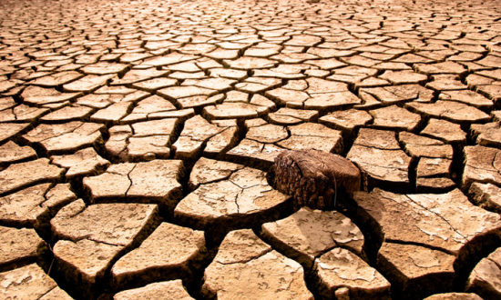
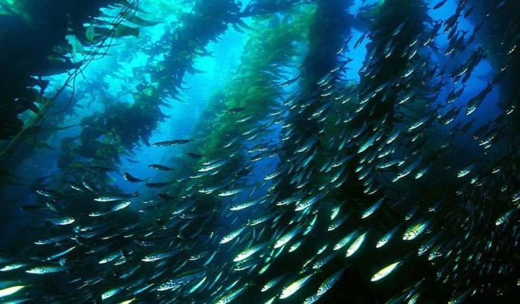
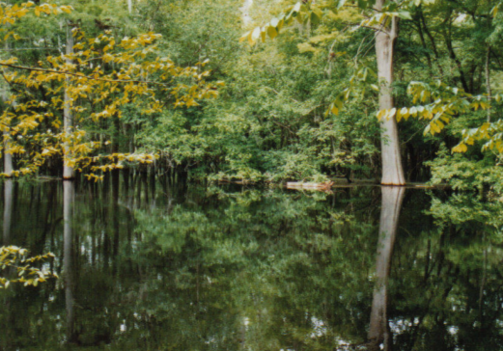
Density Independent Factors
Density independent factors affect birth, death, immigration, and emigration rates regardless of population size
(i.e., affect populations independently of density)
Often due to factors involving the abiotic environment
Drought
Wind & Currents
Floods

Slide 7
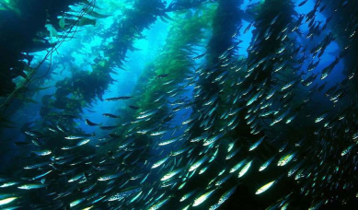
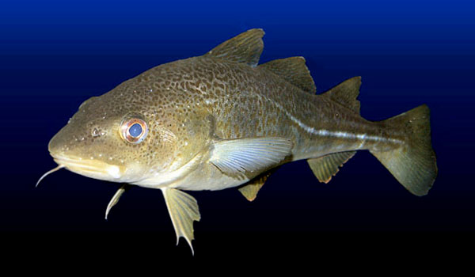
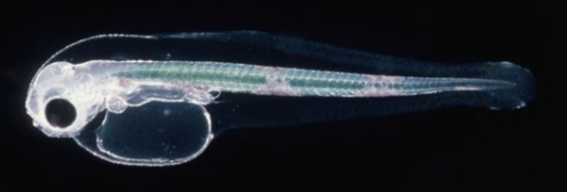
Density Independent Factors
Wind & Currents
Examples of effects on population growth
Many marine fish release eggs into water column
Eggs and larvae are at the mercy of where the currents take them
One 20lb cod can produce 3,000,000 eggs!
No parental care
High egg and larval mortality
Survival determined by transport by currents to favorable areas by time of first feeding
Adult Atlantic cod
Larval Atlantic cod

Slide 8
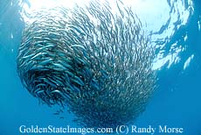
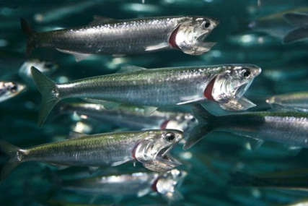
Density Independent Factors
Wind & Currents
Examples of effects on population growth
Many marine fish release eggs into water column
Eggs and larvae are at the mercy of where the currents take them
Northern anchovy adults
Larval anchovy
Notes:
Survival determined by wind speed

Slide 9
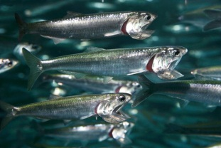
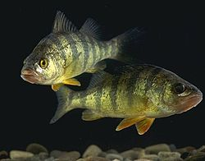
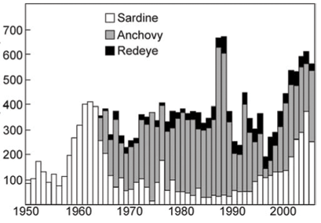
Density Independent Factors
Populations strongly influenced by density-independent factors often show large fluctuations in abundance
Boom or bust years
Adult fish abundance
Larval fish abundance
Abundance Index
Abundance Index
Marine fish with pelagic larvae
Great Lakes fish with pelagic larvae
Notes:
Redeye are round herring

Slide 10
Density Independent Factors
Density independent factors are often unpredictable…
How would we include them in a model?
Stochastic variation
(environmental stochasticity)
Density independent factors affect populations, regardless of population size
e.g., Transport of cod larvae by currents to an unfavorable area
(and subsequent increase in d’)
is independent of number of larvae transported
Density independent factors do not regulate a population
because there is no feedback with population size

Slide 11
Density Dependence
Density dependent factors do regulate populations
Definition of density dependence:
Population growth rate depends on the current population size
An effect on population density (abundance) that results in a negative feedback between population size and population growth rate
i.e., when density gets larger, there are stronger factors limiting growth
(the more density pushes “up”, the more density dependent factors push “down”)
What does this look like in terms of our population growth rate, λ?
Is λ larger or smaller at high population size?

Slide 12
Density Dependence
Density dependent factors do regulate populations
Definition of density dependence:
Population growth rate depends on the current population size
An effect on population density (abundance) that results in a negative feedback between population size and population growth rate
i.e., when density gets larger, there are stronger factors limiting growth
(the more density pushes “up”, the more density dependent factors push “down”)
What does this look like in terms of our population growth rate, λ?
Is λ larger or smaller at high population size?
λ is lowest at high population size
λ is greatest at low population size

Slide 13
Density Dependence
Density dependence causes population regulation…
… like how cruise control regulates the speed of your car
Called negative feedback, because population regulation
involves an opposing force
Conversely, positive feedback causes amplification (acceleration)

Slide 14
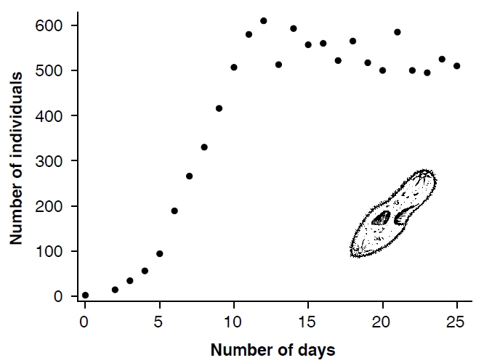
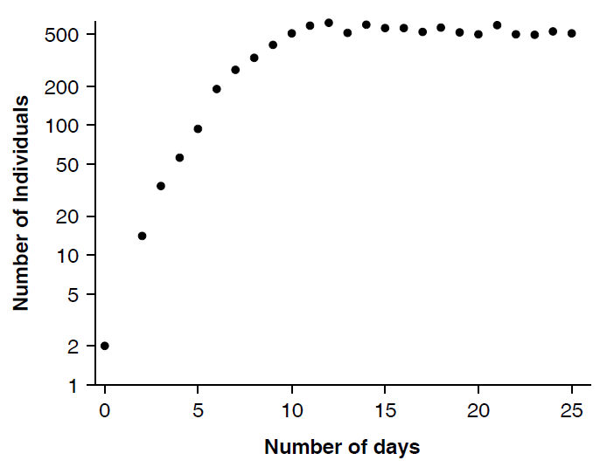
Density Dependence
Density dependence causes population regulation…
… like how cruise control regulates the speed of your car
Population regulated by density-dependence typically shows increases (or decreases) until reaching a constant value
Paramecium growing in a test tube
Growth plotted on log-scale
Stable size: λ = 1
Stable size ~550
Exponential growth: λ > 1
Exponential growth at start

Slide 15
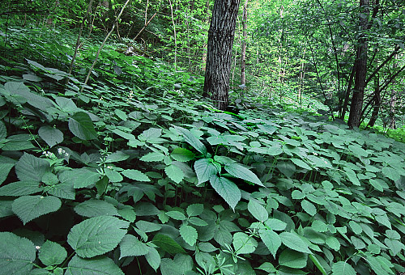
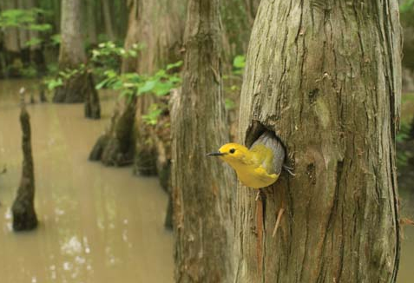
What Causes Density Dependence?
What causes the growth rate, λ, to decline at high density?
λ = 1 + b’ – d’
– e’
→ anything that increases d’ or decreases b’
More competition for good nesting sites: ↓ b’
Increased shading (for plants): ↑ d’
Accumulation of wastes: ↑ d’
Lower food availability per individual: ↑ d’
All of these may also increase emigration
Notes:
Bass nests; cavity nesting bird

Slide 16
Operation of Density Dependence
How do we know when density dependence is operating?
λ = 1 + b’ – d’ – e’
Operation of density dependent factors assessed by looking at per capita rates (λ, b’, d’, e’) for population of interest
Exercise:
Let’s take this statement about density dependence:
“the population grows faster at low density and slower at high density”
and represent it graphically by showing how λ, b’, d’, and e’
change with density (population size)

Slide 17
Operation of Density Dependence
“the population grows faster at low density and slower at high density”
Think about what this statement means for λ, b’, d’, and e’
To which figure do λ, b’, d’, and e’ belong given density dependence?
Figure A
Figure B
high
high
Parameter
Parameter
low
low
0
many
0
many
N_{t}
N_{t}
Notes:
i.e., which of these rates increase with population size, which decrease?

Slide 18
Operation of Density Dependence
“the population grows faster at low density and slower at high density”
Think about what this statement means for λ, b’, d’, and e’
To which figure do λ, b’, d’, and e’ belong given density dependence?
Figure A
Figure B
high
high
Parameter
Parameter
low
low
0
many
0
many
N_{t}
N_{t}
d’ and e’
As population size increases, the death rate and emigration rate increase

Slide 19
Operation of Density Dependence
“the population grows faster at low density and slower at high density”
Think about what this statement means for λ, b’, d’, and e’
To which figure do λ, b’, d’, and e’ belong given density dependence?
Figure A
Figure B
high
high
Parameter
Parameter
low
low
0
many
0
many
N_{t}
N_{t}
λ and b’
As population size increases, the growth rate and birth rate decrease

Slide 20
Operation of Density Dependence
“the population grows faster at low density and slower at high density”
Think about what this statement means for λ, b’, d’, and e’
To which figure do λ, b’, d’, and e’ belong given density dependence?
Figure A
Figure B
high
high
Parameter
Parameter
low
low
0
many
0
many
N_{t}
N_{t}
Note: we will see later that the actual relationships are not linear

Slide 21
Operation of Density Dependence
With density dependence, our vital rates (λ, b’, d’, and e’) are not constants!
Vital rates change with population size
Importantly, the vital rates will change in a deterministic way
i.e., we can write an equation that describes the effect of density on λ
Remember from classes on Population Variation…
Two types of variation:
Deterministic variation
Stochastic variation

Slide 22
Deterministic Variation
Deterministic variation is variation we can identify or predict:
Has a known cause
Can be incorporated in a model
Diurnal variation
Seasonal variation
Density dependence
General strategy for incorporating deterministic variation:
Add factors (parameters) to model that describe variation
e.g., λ = f(density)
We’ll see examples later when covering density-dependence

Slide 23
Operation of Density Dependence
With density dependence, our vital rates (λ, b’, d’, and e’) are not constants!
Vital rates change with population size
Importantly, the vital rates will change in a deterministic way
i.e., we can write an equation that describes the effect of density on λ
This contrasts with:
Exponential growth (no regulation): Vital rates are constant
Stochastic exponential growth: Vital rates vary randomly
(environmental stochasticity)
For density dependent growth, vital rates vary deterministically
(i.e., systematically, predictably)
As in the textbook, we will model density effects on λ (not b’, d’ or e’ directly)

Slide 24
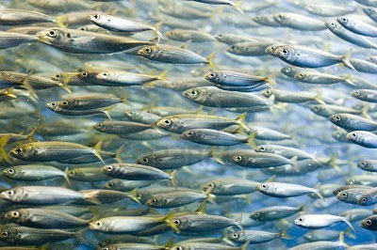
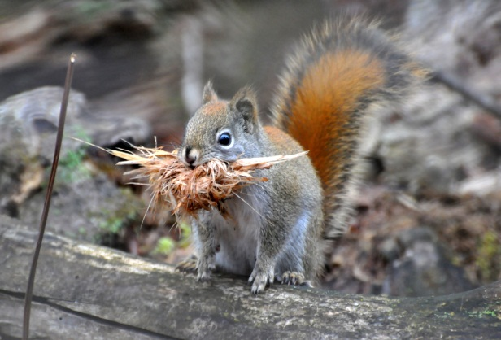
Modeling Density Dependence
The exact form of the relationship between λ and density (N) in our model depends on how individuals within the population interact
(note: also applies to r for continuous growth)
Populations do not all “behave” the same at high density
i.e., how competition occurs differs
There are two forms of density dependent competition:
Scramble competition
Contest competition
Planktivorous fish
Red squirrels

Slide 25
Modeling Density Dependence
Scramble competition
Contest competition
versus
Characteristics of competition:
Exploitative, free-for-all
Interference
How resources are shared:
Equally
Unequally
All individuals have some resources
Some individuals have many resources
Others have few resources
How effects of density dependence are experienced:
Equally
Unequally
All individuals affected
Some individuals are unaffected
Others are strongly affected

Slide 26
Scramble Competition
Scramble competition
All individuals experience the negative effects of density equally: symmetrical effect of density
Example: Planktivorous fish
Prey base evenly distributed and evenly available to predators
Every additional fish added reduces the prey availability for all other fish
How we model scramble competition (i.e., how λ and r change with density):
Every individual added to the population has the same (negative) effect
on the per capita growth rate, i.e., no individuals are “special”
Assume a linear relationship between per capita growth rate (ln λ, r)
and population density

Slide 27
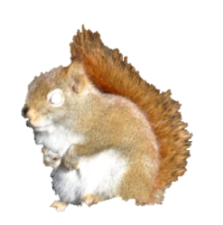
Scramble Competition
y-intercept:
lnλ > 0 means λ > 1
ln λ_{max}
2.00
lnλ > 0
Population growing
1.50
1.00
0.50
steady state
0.00
lnλ (discrete)
r (continuous)
λ = 1, so lnλ = 0
-0.50
r = 0
Carrying capacity (K)
Equilibrium point with
no population growth
-1.00
lnλ < 0
Population shrinking
-1.50
-2.00
lnλ < 0 means 0 < λ < 1
-2.50
0
200
400
600
800
1000
1200
N
Let’s look at λ versus population size…

Slide 28
Scramble Competition
6.0
y-intercept:
λ_{max}
5.0
4.0
λ (discrete)
3.0
2.0
steady state
1.0
Carrying capacity (K)
0.0
0
200
400
600
800
1000
1200
N

Slide 29
Scramble Competition
6.0
y-intercept:
λ_{max}
5.0
4.0
λ (discrete)
3.0
2.0
steady state
1.0
Carrying capacity (K)
0.0
0
200
400
600
800
1000
1200
Challenge: Why does this function decelerate as it declines?
i.e., if every additional individual reduces the growth rate for everyone,
why doesn’t this look like a straight line?
N

Slide 30
Scramble Competition
6.0
y-intercept:
The proportion of the population each additional individual makes up gets smaller as N increases
λ_{max}
5.0
4.0
Starting at N = 1, the addition of the second individual cuts the food by $1/2$ , the third individual by $1/3$ , the fourth by $1/4$ , etc.
λ (discrete)
3.0
2.0
steady state
1.0
Carrying capacity (K)
0.0
0
200
400
600
800
1000
1200
Challenge: Why does this function decelerate as it declines?
i.e., if every additional individual reduces the growth rate for everyone,
why doesn’t this look like a straight line?
N

Slide 31
Equivalency of ln λ and r
An analogy (not a real mathematical proof)
Remember how we linearized our growth equations?
Discrete:
Continuous:
N_{t} = N₀ λ^{t}
N_{t} = N₀ e^{rt}
ln (N_{t}) = ln (N₀ λ^{t})
ln (N_{t}) = ln (N₀ e^{rt})
ln (N_{t}) = ln (N₀) + ln (λ^{t})
ln (N_{t}) = ln (N₀ ) + ln (e^{rt})
ln (N_{t}) = ln (N₀ ) + rt ln (e)
ln (N_{t}) = ln (N₀) + t ln λ
ln (N_{t}) = ln (N₀ ) + rt
ln λ and r are mathematically similar to each other

Slide 32
Contest Competition
Contest competition
Some individuals experience little negative effect of density, while others are strongly affected: asymmetric
Example: Red squirrels
Highly territorial species
Territory ownership means access to cached food for winter = survival
Territory ownership means access to nesting spot = reproduction
As population increases from low to high density, available territories become saturated

Slide 33
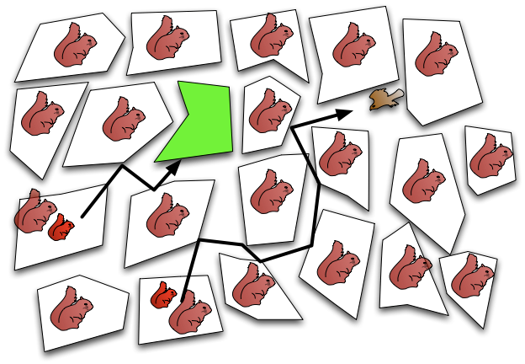
Red Squirrel Population Growth
WINTER
Notes:
Once weened juvenile squirrels must find a territory and cache cones before winter.
Number of offspring produced each year exceeds available territories.
Not much time, very difficult to displace an adult!

Slide 34
Red Squirrel Population Growth
WINTER
Territory owners have a relatively large per capita effect on population
→ Territory owners are competitively dominant individuals
Non-territory owners (“floaters” for birds) have small per capita effect on population growth rate
How λ and r change with density:
Population growth rate declines rapidly at first as population increases
(i.e., strong competitive effect of territory owners)
Then more slowly as carrying capacity is approached (i.e., as territories
are saturated) and exceeded
→ Competitive effect of additional individuals declines with density
Notes:
Once weened juvenile squirrels must find a territory and cache cones before winter.
Number of offspring produced each year exceeds available territories.
Not much time, very difficult to displace an adult!

Slide 35
Contest Competition
y-intercept:
lnλ > 0 means λ > 1
ln λ_{max}
2.00
lnλ > 0
Population growing
1.50
1.00
0.50
steady state
0.00
lnλ (discrete)
r (continuous)
lnλ = 0
r = 0
-0.50
Carrying capacity (K)
Equilibrium point with
no population growth
-1.00
lnλ < 0
Population shrinking
-1.50
-2.00
lnλ < 0 means 0 < λ < 1
-2.50
0
200
400
600
800
1000
1200
N

Slide 36
Contest and Scramble Comparison
y-intercept:
ln λ_{max}
2.00
Contest growth rate declines faster
1.50
1.00
0.50
steady state
0.00
lnλ (discrete)
r (continuous)
-0.50
Carrying capacity (K)
-1.00
contest
Scramble growth rate does not slow down
-1.50
-2.00
scramble
-2.50
0
200
400
600
800
1000
1200
N
Let’s look at λ versus population size…

Slide 37
Contest and Scramble Comparison
6.0
y-intercept:
λ_{max}
Contest: Population growth rate declines faster at first, then slows more
5.0
4.0
scramble
λ (discrete)
3.0
2.0
contest
steady state
1.0
Carrying capacity (K)
0.0
0
200
400
600
800
1000
1200
N

Slide 38
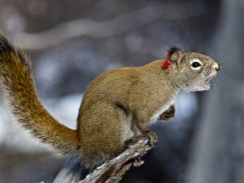
Distinguishing Density Dependence Types
How can we tell which type of density dependence best
describes the population we are interested in?
Make detailed behavioral observations
OR
Do a model fitting exercise
i.e., Collect data on population density over time for many generations
Fit the data to models of scramble and contest competition
Determine which model (i.e., scramble vs. contest) fits best
λ
scramble
contest
N

Slide 39
Distinguishing Density Dependence Types
How can we tell which type of density dependence best
describes the population we are interested in?
Make detailed behavioral observations
OR
Do a model fitting exercise
λ
scramble
contest
N
Keep in mind:
Are working with ideal categories… fit will not be perfect…
…but categorizing is still helpful for modeling and making predictions

Slide 40
Population Dynamics
Why do the different density dependence types matter?
Scramble vs. contest has big difference on population stability
i.e., change in population size through time
Scramble (extreme effect)
Contest
Large fluctuations
Increased extinction risk
Difficult to predict
Stable population
Reduced extinction risk
Easier to predict

