Slide 1
FW364 Ecological Problem Solving
Class 22: Predation
November 20, 2013

Slide 2
Outline for Today
Continuing with our shift in focus from
populations of single species to community interactions
Objectives from Last Classes:
Developed models of predator-prey interactions
Applied calculus to predator-prey dynamics
Linked predator-prey equations
Discussed predator-prey model assumptions
Objectives for Today:
Build predator-prey models that relax assumptions (i.e., add realism)
No textbook chapters!

Slide 3
Recap from Last Class
Victim, V:
dV/dt = b_{v}V - d_{v}V - aVP
Predator, P:
dP/dt = acVP - d_{p}P
Last class we built predator-prey equations with many assumptions:
The predator population cannot exist if there are no prey
In the absence of the predator, the prey grow exponentially
Predators encounter prey randomly (“well-mixed” environment)
Predators are insatiable
No age / stage structure
Predators do not interact with each other except through consumption
(i.e., scramble predators)
Today: Relaxing assumptions

Slide 4
Recap from Last Class
Victim, V:
dV/dt = b_{v}V - d_{v}V - aVP
Predator, P:
dP/dt = acVP - d_{p}P
Last class we built predator-prey equations with many assumptions:
The predator population cannot exist if there are no prey
In the absence of the predator, the prey grow exponentially
Predators encounter prey randomly (“well-mixed” environment)
Predators are insatiable
No age / stage structure
Predators do not interact with each other except through consumption
(i.e., scramble predators)
Today: Relaxing assumptions

Slide 5
Adding Prey Density Dependence
Victim, V:
dV/dt = b_{v}V - d_{v}V - aVP
Predator, P:
dP/dt = acVP - d_{p}P
Assumption 2: In the absence of the predator, the prey grow exponentially
To relax this assumption, we will add in density dependence of the prey
We’ve done this before!
Use logistic equation in prey equation
(same as what we did for scramble competition):
Change b_{v} to b_{max} (1 - V/K)
Instead of a constant birth rate, we make birth rate a function of density
[Recall for single population scramble density dependence,
we substituted λ = λ_{max} (1 - N/K) ]

Slide 6
Adding Prey Density Dependence
Victim, V:
dV/dt = b_{v}V - d_{v}V - aVP
Predator, P:
dP/dt = acVP - d_{p}P
Assumption 2: In the absence of the predator, the prey grow exponentially
b_{v} = b_{max} (1 - V/K)
Challenge: What happens to b_{v} when:
V is very small?
V equals carrying capacity (K)?
V is larger than carrying capacity (K)?

Slide 7
Adding Prey Density Dependence
Victim, V:
dV/dt = b_{v}V - d_{v}V - aVP
Predator, P:
dP/dt = acVP - d_{p}P
Assumption 2: In the absence of the predator, the prey grow exponentially
b_{v} = b_{max} (1 - V/K)
Challenge: What happens to b_{v} when:
V is very small?
V equals carrying capacity (K)?
V is larger than carrying capacity (K)?
→ Negative birth rates are not ecologically possible,
so when modeling, would need to bound b_{v} away from 0
→ b_{v} ≈ b_{max}
→ b_{v} ≈ 0
→ b_{v} < 0 ?!
Let’s look at a figure…

Slide 8
Adding Prey Density Dependence
Victim, V:
dV/dt = b_{v}V - d_{v}V - aVP
Predator, P:
dP/dt = acVP - d_{p}P
Assumption 2: In the absence of the predator, the prey grow exponentially
high
No density dependence: b_{v} does not change with V
b_{max}
With density dependence: b_{v} decreases with V
b_{v}
K
0
high
Prey density (V)

Slide 9
Adding Prey Density Dependence
Victim, V:
dV/dt = b_{v}V - d_{v}V - aVP
Predator, P:
dP/dt = acVP - d_{p}P
Assumption 2: In the absence of the predator, the prey grow exponentially
No density dependence: b_{v} does not change with V
b_{max}
With density dependence: b_{v} decreases with V
b_{v}
K
0
Prey density (V)

Slide 10
Adding Prey Density Dependence
Victim, V:
dV/dt = b_{v}V - d_{v}V - aVP
Predator, P:
dP/dt = acVP - d_{p}P
Assumption 2: In the absence of the predator, the prey grow exponentially
Revised prey equation with this assumption relaxed:
dV/dt = b_{max}(1-V/K)V - d_{v}V - aVP
incorporating b_{v} = b_{max} (1 - V/K)

Slide 11
Adding Prey Density Dependence
Victim, V:
dV/dt = b_{v}V - d_{v}V - aVP
Predator, P:
dP/dt = acVP - d_{p}P
Assumption 2: In the absence of the predator, the prey grow exponentially
Revised prey equation with this assumption relaxed:
dV/dt = b_{max}(1-V/K)V - d_{v}V - aVP
incorporating b_{v} = b_{max} (1 - V/K)
How about predator equation?
Does anything change due to prey density dependence?
Nothing changes!

Slide 12
Adding Prey Density Dependence
Victim, V:
dV/dt = b_{v}V - d_{v}V - aVP
Predator, P:
dP/dt = acVP - d_{p}P
Assumption 2: In the absence of the predator, the prey grow exponentially
Summary: Equations with Assumption 2 relaxed:
dV/dt = b_{max}(1-V/K)V - d_{v}V - aVP
No change
Key point:
Prey density dependence sets a limit on both the number of prey (V, through b_{v})
AND
the number of predators (P)
since predators depend on number of prey (V)

Slide 13
Adding Prey Density Dependence
Victim, V:
dV/dt = b_{v}V - d_{v}V - aVP
Predator, P:
dP/dt = acVP - d_{p}P
Assumption 2: In the absence of the predator, the prey grow exponentially
Summary: Equations with Assumption 2 relaxed:
dV/dt = b_{max}(1-V/K)V - d_{v}V - aVP
No change
Remember from density-dependence lab that scramble competition can cause population fluctuations (population instability)
Three types of behavior (depending on value of parameters)
smooth approach to equilibrium – previously saw for low λ
damped oscillation (eventually reaches a steady-state) – saw for high λ
stable limit cycle (never reaches a constant value) – NEW!

Slide 14
Adding Prey Density Dependence
Victim, V:
dV/dt = b_{v}V - d_{v}V - aVP
Predator, P:
dP/dt = acVP - d_{p}P
Assumption 2: In the absence of the predator, the prey grow exponentially
Summary: Equations with Assumption 2 relaxed:
dV/dt = b_{max}(1-V/K)V - d_{v}V - aVP
No change
smooth approach
damped oscillation
stable limit cycle
V
Time

Slide 15
Adding Predator Satiation
Victim, V:
dV/dt = b_{v}V - d_{v}V - aVP
Predator, P:
dP/dt = acVP - d_{p}P
Assumption 4: Predators are insatiable
i.e., predators consume the same proportion of the prey population (a)
no matter how many prey (V) there are
high
Type I functional response (linear)
aV
low
Is this a reasonable assumption?
0
V
many
Let’s find out with a demonstration!

Slide 16
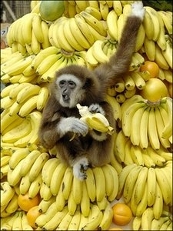
Functional Response Demo
I NEED TWO VOLUNTEERS!!
Volunteer 1: Predator
See how many prey (beans) you can attack
(pick up and put in cup) in 20 seconds
ONE bean at a time!
Simulating predator functional response
i.e., predator feeding rate, aV
Volunteer 2: Time Master
In charge of starting and stopping predator feeding events

Slide 17
Adding Predator Satiation
Victim, V:
dV/dt = b_{v}V - d_{v}V - aVP
Predator, P:
dP/dt = acVP - d_{p}P
Assumption 4: Predators are insatiable
To relax this assumption, we will include predator satiation
i.e., predator eventually reaches a threshold feeding rate
high
Type I functional response (linear)
aV
Type II functional response
low
0
many
Satiation
V

Slide 18
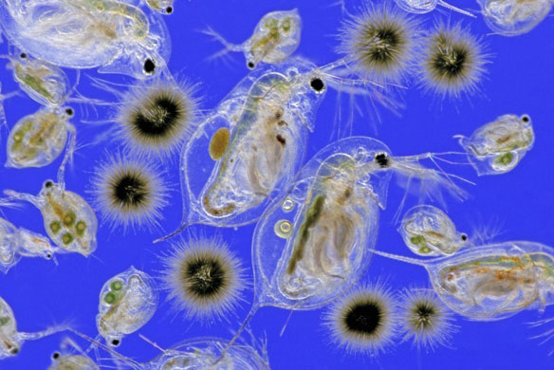
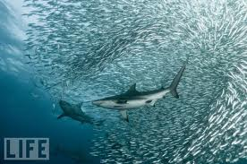
Scramble Predation Assumption
Victim, V:
dV/dt = b_{v}V - d_{v}V - aVP
Predator, P:
dP/dt = acVP - d_{p}P
Assumption 6: Predators do not interact with each other…
… other than by consuming the same resource
→ scramble predators
With a scramble predator:
Predators are non-territorial
There are no direct interactions among predators (no aggression)
But note:
Copper sharks
hunt in groups
→ Possible mutualism
Daphnia and phytoplankton
Copper sharks and sardines

Slide 19
Scramble Predation Assumption
Victim, V:
dV/dt = b_{v}V - d_{v}V - aVP
Predator, P:
dP/dt = acVP - d_{p}P
Assumption 6: Predators do not interact with each other…
… other than by consuming the same resource
→ scramble predators
With a scramble predator:
Predators are non-territorial
There are no direct interactions among predators (no aggression)
Before relaxing this assumption, let’s explore what this assumption (i.e., scramble predation) really means…

Slide 20
Scramble Predation Assumption
Victim, V:
dV/dt = b_{v}V - d_{v}V - aVP
Predator, P:
dP/dt = acVP - d_{p}P
Assumption 6: Predators do not interact with each other…
d_{p}
b_{v} - d_{v}
Remember equilibrium equations:
V* =
P* =
ac
a
An increase in per capita prey production (b_{v}) does NOT result in an increase
in the prey population… only an increase in the predator population
i.e., with scramble predation, prey birth rate (b_{v}) could increase, but we would
not get more prey! → Important effects on predator-prey dynamics
Let’s illustrate with a fertilization experiment

Slide 21
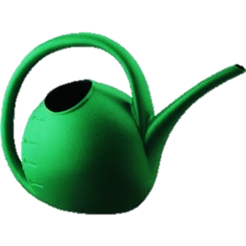
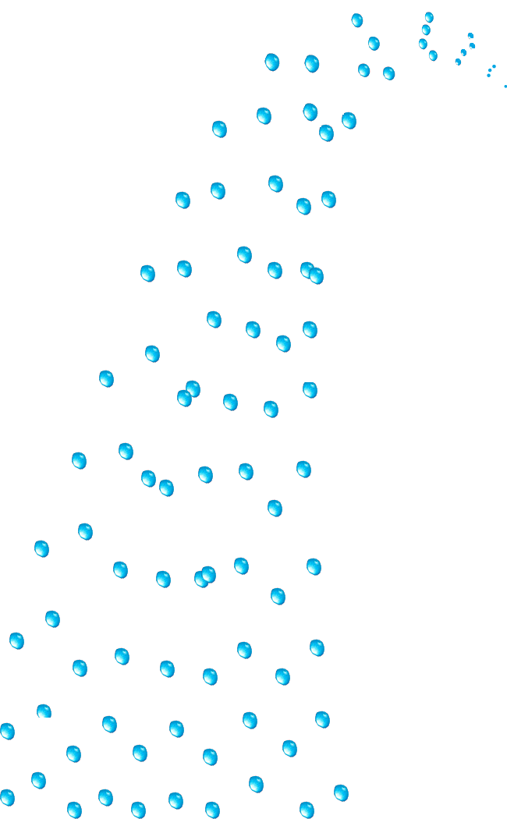
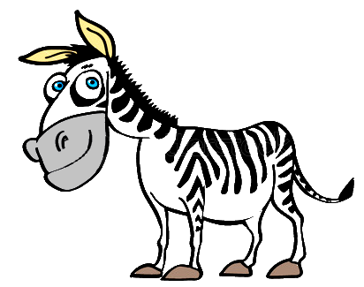
Scramble Predation Assumption
Victim, V:
dV/dt = b_{v}V - d_{v}V - aVP
Predator, P:
dP/dt = acVP - d_{p}P
Assumption 6: Predators do not interact with each other…
Start with a plant (V* = 6) - herbivore (P* = 3) system at equilibrium
Imagine we beginning fertilizing and watering to increase plant growth

Slide 22
Scramble Predation Assumption
Victim, V:
dV/dt = b_{v}V - d_{v}V - aVP
Predator, P:
dP/dt = acVP - d_{p}P
Assumption 6: Predators do not interact with each other…
Start with a plant (V* = 6) - herbivore (P* = 3) system at equilibrium
Imagine we beginning fertilizing and watering to increase plant growth
Initially, there is an increase in plant abundance
Immediately followed by increase in herbivore abundance
Plants grow faster, but mortality from herbivores leads to additional productivity going to herbivores…

Slide 23
Scramble Predation Assumption
Victim, V:
dV/dt = b_{v}V - d_{v}V - aVP
Predator, P:
dP/dt = acVP - d_{p}P
Assumption 6: Predators do not interact with each other…
Start with a plant (V* = 6) - herbivore (P* = 3) system at equilibrium
Imagine we beginning fertilizing and watering to increase plant growth
Grazing by growing herbivore population reduces plant abundance
Plants return to original equilibrium (V* = 6) but
herbivores reach a new (higher) steady state (new P* = 7 with fertilization)
Paradox of enrichment: Get more herbivores, NOT more plants

Slide 24
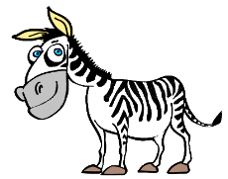
Scramble Predation Assumption
Victim, V:
dV/dt = b_{v}V - d_{v}V - aVP
Predator, P:
dP/dt = acVP - d_{p}P
Assumption 6: Predators do not interact with each other…
Graphically, the fertilization experiment looks like this:
Plant abundance increases immediately after fertilization begins
But then herbivore birth rate increases to completely compensate for plant growth
Increasing herbivore population reduces plant abundance
Plants return to original equilibrium
Predators reach new (higher) equilibrium abundance
high
V
low
high
P
low
begin fertilization
Time

Slide 25
Scramble Predation Assumption
Victim, V:
dV/dt = b_{v}V - d_{v}V - aVP
Predator, P:
dP/dt = acVP - d_{p}P
Assumption 6: Predators do not interact with each other…
Graphically, the fertilization experiment looks like this:
high
More herbivores – NOT more plants!
Can have instances when predator abundance (or biomass) is greater than prey abundance (or biomass)
KEY: Turnover of prey must be high
i.e., net production of prey must be higher than net production of predator
V
low
high
P
low
begin fertilization
Time

Slide 26
Scramble Predation Assumption
Victim, V:
dV/dt = b_{v}V - d_{v}V - aVP
Predator, P:
dP/dt = acVP - d_{p}P
Assumption 6: Predators do not interact with each other…
Graphically, the fertilization experiment looks like this:
high
These dynamics
actually exist in nature
(but are rare)
V
low
high
P
low
begin fertilization
Daphnia and phytoplankton
Time

Slide 27
Scramble Predation Assumption
Victim, V:
dV/dt = b_{v}V - d_{v}V - aVP
Predator, P:
dP/dt = acVP - d_{p}P
Assumption 6: Predators do not interact with each other…
Important consideration:
Need to know what type of predator we are
dealing with in a management situation,
in order to predict how big of an impact there will be
if predator is removed or introduced
Scramble predators may be keeping
a rapidly growing prey population in check

Slide 28
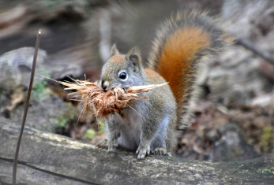
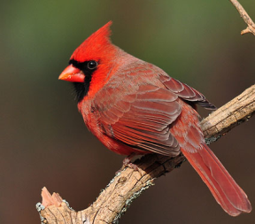
Adding Predator Contest Competition
Victim, V:
dV/dt = b_{v}V - d_{v}V - aVP
Predator, P:
dP/dt = acVP - d_{p}P
Assumption 6: Predators do not interact with each other…
Finally, now let’s relax the assumption that we have scramble predators
→ Consider a territorial, contest predator
Key distinction from scramble predation:
With a contest predator, there may be an upper limit to predator abundance that is below what the prey supply can support
Upper limit may be due to:
Territoriality
(number of territories limits abundance)
Intraspecific aggression

Slide 29
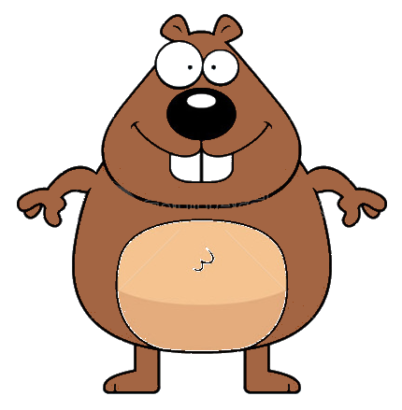
Adding Predator Contest Competition
Victim, V:
dV/dt = b_{v}V - d_{v}V - aVP
Predator, P:
dP/dt = acVP - d_{p}P
Assumption 6: Predators do not interact with each other…
Let’s repeat the fertilization experiment, but with a territorial herbivore
high
e.g., Baird’s pocket gopher
Holds underground territories
Eats grass, tubers, roots, etc.
V
low
high
P
low
Time

Slide 30
Adding Predator Contest Competition
Victim, V:
dV/dt = b_{v}V - d_{v}V - aVP
Predator, P:
dP/dt = acVP - d_{p}P
Assumption 6: Predators do not interact with each other…
Let’s repeat the fertilization experiment, but with a territorial herbivore
Plant abundance increases immediately after fertilization
Then herbivore birth rate increases to completely compensate for plant growth
Increasing herbivore population reduces plant abundance
Herbivore hits territory limit!
Herbivore at self-limited equilibrium
Plants have higher equilibrium!
high
e.g., Baird’s pocket gopher
Holds underground territories
Eats grass, tubers, roots, etc.
V
low
high
territory limit
P
low
begin fertilization
Time

Slide 31
Adding Predator Contest Competition
Victim, V:
dV/dt = b_{v}V - d_{v}V - aVP
Predator, P:
dP/dt = acVP - d_{p}P
Assumption 6: Predators do not interact with each other…
Let’s repeat the fertilization experiment, but with a territorial herbivore
Conclusions:
Contest predators cannot control prey as effectively as scramble predators
i.e., contest predators may hit
self-limitation at an abundance lower
than what the prey could support,
whereas scramble predators do NOT self-limit and can drive prey all the way back down to the original prey equilibrium
high
e.g., Baird’s pocket gopher
Holds underground territories
V
low
high
territory limit
P
low
begin fertilization
Time

Slide 32
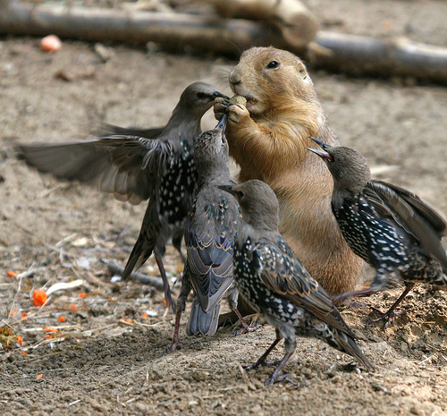
Looking Ahead
Next Class:
Two-species competition

