Slide 1
FW364 Ecological Problem Solving
Class 25: Competition
December 2, 2013

Slide 2
Graphical R* & Competition Summary
    What makes a better competitor (i.e., lower R*)?
        Higher birth rate
        Lower death rate
        Lower h
    Does this perfect competitor exist in nature?
    In general, consumer types emerge along the resource spectrum:
    K-strategists
    r-strategists
    Low resource abundance:
    Low birth rates
    Low death rates
    Low h (b steeper at low R)
    High resource abundance:
    High birth rates
    High death rates
    High h (b shallower at low R)

Slide 3
Graphical R* & Competition Summary
    You know where this terminology comes from!
    r-strategists: Focus on high growth rates (r)
    Take the early lead → Rotifers
    Quantity over quality
    K-strategists: Focus competitive ability at high densities (K)
    Strong competitors at low resources → Daphnia
    Quality over quantity
    K-strategists
    r-strategists
    Low resource abundance:
    Low birth rates
    Low death rates
    Low h (b steeper at low R)
    High resource abundance:
    High birth rates
    High death rates
    High h (b shallower at low R)

Slide 4
Graphical R* & Competition Summary
    You know where this terminology comes from!
    r-strategists: Focus on high growth rates (r)
    Take the early lead → Rotifers
    Quantity over quality
    K-strategists: Focus competitive ability at high densities (K)
    Strong competitors at low resources → Daphnia
    Quality over quantity
    K-strategists
    r-strategists
    Let’s look at figures for these strategists

Slide 5
Case 4A: Trade-off
        b₁
        b₂
        d₁d₂
        Consumer 1 has higher b_{max} and higher h (r-strategist)
        Consumer 2 has lower b_{max} and lower h (K-strategist)
        Both consumers have same death rate, d₁ = d₂
        Monod curves cross
    Who wins?

Slide 6
Case 4A: Trade-off
        b₁
        b₂
        d₁d₂
    R₂*
    R₁*
        Consumer 1 has higher b_{max} and higher h (r-strategist)
        Consumer 2 has lower b_{max} and lower h (K-strategist)
        Both consumers have same death rate, d₁ = d₂
        Monod curves cross
    Consumer 2 wins: R₂* < R₁*
    → Better at low R

Slide 7
Case 4B: Trade-off
        b₁
        b₂
        d₁d₂
        Consumer 1 has higher b_{max} and higher h (r-strategist)… same as before
        Consumer 2 has lower b_{max} and lower h (K-strategist)… same as before
        Both consumers have same death rate, d₁ = d₂, but death rate is higher
        Monod curves cross
    Who wins?

Slide 8
Case 4B: Trade-off
        b₁
        b₂
        d₁d₂
    R₁*
    R₂*
        Consumer 1 has higher b_{max} and higher h (r-strategist)… same as before
        Consumer 2 has lower b_{max} and lower h (K-strategist)… same as before
        Both consumers have same death rate, d₁ = d₂, but death rate is higher
        Monod curves cross
    Consumer 1 wins: R₁* < R₂*
    → Better at high R

Slide 9
Case 4: Example
    K-strategists
    r-strategists
    Low R:
    Low birth and death rates, low h
    High R:
    High birth and death rates, high h
    Example of Case 4: Secondary succession in plant communities
    Abandoned farmland: natural succession of plant types and species
    weeds → grasses → shrubs → trees
    Annual weeds dominate first
    → grow fast, colonize new habitat fast, high b_{max}, high h (r-strategists)
    Climax species eventually replace weeds (K-strategists)
    → grow slowly at high R, but best competitors at low R (light, nutrients)
    In MI, climax species are typically hardwood trees
    → may take > century to complete succession to “old-growth” forests

Slide 10
Case 4: Example
    K-strategists
    r-strategists
    Low R:
    Low birth and death rates, low h
    High R:
    High birth and death rates, high h
    Example of Case 4: Secondary succession in plant communities
    Take home message:
    Ecological succession (secondary succession)
    can be understood in terms of shift from r- to K-strategists…
    … which we can now model as shifts from consumers adapted for high R
    (which have traits yielding high R*)
    to consumers adapted for low R
    (which have traits yielding low R*)

Slide 11
Competitive Exclusion
    One of the most important assumptions we have been making is
    competitive exclusion
    i.e., when two species compete over a common resource, only one species (the superior competitor) can persist in the long-term
C₁
C₂
    We assumed that one competitor will always win
    → consumer with lower R*
R
    Four requirements for competitive exclusion to occur:
          a stable environment
          competitors that are not equivalent (different R*)
          a single resource
          unlimited time

Slide 12
Competitive Exclusion
    Realistically, we rarely meet all of these criteria
              environments fluctuate
              multiple resources are typically consumed
        Result: Multiple competitors for the same resource often co-exist
        Let’s consider how co-existence can occur in more detail…
    Four requirements for competitive exclusion to occur:
          a stable environment
          competitors that are not equivalent (different R*)
          a single resource
          unlimited time
Notes:
http://www.youtube.com/watch?v=Atg-5Nqszxw

Slide 13
    Coexistence:
    Environmental
    Fluctuation

Slide 14
Unstable Environments
    Environments are not stable…
    … and exclusion takes time
    If environment changes before exclusion occurs
    inferior competitor can persist
    The primary way the environment changes is through disturbance
    Challenge question:
    What are some examples of environmental disturbance?

Slide 15
Unstable Environments
    Environments are not stable…
    … and exclusion takes time
    If environment changes before exclusion occurs
    inferior competitor can persist
    The primary way the environment changes is through disturbance
    Challenge question:
    What are some examples of environmental disturbance?
    Big disturbance: Lake turn-over, forest fire, deforestation, flooding
    Small disturbance: Knockdown trees, carp stirring lake bottom, sinkhole

Slide 16
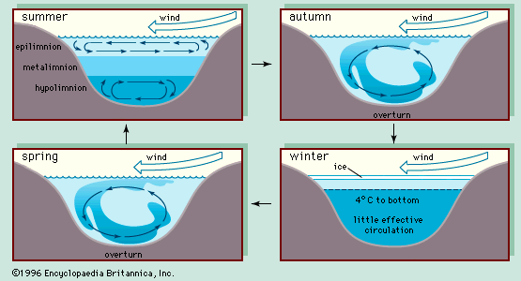
Unstable Environments
    Disturbance examples
      Lakes and oceans:
      Environment changes (resets) during periods of strong mixing
      (occurs during fall and spring turn-over and from strong storms)

Slide 17
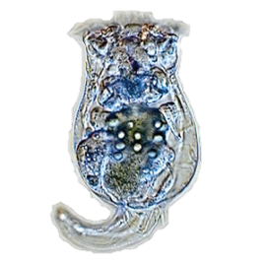
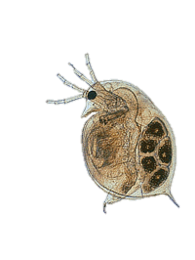
Unstable Environments
    Disturbance examples
      Lakes and oceans:
      Environment changes (resets) during periods of strong mixing
      (occurs during fall and spring turn-over and from strong storms)
    Result: Annual succession of r- (Rotifers) to K-strategists (Daphnia)
    Spring turn-over allows competitively inferior (high R* Rotifers) to persist
    Spring turn-over mixes nutrients from lake bottom into water column…
    …which in turn causes bloom of phytoplankton
    High birth rate herbivores (Rotifers) do well after
    spring turn-over and phytoplankton bloom
      Lower death rate herbivores (Daphnia) do better
      in summer when resources are at lower abundance

Slide 18
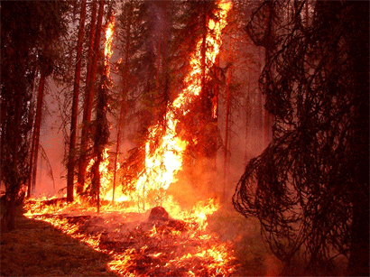
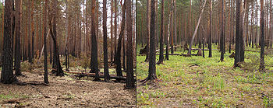
Unstable Environments
    Disturbance examples
      Forests:
      → Fires
    Forest fire
    1 year later
    2 years later
    Fast growing plants (r-strategists) do well right after fire
    (because fire releases nutrients),
    slower growing, longer lived plants (K-strategists) out-compete later

Slide 19
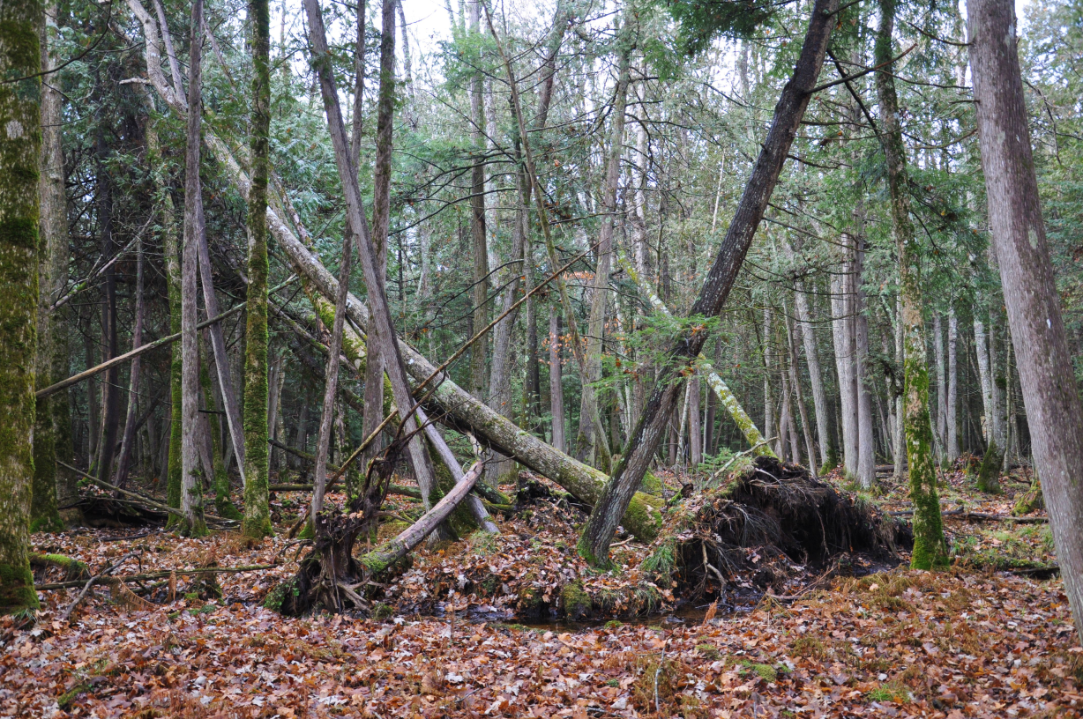
Unstable Environments
    Disturbance examples
      Forests:
      → Fires
    Smaller-scale disturbances
    are important, too!
    → knockdown trees
    Fast growing plants (r-strategists) do well right after fire
    (because fire releases nutrients),
    slower growing, longer lived plants (K-strategists) out-compete later
    Disturbance is important for maintaining inferior competitors!
    → Let’s look at dynamics on a figure

Slide 20
Unstable Environments
    Competition-disturbance model
    Disturbance
    Abundance
    Time
    Disturbance allows inferior competitor to co-exist
    Inferior competitor explodes after disturbance then gradually declines
    Superior competitor rapidly declines after disturbance, then gradually builds back to dominance

Slide 21
Some Ecological History
    For a long time, the importance of disturbance was unappreciated
    Until the 1960-1970s, most ecologists thought in terms of equilibria
    i.e., focused on predicting what happens at equilibrium
    emphasis on “balance” and “regulation”… steady state!
    Ecologists of the time thought species diversity was
    greatest in undisturbed ecosystems
    It was not until the 1970s that the focus shifted to non-equilibrium states
    …and to the importance of disturbance events
    → Led to development of the intermediate disturbance hypothesis (IDH)

Slide 22
Intermediate Disturbance Hypothesis (IDH)
    With IDH:
    focus shifted to dynamics before equilibrium is reached
    Current ecological thought:
    periodic disturbance leads to coexistence
    Disturbance supports biodiversity!
    but… disturbance cannot be too frequent or too infrequent
        Only superior competitor exists with zero disturbance
        Only weed exists with very high disturbance
        → Need intermediate disturbance for coexistence of competitors
    Consequently, managing an ecosystem for high biodiversity
    may require periodic or spatially-patchy disturbances

Slide 23
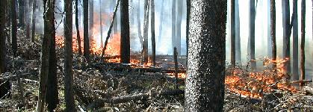
Intermediate Disturbance Hypothesis (IDH)
    Intermediate disturbance was a BIG DEAL at the time
    The idea that disturbances
    ~ which entail the loss (death) of individuals from populations ~
    can be vitally important to the health of ecosystems
    required a major change in perspective
    IDH has changed the attitudes of management agencies
    e.g., allow natural fire to burn in Yellowstone (as of 1972)
    and do some prescribed fires (controlled burns)

Slide 24
    Coexistence:
    Multiple
    Resources

Slide 25
Multiple Resources
    Two consumer species can co-exist if they compete for two resources
    and each consumer has a lower R* for a different resource
    Single resource competition
    Two resource competition
C₁
C₂
C₁
C₂
R
R₁
R₂
    Consumer 1 and Consumer 2 can coexist if, e.g.,
    Consumer 1 has lower R* for Resource 1
    Consumer 2 has lower R* for Resource 2

Slide 26
Multiple Resources
    Two consumer species can co-exist if they compete for two resources
    and each consumer has a lower R* for a different resource
    Single resource competition
    Two resource competition
C₁
C₂
C₁
C₂
R
R₁
R₂
    Same idea works for three species competing over three resources, etc.
    i.e., Can maintain one consumer per limiting resource

Slide 27
    Coexistence:
    Predator
    Preference

Slide 28
Predator Preference
    Can have two consumer species co-exist if a
    common predator prefers the dominant competitor!
    Common predator:
    Single resource competition
P
C₁
C₂
C₁
C₂
R
R
    Even though, e.g., Consumer 1 may have lower R* for resource
    (i.e., Consumer 1 is superior competitor),
    if a common predator prefers Consumer 1… consumers can co-exist!

Slide 29
Predator Preference
    Can have two consumer species co-exist if a
    common predator prefers the dominant competitor!
    Common predator:
    Single resource competition
P
C₁
C₂
C₁
C₂
R
R
    Could model predator preference by allowing consumers
    to have different death rates
    (increasing d of superior competitor decreases competitive ability)

Slide 30
    Application
    of competition models

Slide 31
Practical Application
    What are competition models good for?
  Reason 1: Competition models help us to think about how natural communities are structured
    → Understand how management actions may affect different types of species
      e.g., how management, such as (purposeful) disturbance, affects weed
      versus climax species… and ultimately biodiversity
      Can’t un-burn a forest if a prescribed fire ends up being a bad idea!
      Models help us gain an understanding of the effects of management
      before we make major changes

Slide 32
Practical Application
    What are competition models good for?
  Reason 2: Competition models help us to predict the outcome of competition between species that share resources
  Extremely useful for evaluating the impact of introduced species that may compete with native species
  Can use management models to evaluate the effect of, e.g.:
  Unintentional introduction of exotic species (e.g., Asian carp)
  Intentional introduction of species as biocontrol
  e.g., beetles/weevils to control purple loosestrife
  Re-introduction of native species (e.g., wolves in Yellowstone)
  Competition models can help us predict competitive dominance
  WITHOUT (or BEFORE) putting the species together

Slide 33
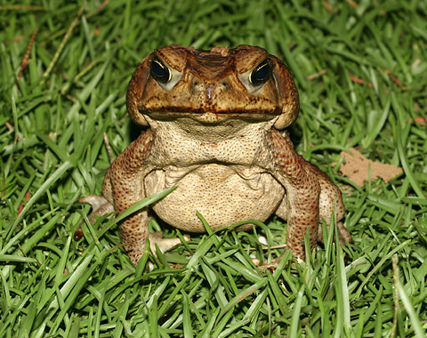
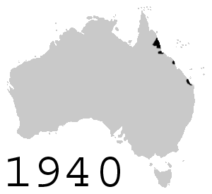
Practical Application
    A spectacular failure of biocontrol: CANE TOADS!
    Invasive species in Australia
    Introduced (without much pre-planning)
    to control insect pests in sugar cane fields
    Bufo marinus
    Introduced 102 individuals in 1935
    Now over 200 million
    → Notorious as one of the most devastating invasive species
Notes:
Introduced in 1935; starting population of 102 individuals
In the serious opening of "CANE TOADS" we are told that in the 1930s sugar cane was one of Australia's major exports, but in North Queensland farmers had a problem that threatened their crops -- the dreaded cane grub. In some places the devastating cane grub and beetle infestation reduced crop output ratio from about 1000 tons to less than one ton. Something had to be done. At the 1932 World Conference of Sugar Technology in Puerto Rico, entomologist Raquel Dexter suggested the Bufo Marinus -- or Cane Toad -- be imported from Hawaii. The idea was that it would eat the Greyback beetle, parent of the cane grub. In 1935, 102 of these amphibious immigrants were introduced to Australia. Problem was, the cane toads ate almost everything that moved -- except the underground cane grub and the voracious cane-eating flying parent beetle. One male and female toad couple can produce over 40,000 fertile eggs in a season. Today, grapefruit-sized cane toads dominate the northern half of Queensland.

Slide 34
Practical Application
    A spectacular failure of biocontrol: CANE TOADS!
    The problems:
    Cane toads had minimal effect on the pest species they were introduced to eat
    Cane toads out-compete native species, causing precipitous declines in abundance
    Cane toads have a wide diet breadth
    → they “will eat anything that moves” … including their competitors
    Cane toads have high breeding rates (breed year round in some places)
    Cane toads are incredibly fecund (r-selected)
    → Females can produce over 40,000 eggs a year
    Cane toads are incredibly toxic to predators
  And they evolve quickly
Notes:
Introduced in 1935; starting population of 102 individuals
In the serious opening of "CANE TOADS" we are told that in the 1930s sugar cane was one of Australia's major exports, but in North Queensland farmers had a problem that threatened their crops -- the dreaded cane grub. In some places the devastating cane grub and beetle infestation reduced crop output ratio from about 1000 tons to less than one ton. Something had to be done. At the 1932 World Conference of Sugar Technology in Puerto Rico, entomologist Raquel Dexter suggested the Bufo Marinus -- or Cane Toad -- be imported from Hawaii. The idea was that it would eat the Greyback beetle, parent of the cane grub. In 1935, 102 of these amphibious immigrants were introduced to Australia. Problem was, the cane toads ate almost everything that moved -- except the underground cane grub and the voracious cane-eating flying parent beetle. One male and female toad couple can produce over 40,000 fertile eggs in a season. Today, grapefruit-sized cane toads dominate the northern half of Queensland.

Slide 35
Practical Application
    A spectacular failure of biocontrol: CANE TOADS!
    The moral of this story:
    Cane toad devastation
    might have been prevented if predator-prey and competition models were used before introduction!
    Modeling is good!
Notes:
Introduced in 1935; starting population of 102 individuals
In the serious opening of "CANE TOADS" we are told that in the 1930s sugar cane was one of Australia's major exports, but in North Queensland farmers had a problem that threatened their crops -- the dreaded cane grub. In some places the devastating cane grub and beetle infestation reduced crop output ratio from about 1000 tons to less than one ton. Something had to be done. At the 1932 World Conference of Sugar Technology in Puerto Rico, entomologist Raquel Dexter suggested the Bufo Marinus -- or Cane Toad -- be imported from Hawaii. The idea was that it would eat the Greyback beetle, parent of the cane grub. In 1935, 102 of these amphibious immigrants were introduced to Australia. Problem was, the cane toads ate almost everything that moved -- except the underground cane grub and the voracious cane-eating flying parent beetle. One male and female toad couple can produce over 40,000 fertile eggs in a season. Today, grapefruit-sized cane toads dominate the northern half of Queensland.

Slide 36
Competition Wrap-Up
  Major Points
  Resource competition can be understood as an extension of simple ideas about predators (consumers) and prey (resources)
  R* rule: Species with the lowest R* (superior competitor) will exclude the inferior competitor at equilibrium ( → competitive exclusion principle)
  Ecological succession can be understood as a replacement of r-strategist (high b_{max}) species by K-strategist (low h) species
  There are limits to competitive exclusion
  One winning consumer for each limiting resource (a species may be a
  good competitor for one resource and lousy competitor for another)
  Inferior competitors can be kept in the game via disturbance
  Managers may promote biodiversity by allowing or encouraging
  disturbance in managed ecosystems
Notes:
Introduced in 1935; starting population of 102 individuals
In the serious opening of "CANE TOADS" we are told that in the 1930s sugar cane was one of Australia's major exports, but in North Queensland farmers had a problem that threatened their crops -- the dreaded cane grub. In some places the devastating cane grub and beetle infestation reduced crop output ratio from about 1000 tons to less than one ton. Something had to be done. At the 1932 World Conference of Sugar Technology in Puerto Rico, entomologist Raquel Dexter suggested the Bufo Marinus -- or Cane Toad -- be imported from Hawaii. The idea was that it would eat the Greyback beetle, parent of the cane grub. In 1935, 102 of these amphibious immigrants were introduced to Australia. Problem was, the cane toads ate almost everything that moved -- except the underground cane grub and the voracious cane-eating flying parent beetle. One male and female toad couple can produce over 40,000 fertile eggs in a season. Today, grapefruit-sized cane toads dominate the northern half of Queensland.

Slide 37
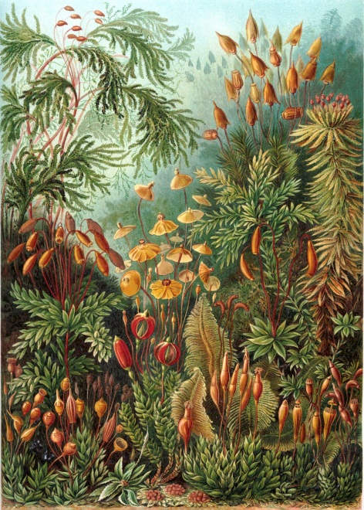
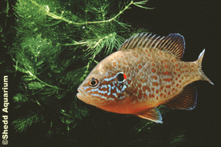
Looking Ahead
Next Class:
BIG Picture Topics:
Why is modeling useful?
Details on Final Exam
Lab tomorrow
Review!

