Slide 1
FW364 Ecological Problem Solving
Class 2: Ecosystems / Mass Balance
September 4, 2013

Slide 2

Ecosystem Ecology
The study of stocks and flows of
materials and energy through ecosystems
(not covered in textbook)
We will use an example to explore ecosystem ecology:
carbon cycle
Global climate change
TOPIC
Deforestation

Slide 3
Carbon cycle
Global carbon cycle is currently being perturbed by:
(a) fossil fuel burning
(b) deforestation
Increase in input to CO₂ stock, decrease in loss to plant uptake
Important questions for consideration:
Where will the excess CO₂ end up?
How much will be sequestered back into plant biomass, given current deforestation rates?
Today:
We will look at the tools used to address questions like this.

Slide 4
Carbon cycle
Stocks and flows model
Stocks
Flows
These models are a general framework (general model) that we will apply in many contexts

Slide 5
Carbon cycle
Primary producers example: Plants – Carbon (C) stocks and flows
Input:
Outputs:
Plant
Photosynthesis
Respiration
& consumed plant material
Stock: Typically a “reservoir” or “compartment”
In this case, the plant is the stock
Carbon incorporated into plant biomass is “fixed”
Flows: Inputs and outputs from the stock
Inputs: The processes that ADD material to the stock
Outputs: The processes that REMOVE material from the stock
What are the inputs and outputs for a plant?

Slide 6
Carbon cycle
Let’s keep building the ecosystem
Class Exercise:
Build a stock and flow model for plants and herbivores
(just a conceptual model for now)
Work with the people next to you – you have 3-5 minutes
Stocks
Think about: What are your stocks?
What are your flows?
Hint: Include CO₂ as a stock
Keep the model simple
Flows

Slide 7
Carbon cycle
Let’s start with just plants and CO₂ treated as a stock
This conceptual model could represent any size ecosystem as currently shown, e.g., the whole earth or just a lake or forest
Respiration
Plant
CO₂
Photosynthesis
Important point:
Losses from one stock are additions to another stock

Slide 8
Carbon cycle
And now add in herbivores
Respiration
Herbivore
plant losses to herbivores
Grazing
(which are also an addition to herbivore biomass)
Respiration
Plant
herbivore loss to respiration
CO₂
Photosynthesis

Slide 9
Carbon cycle
Death
Defecation
Respiration
Herbivore
losses to detritus due to death and waste material
Grazing
Death
Shedding
Respiration
Plant
CO₂
Photosynthesis
Respiration
Detritus
detritus (due to bacterial activity) respires, too

Slide 10
Carbon cycle
Death
Defecation
Respiration
Herbivore
Death
Shedding
Grazing
Respiration
Plant
CO₂
Photosynthesis
Respiration
Detritus
Note: The loop is entirely closed (closed system / complete cycle)

Slide 11
Carbon cycle
Death
Defecation
Respiration
Herbivore
Death
Shedding
Grazing
Respiration
Plant
CO₂
Photosynthesis
Respiration
Detritus
At what points do humans impact the global carbon cycle?
Notes:
Ideas:
We harvest deer / other herbivores (reduce herbivore stock)
We deforest / clear land (reduce plant stock)
Limit natural fires (increase detritus, e.g., leaf litter)

Slide 12
Stock & Flow Equations
Let’s take the conceptual model and get more quantitative
Stock and flow equations = “Mass balance” equations
(explicit, quantitative models)
“Balance” like balancing a check book
Stocks and flows of “currencies”
In previous example, carbon was our currency
Goal is to figure out how everything going in is balancing everything going out
The science of ecosystem ecology is the quantification of stocks and flows

Slide 13


Stock & Flow Equations - Definitions
Flow (F)
Flow (F)
Stock (S)
gC/m²/day
gC/m²/day
gC/m²
Stock (also called pool): S
Amount of material or energy in a defined compartment
Units: mass/area or mass/volume
Typical carbon units: gC/m² (a biomass density)
Flow (also called transfer rate or flux): F
Amount of material or energy flowing into or out of stock
Units: mass/area/time
Typical carbon units: gC/m²/day (or gC/m²/yr)
Turnover time (also called residence time): T
Time it takes for one complete exchange of stock
Units: time (days, months, years)
$$gC⋅m^{−2}⋅d^{−1}$$
$$\frac{gC}{m^{2}d}$$

Slide 14
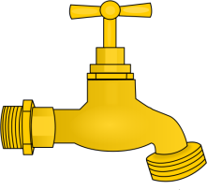

Stock & Flow Equations - Analogy
Analogy:
bathtub, faucet, & drain
What is the stock?
Amount of water in tub
What are the flows?
In: Water arriving from faucet
In? Out?
Out: Water leaving from drain
What is the turnover time?
Time it takes for one complete water exchange for the tub
Average time a water molecule in the tub stays in the tub
(residence time)

Slide 15
Stock & Flow Equations
What makes for a large turnover time?
(i.e., what makes the turnover time longer?)
Reminder:
Turnover time (T): Time it takes for one complete exchange of stock
Tub T: average time a water molecule in the tub stays in the tub
Answers:
Large stock size
Low flow rate

Slide 16
Stock & Flow Equations
At this point, we know that T depends on S and F
This sounds like an equation in the making…
S
T
=
F
where F is total flow in OR out
Going to be making the assumption that flow in = flow out

Slide 17
Stock & Flow Equations - Units
S
T
=
Some consideration of units:
F
We said earlier: T is measured in time units
S is measured as a mass/area (or mass/volume)
F is measured as mass/area/time
mass/area
which reduces to:
time
=
time
=
time
mass/area/time
You can derive this equation by thinking about units of T, S and F!
i.e., understanding units helps with remembering equations

Slide 18
Stock & Flow Equations - Units
S
T
=
Some consideration of units:
F
We said earlier: T is measured in time units
S is measured as a mass/area (or mass/volume)
F is measured as mass/area/time
mass/area
which reduces to:
time
=
time
=
time
mass/area/time
Remember to keep units consistent
E.g., if flow is given as g/m²/d and stock is in kg/m²,
need to covert to same units before calculating turnover

Slide 19
Keep in mind The Questions
Carbon/Movement:
How/why do carbon pools change over time?
Energy:
Where is chemical energy come from? How is it transformed? Where does it go?

Slide 20
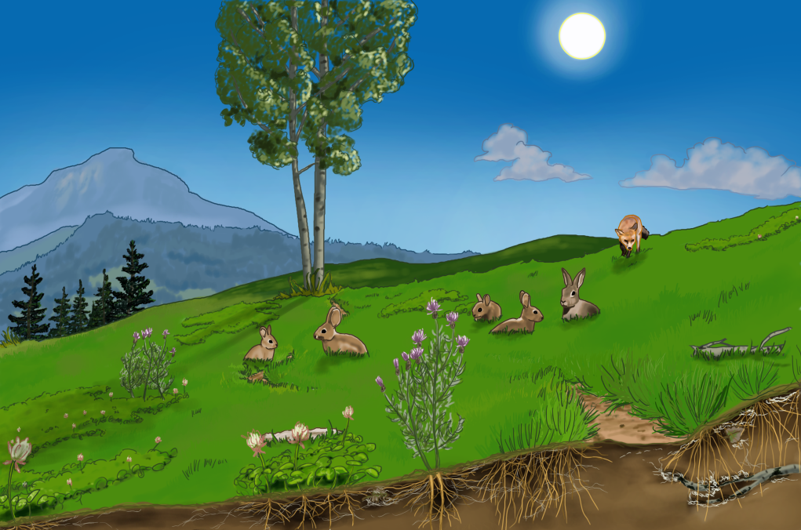
The Carbon Dice Game
You will be carbon atoms cycling through a simple version of an ecosystem with atmosphere, grass, rabbits, foxes, and soil pools (the soil pool contains dirt and decomposers).
Roll your dice to find out where you go and what happens to you along the way

Slide 21
The Carbon Dice Game
Keep a record! Each pool has a Tally Card. Be sure to make a tally mark each time you arrive at a pool (or if you stay in a pool after a dice roll).
|

Slide 22
The Carbon Dice Game
If you are a carbon atom in an organic molecule you have chemical energy in your bonds.
Beans represent energy.
You only get to have 1 bean at a time. Beans are “spent” only once. This happens when the organism needs to use chemical energy. The chemical energy is transformed into motion energy that an organism can use, and eventually is transformed into heat energy.

Slide 23
The Carbon Dice Game
If you are a carbon atom in an organic molecule you have chemical energy in your bonds.
Pick up one bean from the light energy cup when you have chemical energy.
Keep your bean when you move between pools if you still have chemical energy.
Leave your bean in the heat basket when you no longer have chemical energy.

Slide 24
The Carbon Dice Game
Remember that the soil organic carbon pool contains
dead plants and animals waiting to decay (be eaten by decomposers) AND
the organic material of live decomposers.
Carbon atoms move to the soil pool after death and then are eventually digested and respired by decomposers who live in the soil.

Slide 25
To Begin…
Start as a carbon atom in the atmosphere.
When you start, you are part of a carbon dioxide molecule in the atmosphere, which is a form of inorganic carbon. This means you do not start with a energy bean.
Good luck!

Slide 26
After the Carbon Dice Game:
Collect all the Tally Cards from each station. Count the tallies and enter them into the spreadsheet.

Slide 27
Visitation Graph
The graph will show how many times carbon atoms visited each pool.
Which pools were visited the most during the game?
Which pools were visited least during the game?
Notes:
Teacher Instructions: Enter the information for student on the Visitation Graph Tab.
Largest pools: Air, producers & soil (ideally)
Smallest pools: Carnivore, herbivore (ideally)

Slide 28
Visitation Graph
Where were most of the organic carbon atoms located during the game? Why?
Do you think this represents where organic carbon is located in real ecosystems?
Why do you think carbon visits some pools more than others?
Notes:
Students may suggest that in ecosystems most of the biomass is stored in the producers and the decomposers (soil). Carbon must first visit the producers before it can go to any of the other pools. Once in a pool, carbon atoms can go multiple places, so it is less likely that a carbon atom will “make it” all the way to a carnivore pool. So, in other words, you need more organic carbon in the producer pool to support life in the rabbit and fox since some of it goes back to the atmosphere, and some of it goes to the soil pool. It may help to remind them of the Sunny Meadows simulation, which showed that a large amount of grass was needed to support a small amount of rabbits, and an even smaller amount of foxes.
This could be producers or soil or air.
It varies per ecosystem; but in general, most of the organic carbon is located in the soil and in the producers.

Slide 29
Compare to Mr. Terry’s class sample data

Slide 30
What happened to Energy?
Where was energy at the beginning of the game? What form of energy was it in?
Where was energy at the end of the game? What form of energy was it in?

Slide 31
What happened to Energy?
What is the way that sunlight energy becomes chemical energy?
How does chemical energy move around the ecosystem?
Once chemical energy is transformed into heat, can it return to chemical energy?
Notes:
The only way is through producers by photosynthesis
It moves around the ecosystem by eating, death and defecation
No, it cannot return to chemical energy. Heat energy is lost to ecosystems.

Slide 32
Bonus Questions: Important Processes
What is the only way that inorganic carbon transformed into organic biomass?
What is the only way that sunlight energy can be transformed into chemical energy?
What would be the result for the ecosystem if this process did not occur?
Notes:
Photosynthesis
Photosynthesis
2. All the carbon would stay in the air and it would never get turned into plants. Sunlight energy would turn into heat energy. All the animals would die because they wouldn’t have anything to eat. Decomposers would die because they wouldn’t have anything to eat.

Slide 33
Important Processes
Which carbon-transforming process transformed you from a small organic molecule into a LARGE organic molecule?
At which locations in the game did this process happen?
Notes:
Biosynthesis. Biosynthesis is the process of taking small organic molecules and combining them into larger organic molecules to build biomass, or the body of a plant or animal.
Biosynthesis happened in the grass, rabbit, and fox. The grass transformed glucose molecules into the cells of the grass. The rabbit transformed molecules from the grass into cells of the rabbit. And the fox transformed molecules from the rabbit into cells of the fox.

Slide 34
Important Processes
Which carbon-transforming process transformed you from a LARGE organic molecule into a small organic molecule?
At which locations in the game did this process happen?
Notes:
Digestion. Digestion is the process of breaking down larger organic molecules into smaller organic molecules. This happens in the stomach and intestines of the animals. The purpose of this is so that the molecules become small enough to be passed across membranes so that they can be carried throughout the body via the blood.
Digestion happened in the rabbit and in the fox. In the stomach of the rabbit, grass is broken down into small organic molecules. In the stomach of the fox, rabbit is broken down into small organic molecules.

Slide 35
Was that supposed to be real?
The game you just played is a model of a real ecosystem, which means that it represents some parts of an ecosystem, but with limitations. This means what happened in the game is not exactly how things happen in a real ecosystem. With a partner, brainstorm about ways you noticed that this ecosystem is different from real ecosystems. When you are done, share your ideas with the class.

Slide 36
Here are a couple ways that the game differs from real ecosystems.
Rabbits don’t only eat grass, and foxes don’t only eat rabbits.
If you go to the soil pool, there is a chance that you will not get digested for a long time. Some organic material is tough to digest even for a decomposer. This is why soil is such a large carbon sink!
In rabbits and foxes, carbon atoms are sometimes biosynthesized into fat. In this case, the fat may be used in cellular respiration and the carbon atoms will return to the atmosphere after a period of time. This is not represented in the game.
In a pregnant animal it is possible that a carbon atom is biosynthesized into a growing fetus in the mother. In this case, the carbon atom would travel from the parent to the body of the offspring. Very few carbon atoms get to do this!

Slide 37
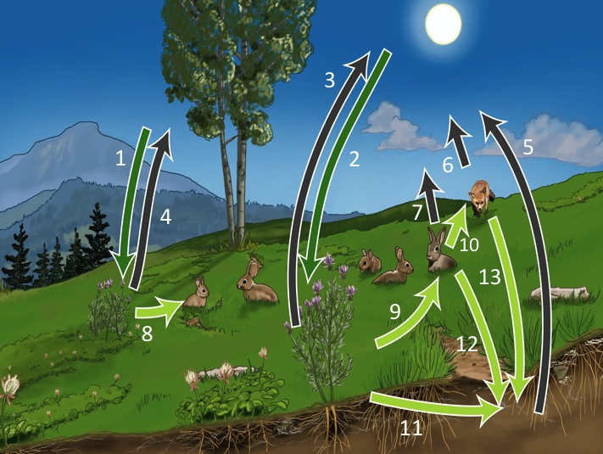
Notes:
Arrows 1 and 2: These arrows represent photosynthesis, or the removal of organic carbon from the atmosphere by the producers. The producers transform the inorganic CO₂ into organic biomass.
Arrows 3, 4, 5, 6, and 7: These arrows represent cellular respiration, or the movement of carbon from organic biomass into the atmosphere. During cellular respiration, carbon is transformed from organic molecules into water and CO2, and the CO2 is released into the atmosphere as a waste product of cellular respiration. You can also think of this as the transformation of organic carbon into inorganic carbon.
Arrows 8, 9, 10: These arrows represent the movement of carbon through digestion and biosynthesis.
Arrows 11, 12, and 13: These arrows represents the movement of carbon from living things into the detritus (organic matter, once-living things, etc) in the soil.

Slide 38
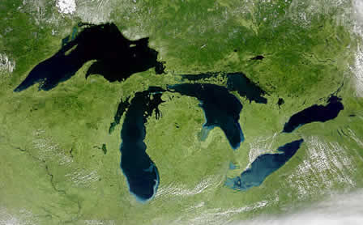
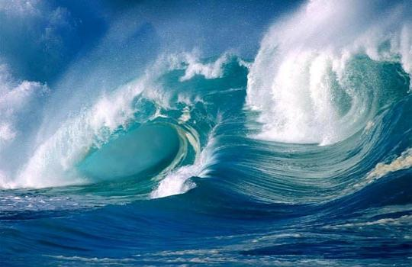
Lab 2
Exercise with acid rain in Lake Ontario and how residence time affects potential for lake acidification
Lab activity involving residence time of oceans

Slide 39
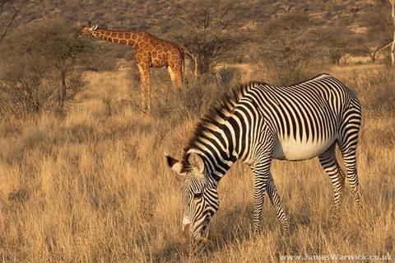
Next Class
Biological production using stocks and flows
(Monday, September 9)
How primary production supports herbivore biomass
Herbivores
How inverted biomass pyramids can develop
Plants

