Slide 1
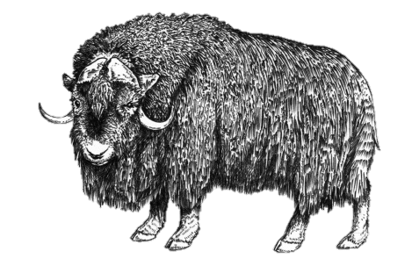
FW364 Ecological Problem Solving
Class 7: Population Growth
September 23, 2013

Slide 2
Outline for Today
Last Two Classes:
Derived a simple model of discrete population growth between consecutive time periods
Derived an equation to forecast population growth (still discrete growth)
Objectives for Today:
Derive continuous population growth equations
Include immigration and emigration into equations
Text (optional reading):
Chapter 1
N_{t+1} = N_{t} λ
N_{t} = N₀ λ^{t}

Slide 3
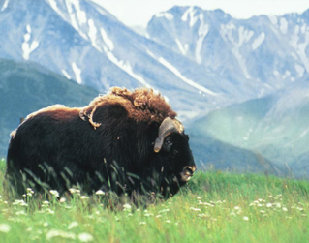
Continuous Growth Equation
Recall that continuous growth is more appropriate for some organisms:
Discrete
Continuous
Population Size
Population Size
Application to humans in text…
…discussed as discrete growth, but continuous is more appropriate
N_{t+1} = N_{t} λ
Today:
Continuous Analogs
N_{t} = N₀ λ^{t}
Notes:
http://www.npr.org/series/141810687/7-billion-people-one-planet

Slide 4
Continuous Growth Equation
Start with general equation for closed population:
N_{t+1} = N_{t} + B - D
Rearrange to:
N_{t+1} - N_{t} = B - D
And substitute ΔN for N_{t+1} - N_{t}
ΔN = B - D
This is a model of rate of change in N
→ Still a discrete equation

Slide 5
Continuous Growth Equation
ΔN = B - D
To make continuous, change time step to “infinitely small time intervals”
(~instantaneous time step)
dN/dt = B - D
In other words, to get from discrete to continuous time,
we make the time step smaller and smaller (until infinitely small)
Important Note:
When changing from discrete to continuous time, we added time units
N: number
B and D: number/time

Slide 6
Continuous Growth Equation
dN/dt = B - D
Like before, let B = bN and D = dN
dN/dt = bN - dN
where
b is instantaneous, per capita birth rate
(average # of births per individual per time)
d is instantaneous, per capita death rate
(probability of an individual dying per time)
Note: no prime symbol for b and d
Restrictions on b and d:
0 ≤ b
0 ≤ d ≤ 1

Slide 7
Continuous Growth Equation
dN/dt = bN - dN
Rearrange:
dN/dt = N (b – d)
Define r = b – d
r is instantaneous per capita population growth rate
Units of r, b, and d (all instantaneous per capita rates) are per time
e.g., per year year⁻¹ 1/year
per day day ⁻¹ 1/day
Finally, substitute r into equation:
dN/dt = r N

Slide 8
Continuous Growth Equation
dN/dt = r N
This equation tells us the rate of change in N
What is happening to a population with an instantaneous
per capita growth rate, r, of:
r > 0 ?
r = 0 ?
r < 0 ?

Slide 9
Continuous Growth Equation
dN/dt = r N
This equation tells us the rate of change in N
What is happening to a population with an instantaneous
per capita growth rate, r, of:
r > 0, population is increasing exponentially (b > d)
r = 0, population is stable (not changing) (b = d)
r < 0, population is decreasing exponentially (b < d)

Slide 10
Forecasting Population Growth
dN/dt = r N
This equation tells us the rate of change in N
… not what population size will be
i.e., equation does not forecast population growth
To forecast growth (i.e., obtain N_{t}) we need to solve the equation…
…using calculus
Solution to
dN/dt = r N
is obtained by integration

Slide 11
Forecasting Population Growth
If you can’t remember your calculus, it’s OK
(you will not be doing calculus on the exam)

Slide 12
Forecasting Population Growth
N_{t} = N₀ e^{rt}
Where e = 2.718…
This equation describes exponential growth
If we know N at a given time, we can calculate N in the future
For comparison, this is our
DISCRETE forecasting equation:
N_{t} = N₀ λ^{t}
λ = 1 + r’
r’= b’ - d’
Note: We could write r in terms of b and d
N_{t} = N₀ e^{(b-d)t}

Slide 13
Forecasting Population Growth
N_{t} = N₀ e^{rt}
We can estimate r using linear regression
(like we did for λ in discrete case)
Need to “linearize” the growth rate equation by taking natural log of both sides
ln (N_{t}) = ln (N₀ e^{rt})
ln (N_{t}) = ln (N₀ ) + ln (e^{rt})
ln (N_{t}) = ln (N₀ ) + rt ln (e)
ln (N_{t}) = ln (N₀ ) + rt
Intercept
Slope
This is a linear equation between ln (N_{t}) and t,
with slope = r and intercept = ln (N₀)
Reminder: r is the instantaneous per capita population growth rate

Slide 14
Forecasting Population Growth
N_{t} = N₀ e^{rt}
Remember from earlier, r can be positive or negative:
When r > 0, population is increasing exponentially (b > d)
When r = 0, population is stable (not changing) (b = d)
When r < 0, population is decreasing exponentially (b < d)
Important:
r is not the proportion by which the population grows or shrinks!
r = 0.05 does not mean the population increases by 5% per time period
This is an important difference from r’

Slide 15
Doubling Time
N_{t} = N₀ e^{rt}
Given a constant r, we can calculate the doubling time
for populations that grow continuously
i.e., For a population growth rate, r,
how long will it take for a population to double in size?
Like for discrete growth, the doubling time of a continuously growing population can be expressed as:
N_{t} = 2N₀
or
N_{t}/N₀ = 2

Slide 16
Doubling Time
N_{t} = N₀ e^{rt}
What is t when N_{t}/N₀ = 2?
N_{t} = N₀ e^{rt}
N_{t}/N₀ = e^{rt}
2 = e^{rt}
ln (2)
ln (2) = ln (e^{rt})
ln (2) = rt
t_{doubling} =
r
0.693
t_{doubling} =
r
Note: We’ll always use natural log for continuous growth doubling time

Slide 17
Comparison of Finite and Instantaneous Rates
Finite (discrete) rate: r’ is a percentage change per time
Instantaneous (continuous) rate: r is not a percentage change per time
Think of instantaneous rate like speed of car
I might travel 30 miles/hr for just one minute
My speed (30 miles/hr) is the instantaneous rate
I did NOT go 30 miles in an hour, since I was not driving for an hour
Advantage to using continuous equations:
As models get more complex, discrete versions cannot be solved
i.e., we cannot get an equation that gives N as a function of time for long-
term forecasting… we would need to use numerical simulation instead
With continuous growth equations, we can usually obtain a solution

Slide 18
Immigration
&
Emigration
for discrete & continuous

Slide 19
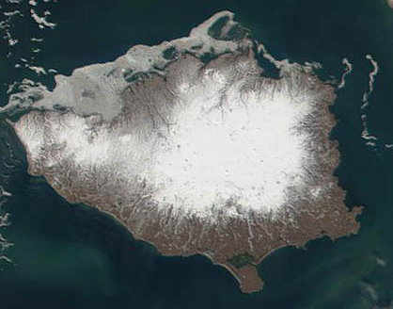
Immigration & Emigration
Until now, we have assumed we were working with a closed population
This allowed us to ignore immigration and emigration
OK assumption for our muskox on Nunivak Island …
… not appropriate for many other populations
New Focus:
Derive population growth equations with immigration and emigration

Slide 20
Immigration & Emigration
For populations with immigration / emigration:
N_{t+1} = N_{t} + B – D + I - E
Inputs to population Outputs from population
Births (B) Deaths (natural, harvesting, other) (D)
Immigration (I) Emigration (E)
We previously said that B = bN_{t}
i.e., that B (number of births) is dependent on density
“Dependent on density” is key:
If there are more individuals, there are more births
Likewise, D = dN_{t}
i.e., that D (number of deaths) is also dependent on density

Slide 21
Immigration & Emigration
For populations with immigration / emigration:
N_{t+1} = N_{t} + B – D + I - E
Question:
Do immigration and emigration depend on density?

Slide 22
Immigration & Emigration
For populations with immigration / emigration:
N_{t+1} = N_{t} + B – D + I - E
Dependence on density determines how we model I and E
Immigration
We’ll use a constant: I
In other words:
Immigration is not dependent
on density
Immigration is a constant factor
Emigration
Need to model like B and D:
E = eN_{t}
e is per capita emigration rate
In other words:
Emigration is dependent on density:
Probability of an individual leaving the area
increases as population size increases

Slide 23
Immigration & Emigration
For populations with immigration / emigration:
N_{t+1} = N_{t} + B – D + I - E
We can now revise the model using: B = bN_{t}, D = dN_{t}, E = eN_{t}, and I
N_{t+1} = N_{t} + bN_{t} – dN_{t} – eN_{t} + I
In this equation (based on our assumptions):
Emigration decreases the population in a geometric way
i.e., constant fraction leaving per time step, like a “death” rate
→ Proportional change
Immigration increases the population in an additive way
i.e., adding a constant number per time step
→ Absolute change

Slide 24
Immigration & Emigration
N_{t+1} = N_{t} + bN_{t} – dN_{t} – eN_{t} + I
We can now derive our discrete model of population growth:
N_{t+1} = N_{t} + b’N_{t} – d’N_{t} – e’N_{t} + I
N_{t+1} = N_{t} (1 + b’ – d’ – e’) + I
(Note the prime symbols)
Substitute r’ = b’ – d’ – e’
N_{t+1} = N_{t} (1 + r’) + I
There is no solution to this equation as a function of time!
Without immigration and emigration, we started with:
N_{t+1} = N_{t} λ
and derived
N_{t} = N₀ λ^{t}
Problem is I, the non-density dependent term
→ Need to calculate N_{t} one time step at a time

Slide 25
Immigration & Emigration
N_{t+1} = N_{t} + bN_{t} – dN_{t} – eN_{t} + I
Let’s derive our continuous model of population growth:
N_{t+1} - N_{t} = bN_{t} – dN_{t} – eN_{t} + I
dN/dt = bN – dN – eN + I
dN/dt = N (b – d – e) + I
Substitute r = b – d – e
dN/dt = rN + I
There is a solution to this equation as a function of time!
… but we won’t do it in this class (phew!)

Slide 26
Looking Ahead…
Next Two Classes:
Population variation
Including uncertainty in population growth
Also including a game where you either die, survive, or reproduce!

