Slide 1
FW364 Ecological Problem Solving
August 28, 2013
Sara Parr Syswerda, PhD

Slide 2
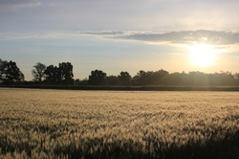
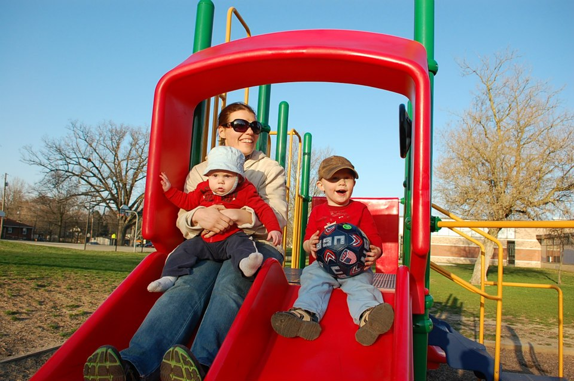
Who am I?
I study ecosystem management and the impact of management on ecosystem services, as well as studying how people learn science
I am particularly interested in the impact of agriculture on environmental quality, pollution, human health, and the health of wildlife
I also enjoy trail running, triathlons, hanging out with my family, and farming.

Slide 3
Course Information
Lecture: Mondays & Wednesdays 10:20-11:10AM
225 Natural Resources
Labs: Section 1: Tuesdays 8-9:50AM, 1210 Anthony Hall
Section 2: Tuesdays 10:20AM-12:10 pm, 1210 Anthony Hall
Office Hours: Mondays 11:30-12:30, NR40A
Tuesday 9:50-10:20, 1210 Anthony Hall
Final Exam: Tuesday, Dec.10, 10AM-12pm

Slide 4
Teaching Style
I believe in using formative assessments and summative assessments so I can adjust my teaching based on where you are.
Please feel free to ask questions during the lecture or labs.
Please feel free to contact me if you have a question. Office hours and email are the best ways to reach me.

Slide 5
Syllabus Highlights
Course Website
Textbook (optional… but software required): Akçakaya, H.R., M.A. Burgman, and L.R. Ginzburg. 1999. Applied population ecology: Principles and computer exercises using RAMAS EcoLab, Second Edition. Sinauer, Sunderland, MA, USA.
You can use your own laptop during labs.
Attendance is optional, but there will be in class work for grades during lectures and labs.

Slide 6
Lab highlights
There will be activities associated with the labs that will be due 2 weeks after they are assigned.
Most of the labs will include a combination of hands-on and computer-based activities.
Each lab will come with specific instructions for the write up to help you complete the activities.

Slide 7
This is not your normal course!
Emphasis on a process
Strong critical thinking component (not as much memorization)
Learning skills that are transferrable to your future work
Observations
Model
Inference
Objectives:
Provide introduction to quantitative analysis of natural resources problems
Practice solving problems: provide tools to solve future problems you will encounter

Slide 8
Solving Ecological Problems…
Ecosystem problems
Approach: Mass balance (checkbook science: balancing budgets)
Example: Balance of carbon flow in ecosystem
Tools: Pencil and paper, calculator, spreadsheet
Population problems
Examples: Endangered species management (extinction probabilities),
effects of simulated harvesting (managing fishing/hunting)
Tools: Spreadsheet models, dynamic simulation models (Ramas)
Community problems
Examples: Predator-prey and competition (effects of exotic species)
Tools: Spreadsheet models, dynamic simulation models (Stella)

Slide 9
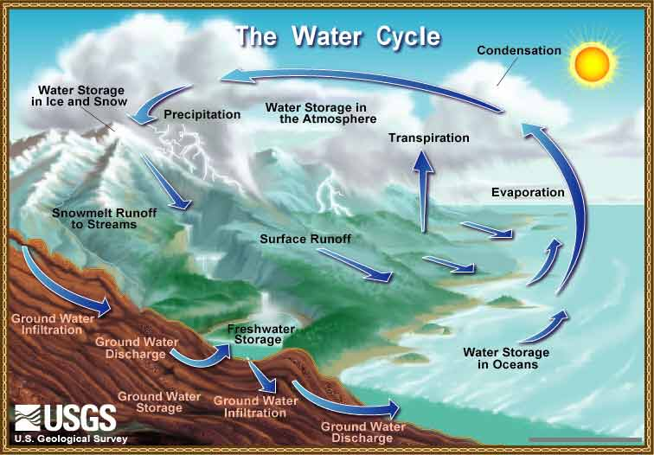
G
eneral approach to course
Objective 1: Provide introduction to quantitative analysis of natural resources problems
By the end of course you should be comfortable with:
Mass-balance (budget) problems (ecosystem ecology)
basic algebra
concept of steady state
The use of spreadsheets for basic population modeling and statistics
mean, standard deviation, regression

Slide 10
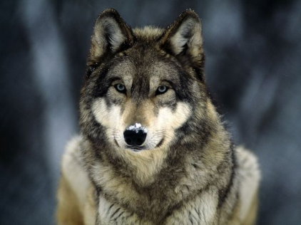
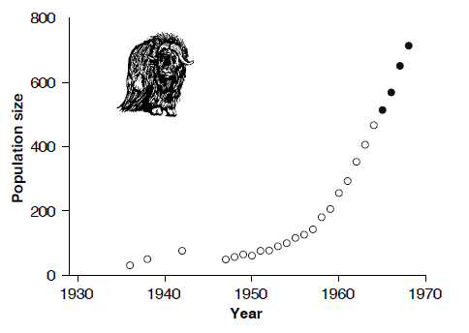
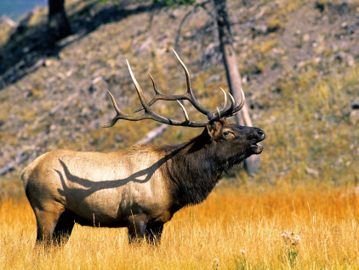
G
eneral approach to course
Objective 1: Provide introduction to quantitative analysis of natural resources problems
By the end of course you should be comfortable with:
Simple models of populations and communities and how they can be used to ask management questions
Importance of uncertainty in the application of science to management problems
Notes:
Muskox reintroduction to Nunivak Island; Wolf predation on elk in Yellowstone

Slide 11
G
eneral approach to course
Objective 1: Provide introduction to quantitative analysis of natural resources problems
Modeling approach:
Understand the basic idea, gloss over much of the details

Slide 12
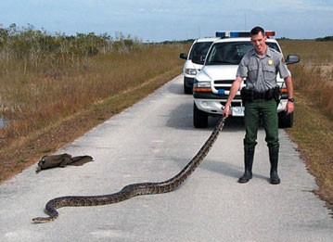
G
eneral approach to course
Objective 2: Practice solving problems: provide tools to solve future problems you will encounter
For example: Are Burmese pythons really a problem in Florida?
To find the answer, you would have to count the pythons to estimate a population size… Good luck with that. ☺
Notes:
http://www.buzzle.com/editorials/5-2-2006-95016.asp

Slide 13
G
eneral approach to course
Objective 2: Practice solving problems: provide tools to solve future problems you will encounter
By answering this simple problem, you have done something important:
→ used a GENERAL quantitative tool (i.e., addition) to answer a specific question.
You can use the same tool to answer other questions about all sorts of things.
We will be focusing on general quantitative tools in this course.
i.e., we will be applying math you learned in other courses.

Slide 14
G
eneral approach to course
Observations
Model
Inference
Words
Framework
Words
We get better at this with practice!
The main point of this course is NOT the actual subject matter of the ecological and management examples, but the process.
This involves:
learning the process,
but more importantly, simply doing

Slide 15
G
eneral approach to course
Impacts to you:
You can solve problems better!
Quantitative methods are a great way to make a study more comprehensive and concrete
You have a better understanding of people’s analyses
Learn tools to add to arsenal when looking for job
→ “Stella” is a lot more impressive than “Microsoft Word”

Slide 16
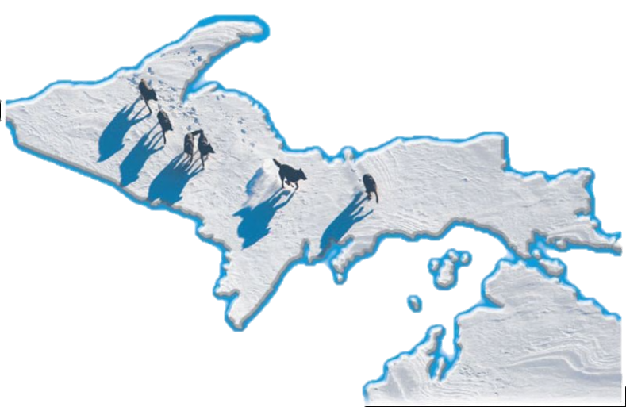
G
eneral approach to course
Example question for which a model can help:
Question: How many wolves will there be in the
Michigan Upper Peninsula in 5 years?
Is this an important question? Why is it important?
Is this a question that Wildlife Managers must answer? Is it their job?
Is this a question that FW majors should understand how to answer?
Does this question require a quantitative answer?
What information do we need to answer this question?
Toledo Blade.com

Slide 17
G
eneral approach to course
Year | # Wolves
1999 | 174
2000 | 216
2001 | 249
2002 | 280
2003 | 321
2004 | 360
2005 | 405
2006 | 434
2007 | 509
What should we do with the data?
How can we now make a quantitative prediction?

Slide 18
G
eneral approach to course
Year | # Wolves
1999 | 174
2000 | 216
2001 | 249
2002 | 280
2003 | 321
2004 | 360
2005 | 405
2006 | 434
2007 | 509
What should we do with the data?
How can we now make a quantitative prediction?
Observations
Model
Inference

Slide 19
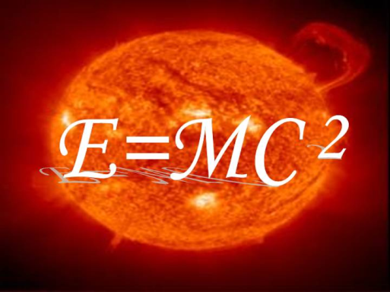
M
odels
What are models?
What do these models have in common?
Abstractions of reality
Do not include all of the real-life detail
Useful representations or guides

Slide 20
M
odels
Why do we need to understand ecological models?
Models are essential for understanding natural phenomena and making predictions
Predictions are essential for management
(complete understanding of natural system not essential,
not practical in ecology)
Model Classification:
Verbal / Conceptual
vs.
Explicit / Quantiative (set of equations)

Slide 21
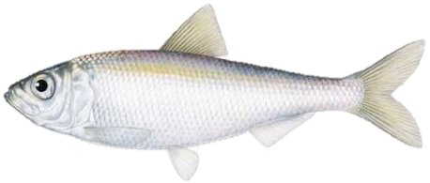
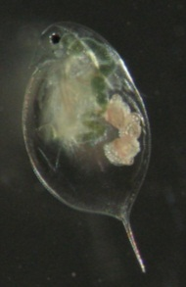
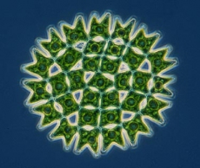
M
odels
Planktivorous fish:
Alewife
Food web example
Aquatic herbivore:
Daphnia
Aquatic plant:
Phytoplankton

Slide 22
M
odels
Conceptual Model
Respiration
Food web example:
Carbon flow
Consumption
Respiration
Consumption
Assumption:
Photosynthesis
Populations are not growing,
just sustaining themselves

Slide 23
M
odels
Quantitative
Model 1
20 gC/m²/yr
Food web example:
Carbon flow
20 gC/m²/yr
80 gC/m²/yr
100 gC/m²/yr
Assumption:
100 gC/m²/yr
Populations are not growing,
just sustaining themselves

Slide 24
M
odels
Quantitative
Model 2
20 gC/m²/yr
Food web example:
Carbon flow
20 gC/m²/yr
80 gC/m²/yr
100 gC/m²/yr
Assumption:
100 gC/m²/yr
Total In = Total Out
100 gC/m²/yr = 20 gC/m²/yr + 80gC/m²/yr

Slide 25
Models
All models (whether verbal, conceptual or mathematical) entail making simplifying assumptions in order to generate predictions about the behavior of the system
we simplify to understand complex phenomena
food web: populations are not growing, just sustaining
In mathematical (quantitative) models, the assumptions are explicit
can be written down as equations
food web: Total In = Total Out
Use of equations means that the logic in mathematical models is transparent
can be readily evaluated by others
if the math is correct, we can be sure that the predictions of the
model follow logically from the assumptions

Slide 26
For Tuesday:
Bring calculator, paper, something to write with (Bring these every week)
I will upload powerpoints and supporting documents at least 2 hours before class (more likely the night before) if you would like to download them for taking notes.

