Slide 1
Nanotechnology, You, and the Environment
Lisa Wininger and Sara Syswerda

Slide 2
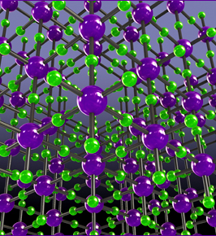
What Is Nanotechnology?
Understanding and control of matter at the nanoscale with at least one dimension sized from 1 to 100 nanometers, where unique phenomena enable novel applications
Includes nanoscale science, engineering, and technology, and involves imaging, measuring, modeling, and manipulating matter at this scale.

Slide 3
How Small Is A Nanometer?
One billionth of a DNA double-helix has a diameter around 2 nm
A hydrogen atom has a diameter of ~0.25 nm
A hair or a sheet of paper is about 100,000 nanometers wide.
25.4 million nm in one inch
Brochure link: http://www.nano.gov/sites/default/files/pub_resource/nanotechnology_bigthingsfromatinyworld-print.pdf
Video http://www.youtube.com/watch?v=qrUzfUcMtaA
http://htwins.net/scale2/

Slide 4
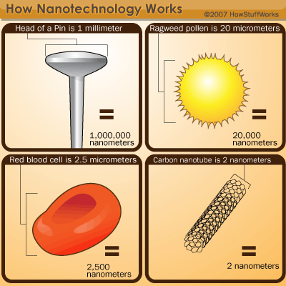

Slide 5
What’s So Special About Nanoscale?
When particles are created with dimensions of about 1–100 nanometers (where the particles can be “seen” only with powerful specialized microscopes), the materials’ properties change significantly from those at larger scales.
This is the size scale where so-called quantum effects rule the behavior and properties of particles. Properties of materials are size-dependent in this scale range. Thus, when particle size is made to be nanoscale, properties such as melting point, fluorescence, electrical conductivity, magnetic permeability, and chemical reactivity change as a function of the size of the particle.

Slide 6
Nanoscale Gold: An Example
Nanoscale gold illustrates the unique properties that occur at the nanoscale. Nanoscale gold particles are not the yellow color with which we are familiar; nanoscale gold can appear red or purple.
At the nanoscale, the motion of the gold’s electrons is confined so that gold nanoparticles react differently with light compared to larger-scale gold particles. Their size and optical properties can be put to practical use: nanoscale gold particles selectively accumulate in tumors, where they can enable both precise imaging and targeted laser destruction of the tumor by means that avoid harming healthy cells.

Slide 7
Nanotechnology History
Initial discussions began in 1959.
In the 1970s and 80s, developments in microscopy allowed scientists to see materials at the atomic level.
In the 1990s, scientists focused on the basic research questions (both privately and publicly funded, espec. IBM)
Around 2000, bulk commercial applications of nanomaterials were developed, and more research research money was designated for this purpose.

Slide 8
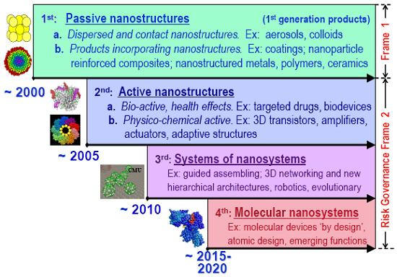

Slide 9
“First Generation” Applications
Mostly passive additions of nanomaterials into other materials
Silver in Clothing, food packaging, disinfectants, and bandages for controlling bacterial growth
Zinc Oxides in sunscreen and cosmetics, Solar cells, and Surface coatings to reduce sun damage
Cerium oxide as a fuel catalyst

Slide 10
“Second Generation” Applications
Many of these are still in the development stages, but they will require further research before they are commercially viable…
New medical approaches like chemotherapy that can target tumor cells (instead of harming the whole body).
Small parts used in microchips, computer processors, and cell phones.

Slide 11
Environmental Concerns
Many of the technologies involve materials that aren’t “health-friendly” to humans or the environment
There are big concerns as far as military applications (and terrorist usage)
There is a risk the technology could be used to violate people’s privacy (tiny cameras or monitoring devices)

Slide 12
Accumulation of Hazards in Ecosystems at the Nanoscale
For most of the materials used in nanomaterials, no toxicology testing has been done.
Many of the materials can result in nanoparticles escaping into the environment either during manufacture or during use.
For example, when zinc oxide in sunscreen is washed off, it ends up in waste water treatment plants. Silver in clothing also gets into the waste water when these garments are washed.

Slide 13
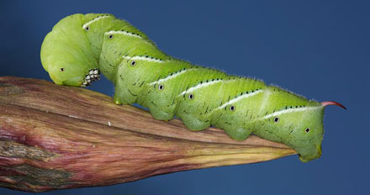
Accumulation of Hazards in Ecosystems at the Nanoscale
The water treatment plants concentrate the nanoparticles into the solid waste, which is sometimes applied onto fields as fertilizer.
Some plants and animals absorb the nanomaterials from the waste, and pass these materials on through their tissue to predators.
http://pubs.acs.org/cen/news/88/i51/8851news.html?utm_source=feedburner&utm_medium=feed&utm_campaign=Feed%3A+cen_latestnews+(Chemical+%26+Engineering+News%3A+Latest+News)
Notes:
Scientists contaminated soil with gold nanoparticles in different concentrations. Earthworms absorbed the gold through their skin, and the tobacco plants growing on the soil also absorbed the gold. As the tobacco plants were eaten by tobacco hornworms, the gold accumulated at greater concentrations within their tissues.

Slide 14
Thinking like a student…
Students don’t have any personal, first-hand experience with this realm of small particles, so we as teachers have to create that for them.
Students also don’t always understand how matter and energy move through food webs.

Slide 15
So for today…
We’re running a simulation of a coastal ecosystem that has been contaminated by gold nanoparticles.
First, let’s look at the ecosystem and food web…
Adapted from materials provided by: http://lifesciences.envmed.rochester.edu/lessons2.htm

Slide 16
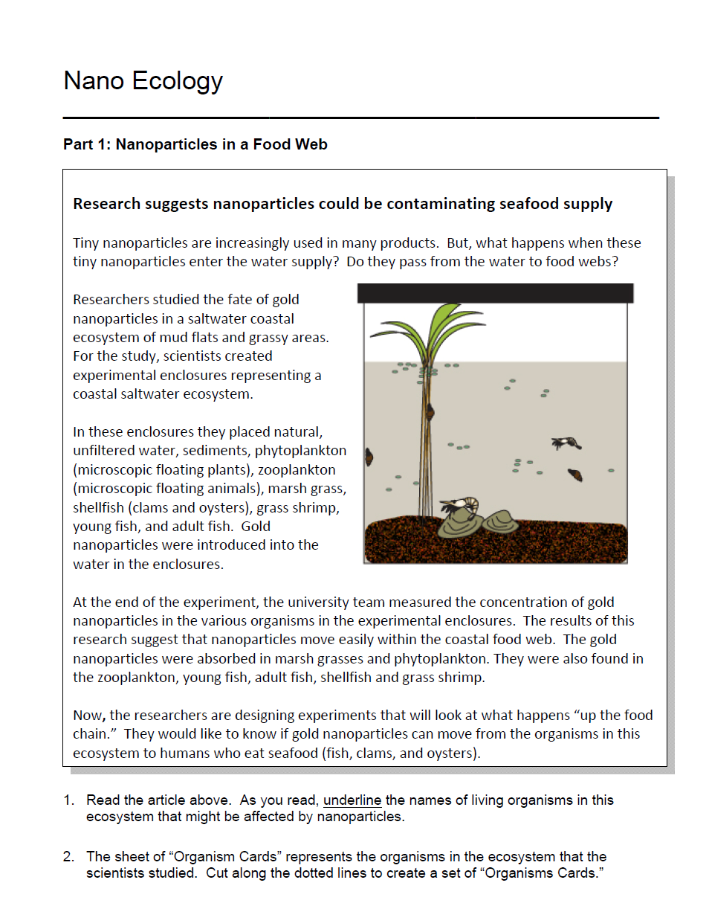
Notes:
Students read the information in the box and underline the names of organisms in the reading.

Slide 17
Nano Ecology
Notes:
Then they use the information in the reading to arrange the organisms on the organism cards to make a food web.
Ask Participants to follow the instructions for Part I. You will need to provide scissors and tape.

Slide 18
Let’s look at energy transfer

Slide 19
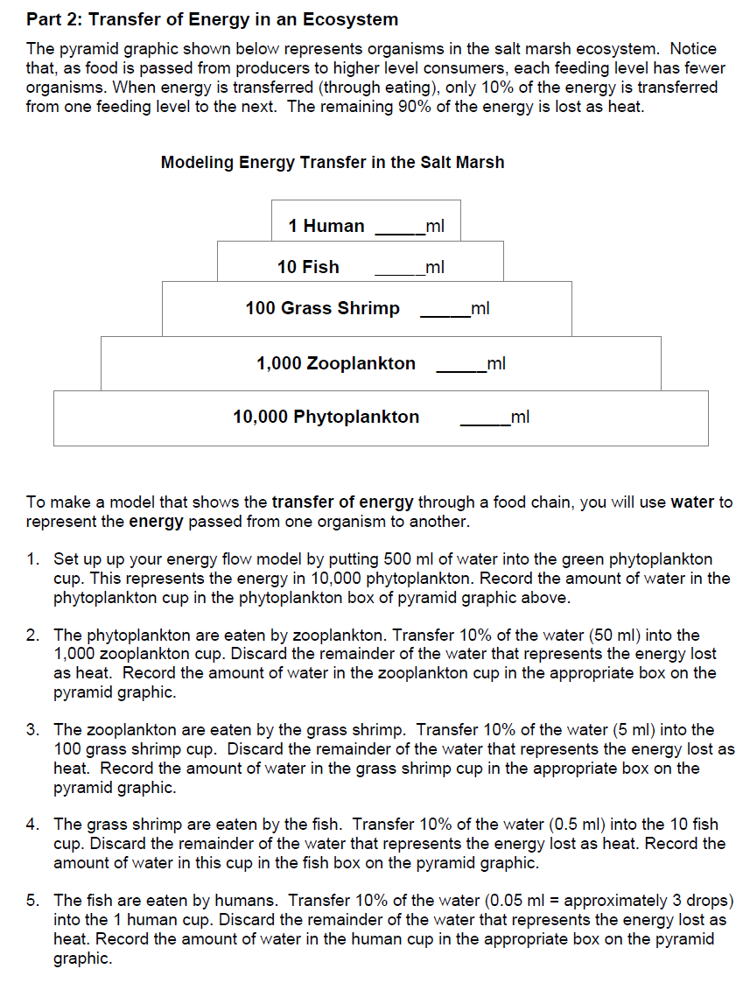
Notes:
In Part 2, students model the flow of energy through the ecosystem. Ask participants to complete Part 2. You will need to provide water, 10 graduated cylinders, and 100 ml graduated cylinders.

Slide 20
Let’s look at bioaccummulation

Slide 21
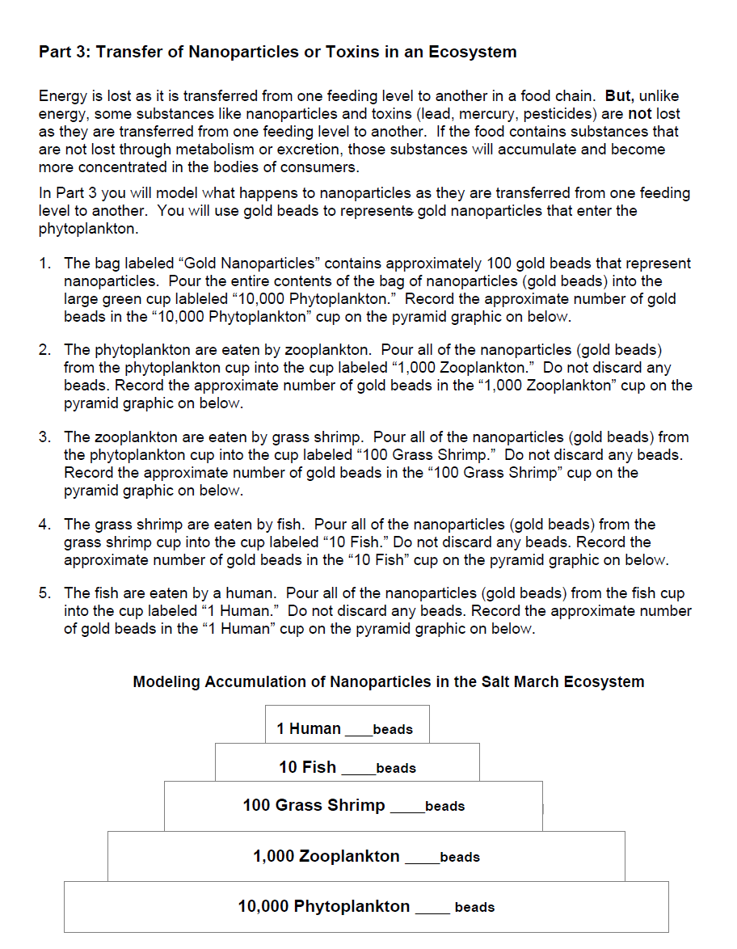
Notes:
In Part 3, students model the flow of nanoparticles in an ecosystem. Ask teachers to complete Part 3.

Slide 22
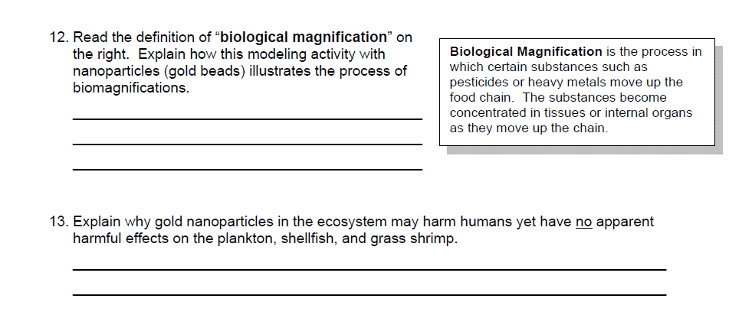
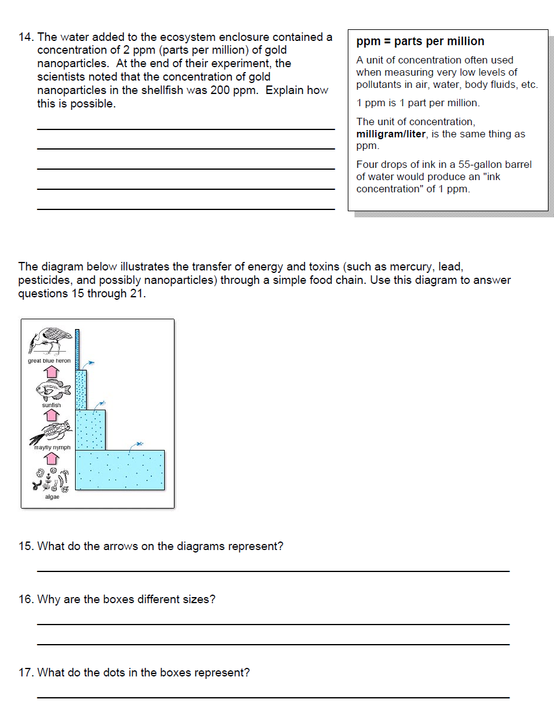
Notes:
Questions at the end of Part 3 ask students to apply what they learned. Participants complete Part 3.

Slide 23
Potential Quantitative Reasoning problems…
Students sometimes have trouble with measuring or quantifying amounts (especially small amounts and also problems with metric units).
Students have trouble thinking about concentrations (or fractions or proportions) and can’t go back and forth between measurements easily (g/mL or ppm)
All of these skills are critical as they move into more complex coursework (especially chemistry).

Slide 24
Discussion
What sort of problems do you think students would have in thinking about this activity?
How would you “upgrade” this for advanced students or adjust it for lower achieving students?
What sort of concerns or questions do you think your students will have ?
http://www.michigan.gov/documents/dnr/FishingGuide_11-low-res_347106_7.pdf

