Slide 1
Dynamic Water Quality Model for Brewster Lake – Simulation Phase
Sarah Brunsvold and Kasey Marley
Faculty Mentor: Dr. Zuhdi Aljobeh
Department of Civil Engineering
Valparaiso University

Slide 2
Background
A dynamic model can be used to predict the water quality of Brewster Lake over time for different conditions
It will help PCCI staff in making decisions about the conservation and preservation of the lake and its watershed
This research is a continuation of last summer’s limited dissolved oxygen model developed by Argueta and Aljobeh

Slide 3
Objectives
Develop a dynamic water quality model for Brewster Lake based on:
Mathematical equations representing the lake’s water quality
The lake’s watershed hydrodynamics
The lake’s water chemical and biological analyses
Compare the water quality of Brewster Lake with similar-sized lakes in the area

Slide 4
Field Work
2 cross sections
14 water columns
3 sampling depths
N-S
E-W

Slide 5
Field Work
2 cross sections
14 water columns
3 sampling depths

Slide 6
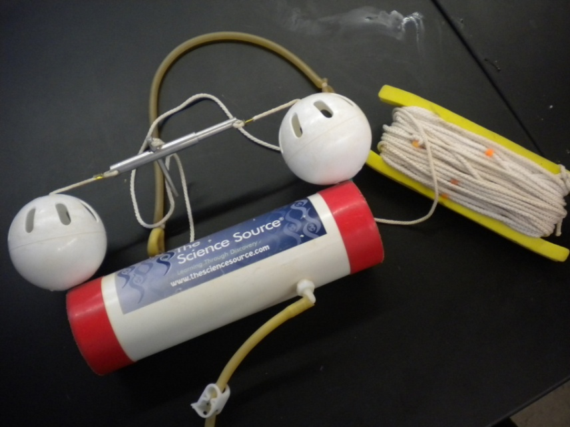
Field Work
2 cross sections
14 water columns
3 sampling depths
1 ft below
surface
Mid-point
1 ft above bottom

Slide 7
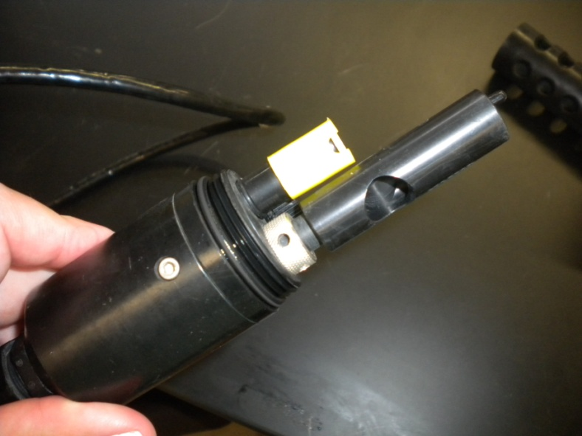
Field Work
2 cross sections
14 water columns
3 sampling depths
YSI Unit
Dissolved Oxygen
Temperature
pH
Conductivity
Water Sampler
GPS Unit

Slide 8
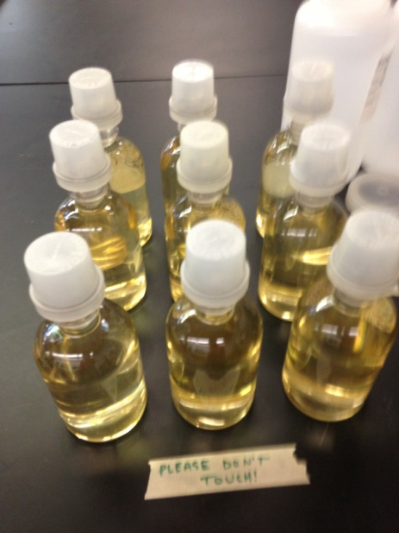
Lab Work
8 Parameters
Total Nitrogen
Total Phosphorus
Reactive Phosphorus
Ammonia
Nitrates
Chemical Oxygen Demand
Biochemical Oxygen Demand
Total Organic Content

Slide 9
Results – E/W Field Values

Slide 10
Results – E/W Lab Values

Slide 11
Results – N/S Field Values

Slide 12
Results – N/S Lab Values

Slide 13
What’s Next?
These results will be used as part of the finite element solution of the model - the initial conditions
A second round of sampling will be conducted by the end of July
These new results will be used to calibrate the model and correct any errors
Need to collect boundary condition measurements
Hydrodynamics – runoff, groundwater interaction, and evaporation

Slide 14
Acknowledgements
Pierce Cedar Creek Institute
Dr. Hugh Brown
Mr. Matt Dykstra
Valparaiso University

Slide 15
Questions?

