Slide 1
FW364 Ecological Problem Solving
Class 21: Predation
November 18, 2013

Slide 2
Outline for Today
Continuing with our shift in focus from
populations of single species to community interactions
Objectives from Last Classes:
Expanded predator-prey models
Applied calculus to predator-prey dynamics
Objectives for Today:
Explicitly link predator-prey equations
Discuss predator-prey model assumptions
Objectives for Next Class:
Build predator-prey models that relax assumptions (i.e., add realism)
No textbook chapters!

Slide 3
Recap from Last Class
Victim, V:
dV/dt = b_{v}V - d_{v}V
Predator, P:
dP/dt = b_{p}P - d_{p}P
Developed predator and prey growth (i.e., rate of change) models
(instantaneous rates)
Look very similar to previous single population growth model:
dN/dt = bN – dN
Today:
Link the equations – this is key!
Predator
Prey

Slide 4
Linking Equations – Prey Equation
Victim, V:
dV/dt = b_{v}V - d_{v}V
Predator, P:
dP/dt = b_{p}P - d_{p}P
Linking prey equation to predators:
How do predators affect prey?
More specifically, predators remove prey
we need to subtract predation effect from prey equation:
(i.e., split prey deaths into predatory deaths and non-predatory deaths)
→ Predators eat prey, of course!
dV/dt = b_{v}V – d_{v}V – Predation loss
Predation loss: number of prey eaten by all predators per unit time
With this expression,
d_{v}V is now death due to factors OTHER than predation
e.g., starvation, disease, genetic effects, etc.

Slide 5
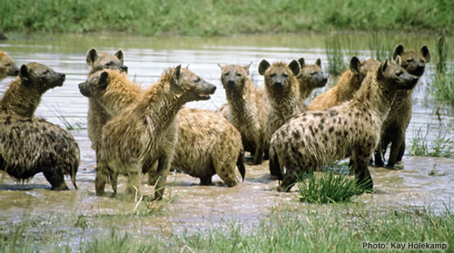
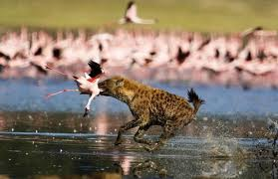
Linking Equations – Prey Equation
Victim, V:
dV/dt = b_{v}V - d_{v}V
Predator, P:
dP/dt = b_{p}P - d_{p}P
dV/dt = b_{v}V – d_{v}V – Predation loss
Equation for “predation loss” will vary for every predator-prey system,
but we can create a simple eqn that captures the essence of most systems
What affects predation rates?
Predator density (# predators)
Prey density (# prey)
Attack rate of predators (prop. of prey removed by a predator per time)

Slide 6
Linking Equations – Prey Equation
Victim, V:
dV/dt = b_{v}V - d_{v}V
Predator, P:
dP/dt = b_{p}P - d_{p}P
dV/dt = b_{v}V – d_{v}V – Predation loss
Equation for “predation loss” will vary for every predator-prey system,
but we can create a simple eqn that captures the essence of most systems
What affects predation rates?
Predator density (# predators)
Prey density (# prey)
Attack rate of predators (prop. of prey removed by a predator per time)
Can define predation loss as:
Predation Loss = aVP
where a is the attack rate of predators
and V and P are density (#) of prey and predators

Slide 7
Linking Equations – Prey Equation
Victim, V:
dV/dt = b_{v}V - d_{v}V - aVP
Predator, P:
dP/dt = b_{p}P - d_{p}P
This is our prey model!
Links death of prey to activity of predators
Our model contains two types of prey death:
Non-predatory mortality (d_{v}V)
Predatory mortality (aVP)
Let’s explore a, the attack rate in more detail

Slide 8
Linking Equations – Prey Equation
Victim, V:
dV/dt = b_{v}V - d_{v}V - aVP
Predator, P:
dP/dt = b_{p}P - d_{p}P
Attack rate (a):
Per capita (i.e., per individual prey) mortality rate of the prey
inflicted by a single predator
i.e., probability a single predator will kill a single prey (particular individual) per unit time
i.e., the proportion of the prey population removed by one predator per unit time
# prey (removed by 1 predator)
1
Units of a:
=
# prey (total) * predator * time
predator * time
= “per predator per time”

Slide 9
Linking Equations – Prey Equation
Victim, V:
dV/dt = b_{v}V - d_{v}V - aVP
Predator, P:
dP/dt = b_{p}P - d_{p}P
Attack rate (a):
Per capita (i.e., per individual prey) mortality rate of the prey
inflicted by a single predator
i.e., probability a single predator will kill a single prey (particular individual) per unit time
i.e., the proportion of the prey population removed by one predator per unit time
Example - How a proportion can also be a per capita mortality:
There are 200 prey. A single predator can attack 20 prey in one time step.
The proportion of prey population attacked by one predator = 20/200 = 0.10
Which means a single prey has a 10% chance of being attacked by one predator
i.e., per capita mortality rate of 0.10 → a = 0.10 /(pred*time)

Slide 10
Linking Equations – Prey Equation
Victim, V:
dV/dt = b_{v}V - d_{v}V - aVP
Predator, P:
dP/dt = b_{p}P - d_{p}P
IMPORTANT DISTINCTIONS:
The attack rate is NOT the feeding rate of one predator
→ feeding rate is aV, number of prey / predator*time
The attack rate is NOT the per capita prey mortality rate
inflicted by the entire predator population
Effect of entire predator population is aP
The attack rate is NOT the total number of prey deaths per time
inflicted by the entire predator population
→ Number of prey deaths due to predation (per time) is aVP
These are important (and conceptually challenging) distinctions!
Let’s compare these quantities directly in a table

Slide 11
Exercise
Victim, V:
dV/dt = b_{v}V - d_{v}V - aVP
Predator, P:
dP/dt = b_{p}P - d_{p}P
Attack rate | # Prey | # Pred | # Prey deaths per time | # Prey deaths per time per predator | Probability (or rate) all predators kill a single prey (particular individual) | Probability a single predator will kill a single prey (particular individual) per unit time
a | V | P | aVP | aV | aP | a
__1__ | prey | pred | prey | __prey__ | __1__ | ___1___
pred*time |  |  | time | pred*time | time | pred*time
0.1 | 100 | 2 | 20 | 10 | 0.2 | 0.1
0.1 | 1000 | 2 | 200 | 100 | 0.2 | 0.1
0.1 | 100 | 4 | ? | ? | ? | ?
0.1 | 1000 | 4 | ? | ? | ? | ?
Exercise: Fill in the cells with question marks above
While you do this, THINK about what each calculation means

Slide 12
Exercise
Victim, V:
dV/dt = b_{v}V - d_{v}V - aVP
Predator, P:
dP/dt = b_{p}P - d_{p}P
Attack rate | # Prey | # Pred | # Prey deaths per time | # Prey deaths per time per predator | Probability (or rate) all predators kill a single prey (particular individual) | Probability a single predator will kill a single prey (particular individual) per unit time
a | V | P | aVP | aV | aP | a
__1__ | prey | pred | prey | __prey__ | __1__ | ___1___
pred*time |  |  | time | pred*time | time | pred*time
0.1 | 100 | 2 | 20 | 10 | 0.2 | 0.1
0.1 | 1000 | 2 | 200 | 100 | 0.2 | 0.1
0.1 | 100 | 4 | 40 | 10 | 0.4 | 0.1
0.1 | 1000 | 4 | 400 | 100 | 0.4 | 0.1
Exercise: Fill in the cells with question marks above
While you do this, THINK about what each calculation means

Slide 13
Linking Equations
Victim, V:
dV/dt = b_{v}V - d_{v}V - aVP
Predator, P:
dP/dt = b_{p}P - d_{p}P
That’s it for the prey model!
Let’s move on to the predator model

Slide 14
Linking Equations – Predator Equation
Victim, V:
dV/dt = b_{v}V - d_{v}V - aVP
Predator, P:
dP/dt = b_{p}P - d_{p}P
Linking predator equation to prey:
→ Prey keep predator alive
How do prey affect predators?
For model purposes, we’ll link prey to predators births
Predator birth rate (b_{p}) will be a function of how much prey predators kill
(i.e., predator feeding rate, aV)
and how much of what predators kill gets converted to babies
(i.e., conversion efficiency, c)
b_{p} = feeding rate * conversion efficiency = aV*c
where c is the fraction of prey consumed that gets
converted into new predators (via reproduction)
Plugging into model:
dP/dt = acVP - d_{p}P

Slide 15
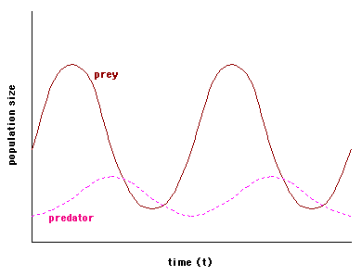
Linking Equations
Victim, V:
dV/dt = b_{v}V - d_{v}V - aVP
Predator, P:
dP/dt = acVP - d_{p}P
These are our linked predator-prey models!
Equivalent to
Lotka-Volterra models
Yield characteristic
predator-prey dynamics

Slide 16
Implications & Assumptions
Victim, V:
dV/dt = b_{v}V - d_{v}V - aVP
Predator, P:
dP/dt = acVP - d_{p}P
Let's look at the assumptions we have made
(simple model →many assumptions):
Assumption 1: The predator population cannot exist if there are no prey
i.e., if V = 0, the predator declines to extinction
at a rate given by it’s death rate (d_{p})
What situations could this represent?
The predator is a specialist
V represents all prey species of this predator
(V = abundance of all potential prey)
Specialist predator

Slide 17
Implications & Assumptions
Victim, V:
dV/dt = b_{v}V - d_{v}V - aVP
Predator, P:
dP/dt = acVP - d_{p}P
Assumption 2: In the absence of the predator, the prey grow exponentially
Growth happens at a constant per capita rate given by b_{v} - d_{v}
i.e., no density dependence of prey
Remember from before: r = b – d
We can rearrange b_{v}V – d_{v}V
to V(b_{v} – d_{v})
and substitute r = b_{v}-d_{v}
to get rV
Without predation, P = 0, so aVP = 0
Which together make
dV/dt = b_{v}V - d_{v}V - aVP
reduce to:
dV/dt = rV
→ Exponential prey growth

Slide 18
Implications & Assumptions
Victim, V:
dV/dt = b_{v}V - d_{v}V - aVP
Predator, P:
dP/dt = acVP - d_{p}P
Assumption 3: Predators encounter prey randomly (“well-mixed” environment)
Mathematically, we represent the random encounter by multiplying V and P
(as done in the aVP term for prey and acVP for predators)
Random encounter is based on the rule for probability of independent events
We assume the distributions of predators and prey are independent of each other
i.e., prey do not have a refuge from predation (no spatial structure)
predators do not aggregate to areas with higher prey

Slide 19
Implications & Assumptions
Victim, V:
dV/dt = b_{v}V - d_{v}V - aVP
Predator, P:
dP/dt = acVP - d_{p}P
Assumption 4: Predators are insatiable
i.e., predators consume the same proportion of the prey population (a)
no matter how many prey there are
Relationship between predator feeding rate
(# of prey consumed per unit time by a single predator, aV)
and prey density is a linear functional response (Type I)
high
aV
low
0
V
many

Slide 20
Implications & Assumptions
Victim, V:
dV/dt = b_{v}V - d_{v}V - aVP
Predator, P:
dP/dt = acVP - d_{p}P
Assumption 5: No age / stage structure
Assumption 6: Predators do not interact with each other…
… other than by consuming the same resource
i.e., no aggression, no territoriality
What type of density dependence do these predators have?
→ scramble predators
That’s it for the assumptions!
→ Next class we will relax three of these assumptions

Slide 21
Predator-Prey Dynamics
Victim, V:
dV/dt = b_{v}V - d_{v}V - aVP
Predator, P:
dP/dt = acVP - d_{p}P
An important aspect of these equations:
Equations express rate of change in predators and prey…
… not abundance of predators and prey at particular times
To compare to previous equations,
Our predator-prey equations are like: dN/dt = bN – dN
NOT N_{t} = N₀e^{rt}
Remember how we derived N_{t} = N₀e^{rt}
from dN/dt = bN – dN ? ….

Slide 22
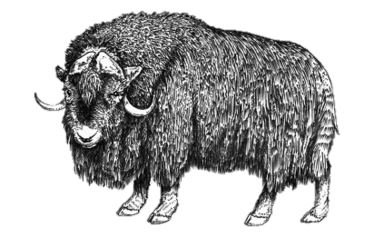
Forecasting Population Growth
dN
dN
dN
1
= r N
= r dt
= r dt
dN = r dt
dt
N
N
N
1
t
Apply general rules:
dx = ln x
and:
dx = x
with:
x
0
ln N_{t} - ln N₀ = r(t_{t} - t₀)
ln N_{t} - ln N₀ = rt
ln N_{t} = ln N₀ + rt
Raise each side to the e power
ln N_{t}
ln N₀ + rt
ln N_{t}
ln N₀
rt
e
e
e
e
e
=
=
*
ln (x)
x
e
Apply general rule:
=
N_{t} = N₀ e^{rt}
Where e = 2.718…

Slide 23
Predator-Prey Dynamics
Victim, V:
dV/dt = b_{v}V - d_{v}V - aVP
Predator, P:
dP/dt = acVP - d_{p}P
The predator-prey equations are solvable with calculus (integration)
i.e., can obtain equations to forecast V_{t} and P_{t} at any time
…but the math is pretty ridiculous
We’ll rely on our simulation software (Stella) to examine V_{t} and P_{t}
BUT, without simulating, we can learn something general about how
predators and prey interact by “solving equations at equilibrium”
i.e., we can derive equations that tell us the abundance of predators and prey at steady-state (i.e., abundance not changing through time)

Slide 24
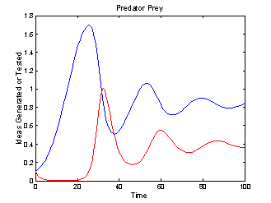
Equilibrium Solutions
Victim, V:
dV/dt = b_{v}V - d_{v}V - aVP
Predator, P:
dP/dt = acVP - d_{p}P
Steady-state
Abundance (thousands)
Prey
Predator
Time

Slide 25
Equilibrium Solutions
Victim, V:
dV/dt = b_{v}V - d_{v}V - aVP
Predator, P:
dP/dt = acVP - d_{p}P
Let’s solve the equations at steady-state
You’ll need to do this in lab, so watch carefully!
What do dV/dt and dP/dt equal at steady-state?
→ dV/dt and dP/dt = 0 at steady-state! (abundance does not change)
To solve at steady state, set both equations equal to zero:
Victim eqn:
0 = b_{v}V - d_{v}V - aVP
Predator eqn:
0 = acVP - d_{p}P
To denote that we are solving for V and P abundance at equilibrium,
we’ll use V* and P*

Slide 26
Equilibrium Solutions
Victim, V:
dV/dt = b_{v}V - d_{v}V - aVP
Predator, P:
dP/dt = acVP - d_{p}P
Let’s solve the equations at steady-state
You’ll need to do this in lab, so watch carefully!
What do dV/dt and dP/dt equal at steady-state?
→ dV/dt and dP/dt = 0 at steady-state! (abundance does not change)
To solve at steady state, set both equations equal to zero:
Victim eqn:
0 = b_{v}V* - d_{v}V*- aV*P*
Predator eqn:
0 = acV*P* - d_{p}P*
To denote that we are solving for V and P abundance at equilibrium,
we’ll use V* and P*

Slide 27
Equilibrium Solutions
Victim, V:
dV/dt = b_{v}V - d_{v}V - aVP
Predator, P:
dP/dt = acVP - d_{p}P
Solution for prey equation:
0 = b_{v}V* - d_{v}V*- aV*P*
Key question: What are we solving for?
i.e., what variable (V* or P*) are we trying to isolate?
→ We use the prey equation to solve for predator abundance, P*!
Why?
Think of solving for factors that determine predator and prey abundance
i.e., growth of prey determines predator equilibrium abundance
So we solve prey equation for predator equilibrium
i.e., predation determines prey equilibrium abundance
→ So we solve predator equation for prey equilibrium

Slide 28
Equilibrium Solutions
Victim, V:
dV/dt = b_{v}V - d_{v}V - aVP
Predator, P:
dP/dt = acVP - d_{p}P
Solution for prey equation:
0 = b_{v}V* - d_{v}V*- aV*P*
Solving for P*
aV*P* = b_{v}V* - d_{v}V*
aV*P* = b_{v}V* - d_{v}V*
aV*
aV*
b_{v} - d_{v}
P* =
a

Slide 29
Equilibrium Solutions
Victim, V:
dV/dt = b_{v}V - d_{v}V - aVP
Predator, P:
dP/dt = acVP - d_{p}P
Solution for prey equation:
Solution for predator equation:
0 = b_{v}V* - d_{v}V*- aV*P*
0 = acV*P* - d_{p}P*
Solving for P*
Solving for V*
aV*P* = b_{v}V* - d_{v}V*
See practice problems!
aV*P* = b_{v}V* - d_{v}V*
aV*
aV*
d_{p}
V* =
ac
b_{v} - d_{v}
P* =
a

Slide 30
Equilibrium Solutions
Victim, V:
dV/dt = b_{v}V - d_{v}V - aVP
Predator, P:
dP/dt = acVP - d_{p}P
d_{p}
Equilibrium predator
abundance
b_{v} - d_{v}
Equilibrium prey abundance
V* =
P* =
ac
a
These equations make some surprising predictions!
Prey abundance at equilibrium (V*) is independent of prey birth rate (b_{v}) and non-predatory death rate (d_{v})
Predator abundance at equilibrium (P*) is independent of predator death rate (d_{p})

Slide 31
Equilibrium Solutions
Victim, V:
dV/dt = b_{v}V - d_{v}V - aVP
Predator, P:
dP/dt = acVP - d_{p}P
d_{p}
Equilibrium predator
abundance
b_{v} - d_{v}
Equilibrium prey abundance
V* =
P* =
ac
a
These equations make some surprising predictions!
Prey abundance is an inverse function of predator attack rate (a)
Predator abundance is an inverse function of its attack rate (a)
i.e., the greater the mortality inflicted by individual predators,
the fewer predators AND prey there can be at equilibrium
→ higher a = lower V*, P*

Slide 32
Equilibrium Solutions
Victim, V:
dV/dt = b_{v}V - d_{v}V - aVP
Predator, P:
dP/dt = acVP - d_{p}P
d_{p}
Equilibrium predator
abundance
b_{v} - d_{v}
Equilibrium prey abundance
V* =
P* =
ac
a
These equations make some surprising predictions!
Prey abundance increases as predator’s death rate (d_{p}) increases
Predator abundance is a function of prey net growth rate (b_{v} - d_{v})
The more productive the prey,
the more predators there can be
Births
Deaths
Predator
acV
d_{p}
Increased predator death requires more input to sustain predator stock
→a and c are constants, so V has to increase
…we will come back to this when we talk about competition

Slide 33
Equilibrium Solutions
Victim, V:
dV/dt = b_{v}V - d_{v}V - aVP
Predator, P:
dP/dt = acVP - d_{p}P
d_{p}
Equilibrium predator
abundance
b_{v} - d_{v}
Equilibrium prey abundance
V* =
P* =
ac
a
These equations make some surprising predictions!
Many of these predictions are pretty surprising!
One reason models are useful
→ Models help us find non-intuitive results!

Slide 34
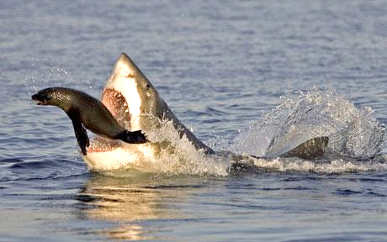
Looking Ahead
Next Class:
Relax predator-prey assumptions
i.e., add realism

