Slide 1
FW364 Ecological Problem Solving
Class 8: Population Variation
September 25, 2013

Slide 2
Up-coming Exam
First Exam: One week from Wednesday (on October 2)
Review session in next lab
Practice exam will be posted on the website
We will go over practice exam in review session
Test will cover material taught this week, but not Monday next week
Topics covered will be:
Mass balance
Quantitative tools (general lecture)
Population growth
Can use your calculator on exam

Slide 3
Up-coming Exam
Study tips
Do the practice exam!
Look through my PowerPoint presentations on the website
Look through activities you have done in lab
Practice writing all equations from memory—you will have a sheet of equations, but you will have to choose which to use and how to rearrange things.
Practice deriving equations
Useful if you forget an equation on the exam
Good practice for really understanding the equations
Remember to study units for equations

Slide 4
Outline for Today
New focus: Making population growth models more realistic
Previous classes: We worked with deterministic models
Today: Introduce stochastic models
Objective for Today:
Introduce the concept of stochastic variation
Discuss demographic stochasticity
Objective for Next Monday:
Discuss environmental stochasticity
Text (optional reading):
Chapter 2

Slide 5
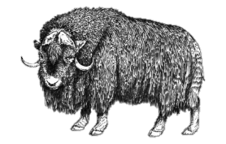
Deterministic Models
So far we have worked with deterministic models
Our calculations of future population size (N_{t}) were made without error
(“error” as in variation / statistics, not mistakes)
N₀ = 511 muskox
λ = 1.15
t = 10 years
Calculated EXACTLY:
N_{t} = N₀ λ^{t}
N_{t} = 2,067 muskox
Do we really expect exactly 2,067 muskox in 10 years?
Probably not…
Ecology may make us think 2,067 muskox is too many for Nunivak Island
e.g., perhaps carrying capacity is reached below 2,067 individuals
Intuition tells us predictions are typically not perfect
e.g., perhaps an important environmental change might occur

Slide 6
Deterministic Models
So far we have worked with deterministic models
Our calculations of future population size (N_{t}) were made without error
(“error” as in variation / statistics, not mistakes)
N₀ = 511 muskox
λ = 1.15
t = 10 years
Calculated EXACTLY:
N_{t} = N₀ λ^{t}
N_{t} = 2,067 muskox
Do we really expect exactly 2,067 muskox in 10 years?
Deterministic models make predictions without error (no uncertainty)
i.e., we calculate a single value for each time
We expect deterministic models to deviate from reality
(although are still useful tools)

Slide 7
Variation
To be more realistic, we can build variation into models
I.e., we can take deterministic equations, such as:
N_{t+1} = N_{t} λ
N_{t} = N₀ λ^{t}
and add in variation by:
including new factors (parameters) that explain (account for) variation
OR
allowing the value of current parameters to fluctuate
e.g., instead of λ = 1.15 , we use 1.14 < λ < 1.16
Two types of variation:
Deterministic variation
Stochastic variation

Slide 8
Deterministic Variation
Deterministic variation is variation we can identify or predict:
Has a known cause
Can be incorporated in a model
Diurnal variation
Seasonal variation
Density dependence
General strategy for incorporating deterministic variation:
Add factors (parameters) to model that describe variation
e.g., λ = f(density)
We’ll see examples later when covering density-dependence

Slide 9
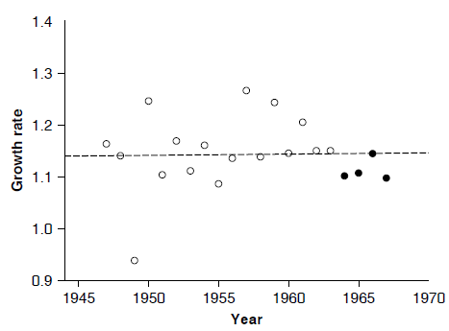
Stochastic Variation
Stochastic variation is variation we cannot predict, either because:
We do not understand the cause of variation (in the parameter)
We simply cannot predict the exact value (of parameter) in the future
(talking about variation that affects the parameters in our models)
Example: Variation in λ
λ fluctuated,
but showed no trend over time
λ
Why did λ fluctuate?
Likely some aspect of the environment that we cannot predict, e.g., the weather
Fig 1.4
Goal: Incorporate uncertainty about parameters into population models

Slide 10
Stochastic Variation
There is always some unexplained variation in natural ecological systems
Can include this “randomness” (stochasticity)
into population growth models
Change in perspective:
We are no longer only interested in predicting future population size
also interested in predicting probabilities of how the population
will behave in the future
I.e., Will no longer say the population will be, e.g., 2,067 muskox in the future
Instead, we describe the chances of the future population being 2,067 muskox
Could also describe the chances the population will go extinct or explode

Slide 11
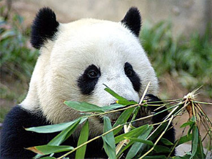
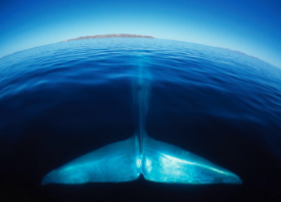
Stochastic Variation
Example: Conservation of rare species
Important question:
Given a species that is rare, what are the chances
that the population will go extinct in the future?
With perfect knowledge (not possible) about the population and its environment, we could just plug in values for λ (or r) into a deterministic model if λ > 1, then ?
if λ < 1, then ?

Slide 12
Stochastic Variation
Example: Conservation of rare species
Important question:
Given a species that is rare, what are the chances
that the population will go extinct in the future?
With perfect knowledge (not possible) about the population and its environment, we could just plug in values for λ (or r) into a deterministic model if λ > 1, then population will not go extinct deterministically
if λ < 1, then population will go extinct deterministically
Without perfect knowledge (realistic), we determine the risks of extinction
In reality, could a population with an average λ > 1 go extinct?

Slide 13
Stochastic Variation
Example: Conservation of rare species
Important question:
Given a species that is rare, what are the chances
that the population will go extinct in the future?
New goal is to answer questions like:
What is the “worst-case” scenario?
What is the risk of extinction if we:
do nothing (text calls this “background risk”)?
protect the species in some way (e.g., habitat preservation)?
actively manage (e.g., try to increase birth rates)?
(not just questions about exact population size in future)
These management scenarios can be evaluated with stochastic models

Slide 14
Stochastic Variation
Example: Conservation of rare species
Important question:
Given a species that is rare, what are the chances
that the population will go extinct in the future?
Main Point:
We never have perfect knowledge about natural populations, so we need stochastic versions of population growth models
i.e., need models that include outcomes that can occur due to chance in real life
Using those models, we can obtain some knowledge about the
risks of “bad things” happening

Slide 15
Stochastic Variation
Two types of stochastic variation that we can include in models:
Demographic stochasticity
Environmental stochasticity
Demographic stochasticity:
Variation in the average chances of survivorship and reproduction that occurs because a population is made up of a finite, integer number of individuals, each with different characteristics
Environmental stochasticity:
Unpredictable change in the environment in time and space
e.g., years of unusually low snowfall
Notes:
Working with individuals has certain mathematical consequences

Slide 16
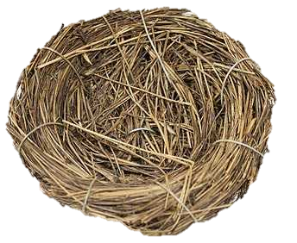
Demographic Stochasticity
Results from the fact that populations are made up of individuals
Individuals vary:
There is an average per capita birth rate (average for population), but individuals vary in how many offspring they produce
Among individuals:
(within Year 1)
Mom 1
Mom 2
Mom 3
Within an individual:
(Mom 2 across years)
Year 1
Year 2
Year 3

Slide 17
Demographic Stochasticity
Results from the fact that populations are made up of individuals
Cannot directly apply average proportional rates to an individual:
e.g., cannot apply b’ = 1.5 and d’ = 0.20 to an individual
because individuals cannot reproduce or die in proportions:
an individual can have 1 or 2 offspring; it cannot produce 1.5 offspring
an individual either dies or not; it cannot be 20% dead
→ The models we've used so far rely on population averages (less realistic)
and, therefore, ignore variation among individuals

Slide 18
Demographic Stochasticity
Results from the fact that populations are made up of individuals
Example:
31 muskox in 1936, with λ = 1.15
N₁₉₃₇ = N₁₉₃₆ λ
N₁₉₃₇ = 31 * 1.15
N₁₉₃₇ = 35.7 muskox
Likely the population will grow by 4 or 5 muskox, but not 4.7 muskox
Effect of individuals can cascade throughout time trajectory!

Slide 19
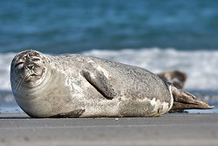
Demographic Stochasticity Game
Let’s illustrate with a game!
You are all (female) harbor seals
Population reproduces annually
Moms typically only have one pup

Slide 20
Demographic Stochasticity Game
Rules:
Three small populations, each starting with 3 individuals (N₀)
Need 1 census taker (recorder), too
All three population are identical: same b’, d’, and N₀
During each time step, each individual rolls die to see if lives, lives and reproduces, or dies (pass die around)
Roll 1 or 2: Live and reproduce (grab someone from group)
Roll 6: Die ☹ (sit down)
Roll 3, 4, or 5: Live to next time step (stay standing)
After all individuals have rolled, census taker counts population size (N_{t}) and records on paper
I will keep time; we will go for 10 time steps

Slide 21
Demographic Stochasticity Game
Post-Game Explanation:
Rolling the die is a randomization technique:
on average (mean of many rolls), there is a 1/6 chance for any number
Two numbers for "reproduce" make the long term average birth rate
(b’) 2/6 = 0.333
One number for “dying” makes the long term average death rate
(d’) 1/6 = 0.167
Net growth rate (λ) is:
λ = 1 + b’ + d’ = 1 + 0.333 - 0.167 = 1.167
Let’s looks at data in Excel

Slide 22
Demographic Stochasticity Game
Post-Game Explanation:
Birth (b’) and death (d’) rates are probabilities
All three stochastic populations had the same vital rates (probabilities
of reproducing or dying, b’ and d’) and starting size (N₀ = 3)
In large populations, the actual (realized) rates will be nearly the same as the probabilities
But in small populations, the actual (realized) rates may vary substantially from the average due to chance (lucky or unlucky populations)

Slide 23
Demographic Stochasticity
How do we actually model demographic stochasticity?
→ Can use computer simulations
Individual:
yes
yes
survive?
reproduce?
no
no
stop
stop
Simulate what happens to one individual:
Does this individual survive or not? [ random number draw ]
If yes, does the individual reproduce? [ random number draw ]

Slide 24
Demographic Stochasticity
How do we actually model demographic stochasticity?
→ Can use computer simulations
Population:
# surviving
new population size
yes
yes
survive?
reproduce?
sum
no
no
stop
stop
# born
Simulate what happens to one individual:
Does this individual survive or not? [ random number draw ]
If yes, does the individual reproduce? [ random number draw ]
Simulate what happens to population:
Do above for every individual in population
Add up the total survivors plus offspring to get pop size next time step
Repeat for whole population over multiple time steps (desired duration)

Slide 25
Demographic Stochasticity
How do we actually model demographic stochasticity?
→ Can use computer simulations
Population:
new population size
yes
yes
survive?
reproduce?
sum
no
no
stop
stop
Next: REPEAT entire process
Use same parameter values (b’, d’, λ) and starting densities (N₀)
Each outcome will be different because of the randomization at each step
Each repeat is called a “trial” or “replicate” run of the model
Calculate the mean final population size among all trials
Calculate variance (σ²) of mean final population size among trials

Slide 26
Demographic Stochasticity
How do we actually model demographic stochasticity?
→ Can use computer simulations
Population:
new population size
yes
yes
survive?
reproduce?
sum
no
no
stop
stop
Next: REPEAT entire process
We expect the mean final population size of stochastic simulations
to be close to prediction of deterministic model
(assuming many trials were run)
This is an important check to perform on a stochastic simulation:
If mean of simulation is far off, then need to de-bug model

Slide 27
Demographic Stochasticity
How do we actually model demographic stochasticity?
→ Can use computer simulations
Population:
new population size
yes
yes
survive?
reproduce?
sum
no
no
stop
stop
Note: this is different process from the Blue Whale Lab
In lab 3, we ran a deterministic simulation model several times in Excel
These were not replicate trials; were runs of the model under different circumstances (harvest)… the starting parameters were different

Slide 28
Demographic Stochasticity
How do we actually model demographic stochasticity?
→ Can use computer simulations
Population:
new population size
yes
yes
survive?
reproduce?
sum
no
no
stop
stop
Note: this is different process from the Blue Whale Lab
If we ran multiple trials of a deterministic model using
the same parameter values and starting densities,
we would get the same answer every time

Slide 29
Looking Ahead
Next Class:
Introduce risk curves
Delve into environmental stochasticity

