Slide 1
FW364 Ecological Problem Solving
Lab 3: Blue Whales Population Growth

Slide 2
Log onto computers please
Download files from http://saraparrsyswerda.weebly.com/fw364-ecological-problem-solving.html

Slide 3
Computer Lob Logistics
Feel free to use your own laptops instead of lab computers
To save files using lab computers:
Portable drive (thumbdrive, external hard drive)
P: drive…. But make a backup in case P: drive not accessible

Slide 4
Outline for Today
Do a case study together of human population growth to:
Introduce spreadsheet modeling
Illustrate how λ can be obtained using linear regression
Show how to forecast population size using spreadsheets
Exercise 3: Case study of blue whale population growth to:
Practice spreadsheet modeling
Practice forecasting population size using spreadsheets
Learn about absolute vs. proportional gains and losses
→ You do not need to get λ through linear regression
Important note: Going to use only DISCRETE equations

Slide 5
Case Study
Case Study: Human Population Growth
We will:
Forecast human population size
using data from 1800-1995 (given in textbook)
Objectives:
Introduce spreadsheet modeling
Illustrate how λ can be obtained using linear regression
Show how to forecast population size using spreadsheets

Slide 6
Case Study
To forecast human population growth, we need λ
N_{t} = N₀ λ^{t}
Two methods:
Calculate geometric mean (book uses this way)
Use linear regression (book does not address this approach)

Slide 7
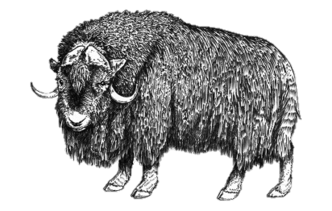
λ Determination – Linear Regression
Method : Linear Regression
See Excel file on course website
“Muskox Linear Regression.xlsx”
Year | Year | N_{t} | log N_{t}
1948 | 1 | 57 | 1.756
1949 | 2 | 65 | 1.813
1950 | 3 | 61 | 1.786
1951 | 4 | 76 | 1.883
1952 | 5 | 84 | 1.924
1953 | 6 | 98 | 1.992
1954 | 7 | 109 | 2.038
1955 | 8 | 127 | 2.102
1956 | 9 | 138 | 2.140
1957 | 10 | 157 | 2.197
1958 | 11 | 200 | 2.300
1959 | 12 | 228 | 2.357
1960 | 13 | 282 | 2.451
1961 | 14 | 322 | 2.508
1962 | 15 | 386 | 2.587
1963 | 16 | 444 | 2.647
1964 | 17 | 511 | 2.708
Equation and R² obtained by adding a trendline
Slope = 0.062 = log λ
λ = 10 ^{0.062} = 1.15
log base 10: log₁₀
R² indicates good fit

Slide 8
Case Study
To forecast human population growth, we need λ
N_{t} = N₀ λ^{t}
Today: we’ll do an example for human population growth
Over to Excel – Open: Human Population Growth.xlsx

Slide 9
λ Determination – Linear Regression
Start with equation for forecasting population growth:
N_{t} = N₀ λ^{t}
Take the natural log of both sides:
ln (N_{t}) = ln (N₀ λ^{t})
ln (N_{t}) = ln (N₀) + ln (λ^{t})
ln N_{t} = ln N₀ + t ln λ
Intercept
Slope
Linear equation between ln N_{t} and t, with:
Slope ln λ
Intercept ln N₀

Slide 10
λ Determination – Linear Regression
Start with equation for forecasting population growth:
N_{t} = N₀ λ^{t}
Take the natural log of both sides:
ln (N_{t}) = ln (N₀ λ^{t})
ln (N_{t}) = ln (N₀) + ln (λ^{t})
ln N_{t} = ln N₀ + t ln λ
Intercept
Slope
Can determine slope with linear regression
Slope = ln λ
λ = e^{slope}
Back to Excel!

Slide 11
Forecasting Population Growth
Two ways to forecast population growth:
N_{t+1} = N_{t} λ
N_{t} = N₀ λ^{t}
For consecutive years
For any year
Can use spreadsheet models to forecast farther into future
Just calculated λ in Excel
Remember: λ = 1 + b’ - d’
Actual birth and death rates are:
b’ = 0.030
d’ = 0.011
Back to Excel!

Slide 12
Forecasting Population Growth
What if we wanted to forecast population size for a particular country?
We’d want to also consider immigration and emigration
N_{t+1} = N_{t} (1 + b’ – d’ – e’) + I
Immigration, I, is an absolute gain
Emigration rate, e’N_{t}, is a proportional loss
For Lab Exercise: working with absolute and proportional losses due to blue whale harvest

Slide 13
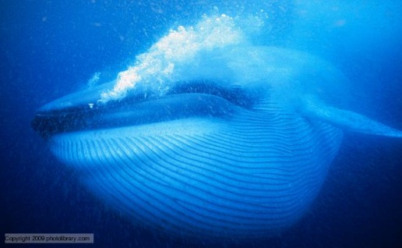
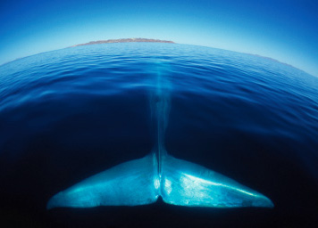
Blue Whales Case Study
Example of geometric population decline
1900s: Unsustainable harvest of blue whales
1946: International Whaling Commission created to set limits to total Antarctic whale catch
1953: Shorter open season for blue whales introduced, but…
…management still failed because harvest quota was fixed and the population birth rate was not high enough to replace harvested individuals
1963: Appropriate harvest reductions implemented
Currently: Endangered conservation status
Notes:
Blue whale video

Slide 14
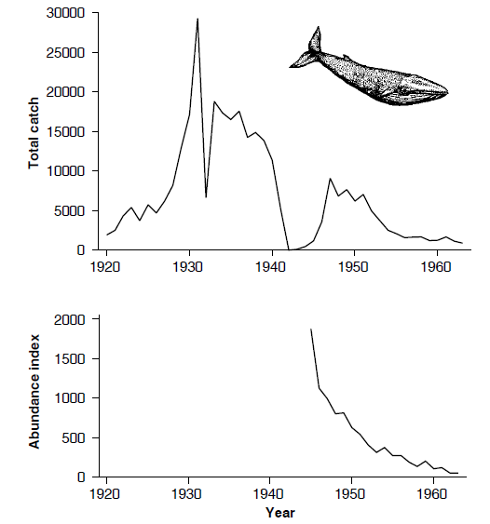
Blue Whales Case Study
Example of geometric population decline
1900s: Unsustainable harvest of blue whales
Appropriate
harvest reductions
WWII
# whales / catcher-ton-day
Looks like geometric decline
Fig. 1.8

Slide 15
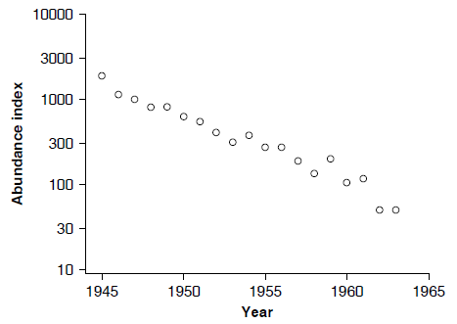
Blue Whales Case Study
Example of geometric population decline
1900s: Unsustainable harvest of blue whales
Note: log scale
Fig. 1.9
Straight line when plotted on a log-scale
→ Indicative of geometric decline

Slide 16
Blue Whales Case Study
Example of geometric population decline
1900s: Unsustainable harvest of blue whales
Population Sizes
1930s: 20-50,000 individuals
1965-1975: 14,000 individuals
Today’s Lab
Investigate population recovery
with sustainable harvest
Fig. 1.9
Straight line when plotted on a log-scale
→ Indicative of exponential decline

Slide 17
Exercise 3
Part 1: Answer Exercise 1.1 from textbook
Question: How long will it take the blue whale population to increase from 10,000 to 50,000 individuals (in the absence of harvest)?
Remember: R in textbook is equivalent to λ
Approach this similar to a doubling time problem,
except the goal population size is more than double

Slide 18
Exercise 3
Part 2a: Investigate of the effect of an absolute harvest rate on population size
Estimate the number of years it will take the blue whale population to increase from 10,000 to 50,000 whales using a series of absolute harvests (constant number) between 0 and 600 whales per year (e.g., 0, 100, 200, etc.)
Determine the maximum sustainable harvest level
(i.e., harvest amount that causes no population change)
Plot the relationship between harvest level and number of years to reach 50,000 whales
Plot the trend in population size over time for the next harvest level above the maximum sustainable
For report: Comment on the shape of both plots

Slide 19
Exercise 3
Part 2b: Investigate of the effect of a proportional harvest rate on population size
Estimate the number of years it will take the blue whale population to increase from 10,000 to 50,000 whales using a series of proportional harvests starting at 0.5% per year (e.g., 0.5%, 1.0%, 1.5%, etc.) and ending at the maximum sustainable harvest
You do not need Excel (i.e., a spreadsheet model) for this part!

Slide 20
Exercise 3
General Comments
Use discrete population growth models for all parts
For reports:
Remember axis labels on figures; don’t add trend lines
Don’t forget to think about the assumptions you are making…
→ Important assumption about natural death and harvest

