Slide 1
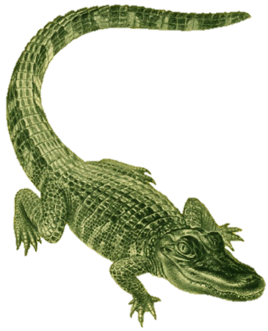
FW364 Ecological Problem Solving
Predation Lab
[Stella Lab]

Slide 2
Log onto computers please
Download files from http://saraparrsyswerda.weebly.com/fw364-ecological-problem-solving.html
Start Stella 9
[Start, All Programs, Course Software, Stella 9]

Slide 3
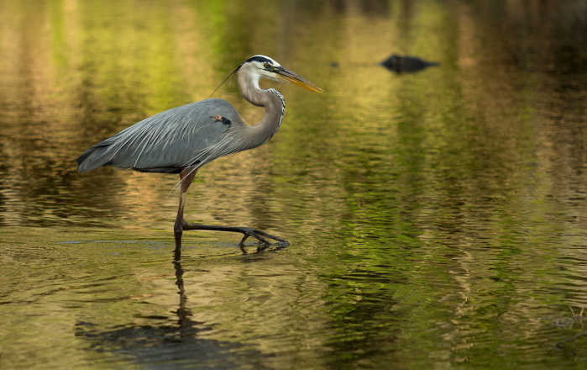
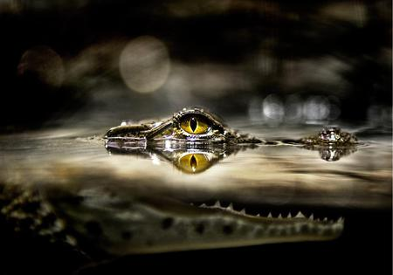
Outline for Today
Introduction: Modeling in Stella
Explanation of how to model in Stella – FOLLOW ALONG!!
Build models of increasing complexity up to model used in lab
Lab 9: Predator-prey dynamic interactions
Solve predator-prey equations at equilibrium and determine how steady state abundances change with prey carrying capacity (Excel)
Investigate dynamic interactions of predators and prey (Stella)

Slide 4
Modeling in Stella
Stella: Systems approach to modeling
→ In Stella, we build the models ourselves (from scratch)
→ Stella is powerful software, but has a steep learning curve
Stella Process: Create visual models – make box & arrow
(stock & flow) diagram of the model:
dV/dt = b_{v}V - d_{v}V
Exponential growth of prey

Slide 5
Modeling in Stella
Then add equations and parameters (constants) that
specify the model:
In the Prey births inflow, can specify equation for births:
= Prey birth rate * Prey stock i.e., = b_{v}*V
For prey birth rate, can specify constant prey birth rate (b_{v})
In next model, we’ll build in a function ( b_{v} = b_{max} (1 – V/K) )

Slide 6
In-Class Exercise
In-class activity:
Build a series of models one step at a time
Goal: build a model of coupled predator-prey interaction, with:
scramble density dependence of prey
contest density dependence of predators
→ This will be the model you use for Lab 9
All models will be deterministic
Be sure to save each model as we go (save to P-drive)
Progression of models will be as follows…

Slide 7
PredModel1
dV/dt = b_{v}V - d_{v}V
(prey exponential growth, no predators)

Slide 8
PredModel2
dV/dt = b_{max}(1 - V/K)V - d_{v}V
(prey logistic growth / density dependence, no predators)

Slide 9
PredModel3
dV/dt = b_{max}(1 - V/K)V - d_{v}V- aVP
(PredModel2 with predation included)
dP/dt = acVP - d_{p}P
(adding predation with scramble predators)

Slide 10
PredModel4
dV/dt = b_{max}(1 - V/K)V - d_{v}V- aVP
dP/dt = acVP - d_{p}P
PredModel 3 WITH PREDATOR CEILING
This is model for Lab 9, Part B

Slide 11
Let’s try this out!
Over to Stella

Slide 12
Lab 9: Predation
Goal: Examine how scramble and contest predators affect prey dynamics
Part A: Solve predator-prey equations at equilibrium and determine how steady state abundances change with prey carrying capacity (Excel)
Part B: Investigate dynamics of predators and prey (Stella):
- With different predator types (scramble vs. contest)
- At different prey carrying capacities

Slide 13
Part A: Solving for Equilibrium
Solving these equations for P* and V*
$${dV}/{dt}=b_{max}\left(1−\frac{V}{K}\right)V−d_{v}V−aVP$$
$${dP}/{dt}=acVP−d_{p}P$$
Trick to doing this!!
Solve predator equation for V* first
Solve prey equation for P* second
→ You’ll find that V* is part of the solution for P*…
… can substitute solution for V* into equation for P*
Using solutions, calculate V* and P* for range of prey K (20-180)
See excel sheet for setup

Slide 14
Part B: Stella Simulations
Running Stella simulations:
With predators (scramble and contest)
Without predators
With range of prey K (20-180)
Setting predator density dependence through a predator ceiling
Ceiling = 100 simulates scramble predator
Ceiling = 5 simulates contest predator
Set predator stock = 0 to simulate predator absence
Running 27 simulations
(9 with scramble predator; 9 with contest predator; 9 w/o predator)

Slide 15
Part B: Stella Simulations
Recording V* and P* for each simulation
Also need to pay attention to dynamics!
Remember from class…
smooth approach
damped oscillation
stable limit cycle
V
We’ll see this in Lab 9
Time

Slide 16
General Comments
Stella Modeling Notes website, if needed
Read lab instructions when working through Stella!!!!
YOU CAN WORK IN GROUPS and divide work ☺
Report: turn in excel file on or before Dec. 3
Assumptions:
Think about the structure of the model

Slide 17
PredModel2
dV/dt = b_{v}V - d_{v}V
let b_{v} = b_{max}(1 - V/K)
dV/dt = b_{max}(1 - V/K)V - d_{v}V
(prey logistic growth, no predators)

