Slide 1
How to not give a presenation
Bradley J Swanson
Notes:
Mistakes
Spelling
Split infinitive

Slide 2
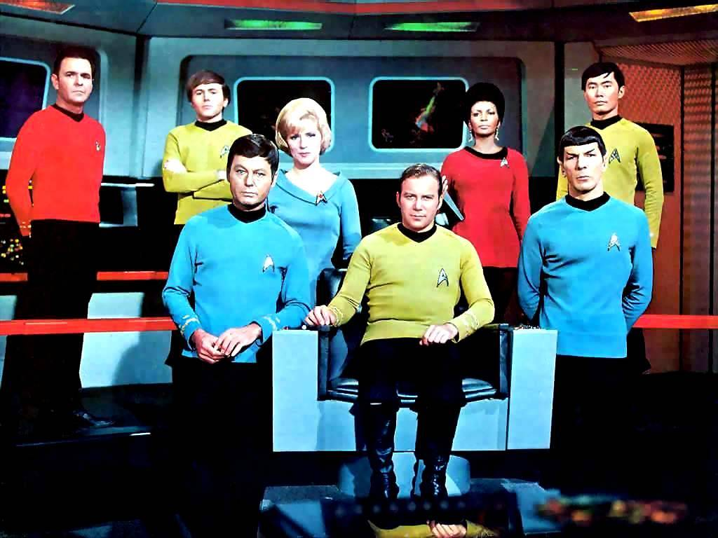
How to not give a presenation
Bradley J Swanson
Notes:
Mistakes
Spelling
Split infinitive – Thus the star trek image
No address or how to contact the author

Slide 3

How to not give a presenation
Bradley J Swanson
Notes:
Mistakes
Spelling
Split infinitive
No address or how to contact the author

Slide 4
Outline
Introduction
Methods
Results
Discussion
Notes:
Everyone knows that these are the parts of talk

Slide 5
Outline
Introduction = What others have done
Objects = What I intend to do
Methods = How I did it
Results = What I found
Discussion = What it means relative to the first two.
Notes:
Everyone knows that these are the parts of talk

Slide 6
Introduction
Giving a talk is an important method for conveying your information to other scientists because what you have to say is very important and earth-shattering. Everyone should be very excited about your work so you need to make sure that you convey all of the information that has every been learned about your subject and how smart you are so that everyone will trust you implicitly. Such as important things like how many angels can dance on the head of a pin, or if a tree falls in the forest with nobody around does it make a sound, or what is the sound of one hand clapping, or most interesting, what came first the chicken or the egg? Well, the ultimate example is not really a very good one because we all ready know the answer to that one don’t we? Now in dramatic contrast, the penultimate question is obviously a much more interesting philosophical question, although, when one actually knows the definition of the word clapping, it readily becomes an antinomy because clapping is defined in Webster’s dictionary as “brining one’s hands together to make a sound”, which self-evidently precludes the eventuality of clapping with only on hand. Similarly, a simple basic barebones background in physics elucidates the obvious implication that any thing traversing a great distance, as compiled by the laws of gravitational attraction requisitely will have some of its kinetic energy transmogrified into sound waves, which by definition indicates that sound is a by-product of the after affect of the large piece of secondary xylem plummeting to the Earths Surface.
Notes:
Too many words.
Too many “big” words.
Mistakes in word usage that Powerpoint didn’t catch because they are spelled correctly

Slide 7
Introduction
Giving a talk is an important method for conveying your information to other scientists because what you have to say is very important and earth-shattering. Everyone should be very excited about your work so you need to make sure that you convey all of the information that has every been learned about your subject and how smart you are so that everyone will trust you implicitly. Such as important things like how many angles can dance on the head of a pin, or if a tree falls in the forest with nobody around does it make a sound, or what is the sound of one hand clapping, or most interesting, what came first the chicken or the egg? Well, the ultimate example is not really a very good one because we all ready know the answer to that one don’t we? A simple basic barebones background in physics elucidates the obvious implication that any thing traversing a great distance, as compiled by the laws of gravitational attraction requisitely will have some of its kinetic energy transmogrified into sound waves, which by definition indicates that sound is a by-product of the after affect of the large piece of secondary xylem plummeting to the Earths Surface. Now in dramatic contrast, the penultimate question is obviously a much more interesting philosophical question, although, when one actually knows the definition of the word clapping, it readily becomes an antinomy because clapping is defined in Webster’s dictionary as “brining one’s hands together to make a sound”, which self-evidently precludes the eventuality of clapping with only on hand.
Notes:
Too many words.
Too many “big” words.
Mistakes in word usage that Powerpoint didn’t catch because they are spelled correctly

Slide 8
Use lots of words
A good presentation has significantly more words per slide in it than a bad presetion
Notes:
Misspelling
3-D when not needed
Title and legend – neither are needed
Y-axis label missing.

Slide 9
Material and Methods
In order to find out what makes a good presentation I used the following things
  Desk and Chair
  Computer
  Internet
  Library
  Search engine
  My stupendous intellect
Notes:
You never need a list of materials either in a presentation or a paper. It will all come out during your exposition.

Slide 10
Material and Methods
I sat down at my desk and used the search engine Google to try find lots of different information about what makes a good and bad presentation
I search using the following term
  Good presentation
  Bad presentation
I then tallied up the results and put them in Microsoft Excel.
I then used a statistical test to determine which items were found most often in each type of list
The statistical test I used was a t-test.
Notes:
Try not to make it sound like a cook book
Tenses are wrong
Passive voice vs. active voice

Slide 11
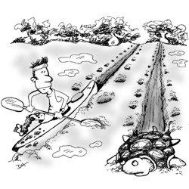
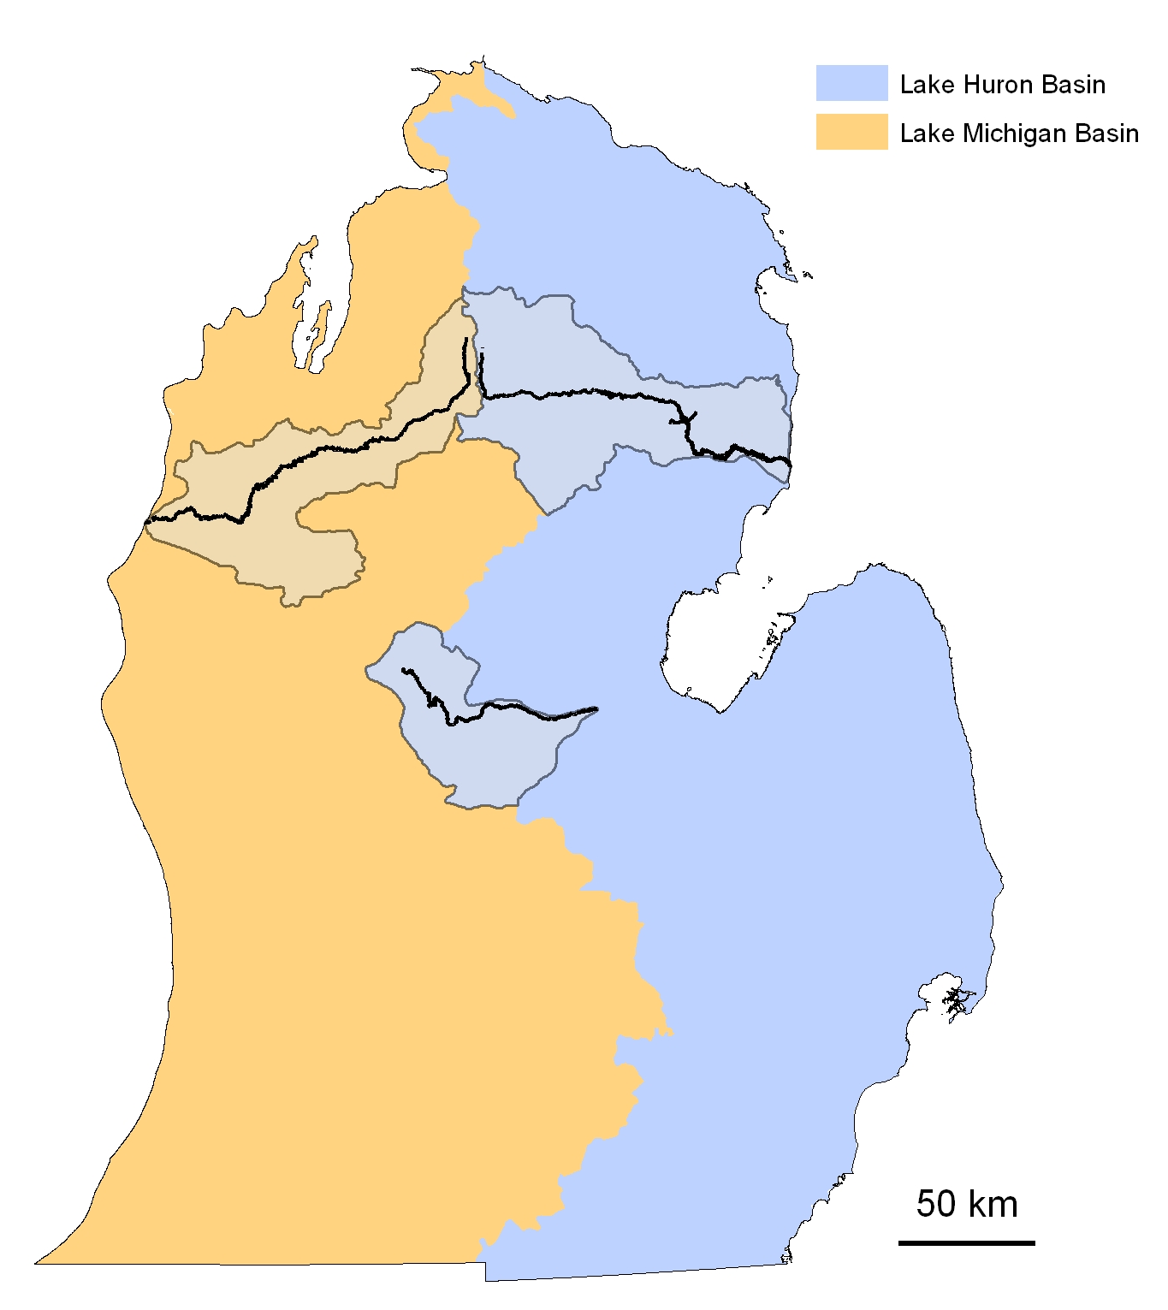
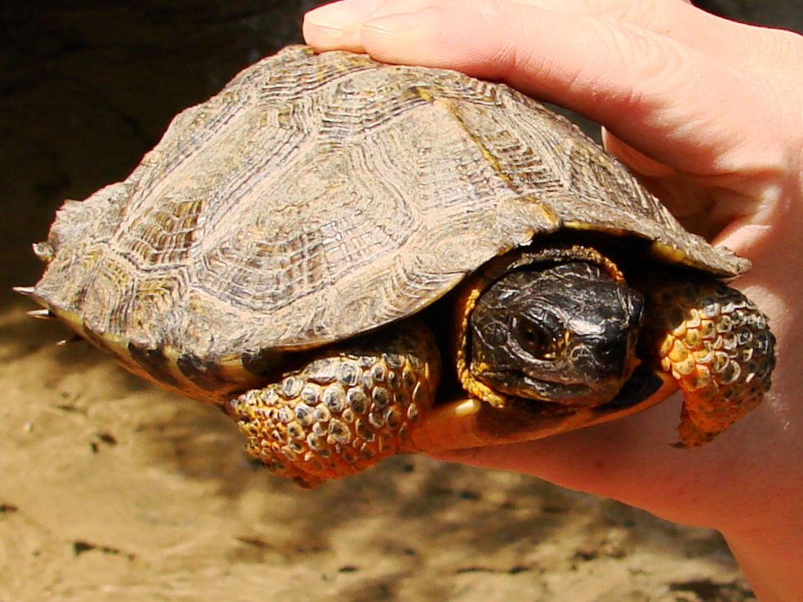
DNA Sampling
Caught turtles by hand/net from kayak
Three scales per individual clipped from appendages
Captured individuals in 3 watersheds, 2 drainage basins
Amplified at 9 microsatellite loci
n=29
n=16
n=23
Notes:
Why these rivers?

Slide 12
DNA Sampling
Caught by hand
Scale clips
2 drainage basins
  3 watersheds
9 microsatellite loci
n=29
n=16
n=23
Notes:
Why these rivers?

Slide 13
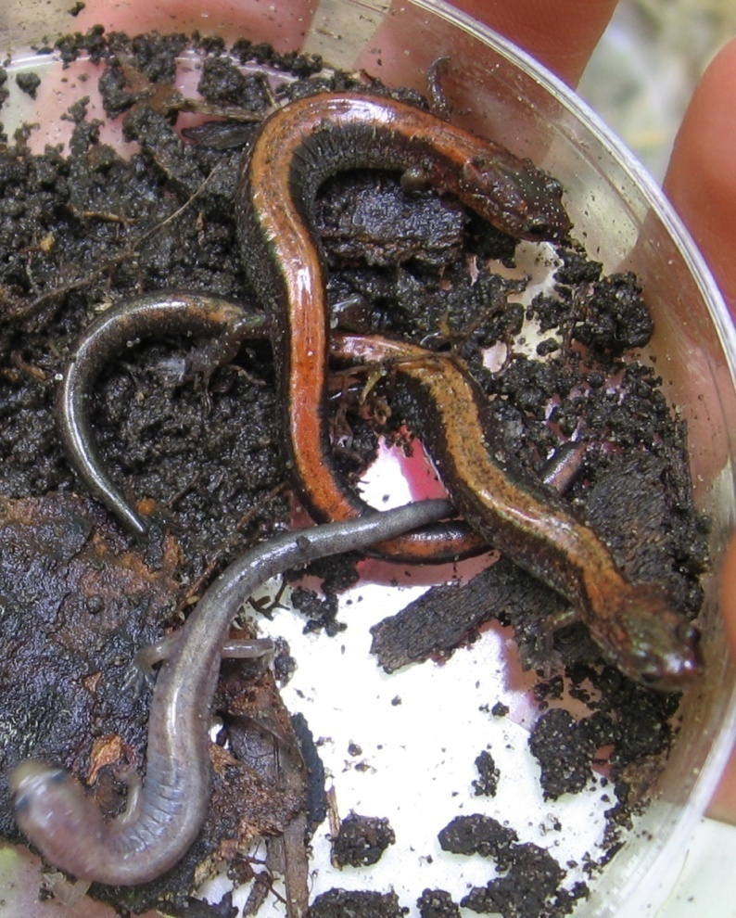
Objectives
Patterns of genetic diversity
Island Biogeography as a predictor of genetic diversity (gd).
  Mainland populations > gd than islands
  Larger islands > gd than smaller islands
  No impact of distance on gd
Notes:
Don’t use abbreviations where you don’t need them. Rarely are you limited for space.

Slide 14
Objectives
Determine patterns of genetic diversity in red-backed salamanders.
Determine the effectiveness of Island Biogeography as a predictor of genetic diversity.
  Mainland populations will have greater genetic diversity than islands
  Larger islands will have greater genetic diversity than smaller islands
  Distance will have a marginal impact on genetic diversity among the islands
Notes:
It is not always true that fewer words and non-sentences are better. Compare this slide to the following

Slide 15
Comparison of number of pictures in a presentation
A good presentation has significantly fewer pictures in it than a bad presentation because pictures only confuse people.
Number of pictures in a presentation

Slide 16

Lots of hands make easy work
Notes:
Make sure your images aren’t pixilated.

Slide 17
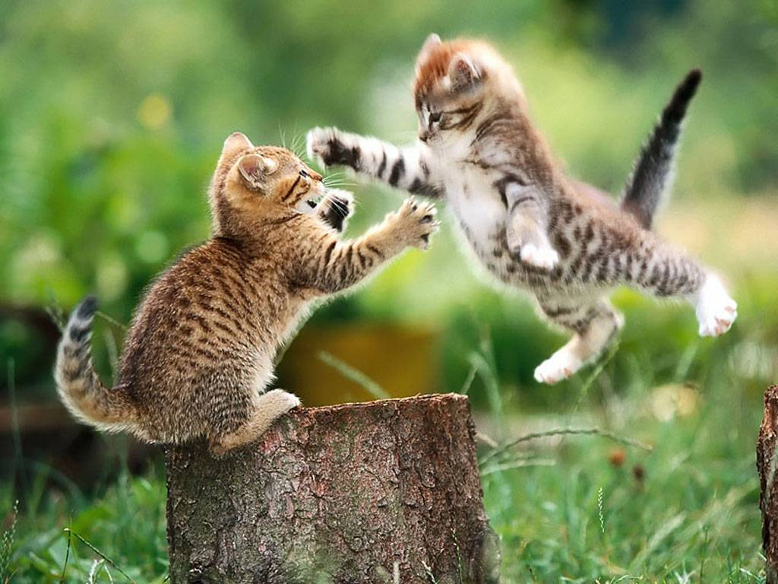
Even kittens are horrible little beasts

Slide 18
Even kittens are horrible little beasts
http://www.fanpop.com/
Notes:
Fair use in an academic setting allows you to use images without having to pay for their use, providing you aren’t making money off of them.

Slide 19
Results
A good presentation has significantly fewer missepllings per slide in it than a bad presentation.
Number of picturesmispelled words in a presentation
Notes:
Problems
Misspelling
Copy and paste
3-D
Scale to small

Slide 20
Results
A good presentation has significantly fewer misspellings per slide in it than a bad presentation.
Number of misspelled words
Notes:
Problems
Misspelling
Copy and paste
3-D
Scale to small

Slide 21
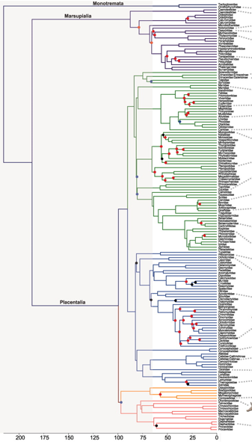
Results

Slide 22
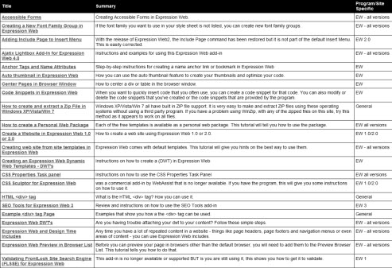
Results

Slide 23
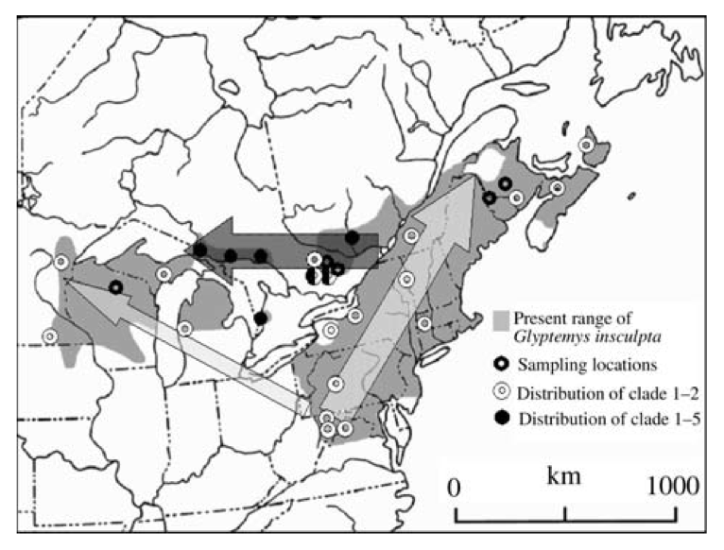
Recolonization
During ice age, refugia in North Carolina
  Recolonized range over 3 major routes
Recolonized Michigan from two routes
  South population: through Ohio
  North population: through Canada
(Amato et al. 2008)
Notes:
North Carolina and south

Slide 24
Doh Assignment Test
Population A
Population B
Notes:
I used two programs to analyze my data; the first was genepop which I used to check for HWE and LDE (only microsats which are in HWE and are not linked can be used for further analysis). I then calculated population differentiation, allele frequencies, and Rho-statistics (similar to F-statistics). Then, using the program Doh, I examined dispersal rates with the assignment calculator.
Because I have populations of different sizes, re-sampled statistics were applied to sample the large populations down to the size of the smaller populations.
Finally, where necessary, Bonferroni correction was applied to p-values.
According to H-W, gene (allele) frequencies and genotype ratios in a randomly-breeding population remain constant from generation to generation. Only microsatellite loci that are in Hardy-Weinberg can be used for analysis. The null hypothesis is that the locus is in Hardy-Weinberg (its easier to be in than out). To test for Hardy-Weinberg Equilibrium, I use GENEPOP to compare the allele frequency that I observe in the sampled population to what would be expected if the population were not evolving. Expected values are based on the equation. GENEPOP essentially conducts a series of tests similar to a chi-squared to yields a p-value that I will compare to my alpha of 0.05. If the observed allele frequencies are significantly different from what would be expected, then the loci is not in Hardy-Weinberg.

Slide 25
Doh Assignment Test
+
+
Notes:
I used two programs to analyze my data; the first was genepop which I used to check for HWE and LDE (only microsats which are in HWE and are not linked can be used for further analysis). I then calculated population differentiation, allele frequencies, and Rho-statistics (similar to F-statistics). Then, using the program Doh, I examined dispersal rates with the assignment calculator.
Because I have populations of different sizes, re-sampled statistics were applied to sample the large populations down to the size of the smaller populations.
Finally, where necessary, Bonferroni correction was applied to p-values.
According to H-W, gene (allele) frequencies and genotype ratios in a randomly-breeding population remain constant from generation to generation. Only microsatellite loci that are in Hardy-Weinberg can be used for analysis. The null hypothesis is that the locus is in Hardy-Weinberg (its easier to be in than out). To test for Hardy-Weinberg Equilibrium, I use GENEPOP to compare the allele frequency that I observe in the sampled population to what would be expected if the population were not evolving. Expected values are based on the equation. GENEPOP essentially conducts a series of tests similar to a chi-squared to yields a p-value that I will compare to my alpha of 0.05. If the observed allele frequencies are significantly different from what would be expected, then the loci is not in Hardy-Weinberg.

Slide 26
Re-sampling Statistics
Replacement
Multiple Iterations
P-value → frequency of observed genotypes
Sample Size
40
20
10
A = 4
A = 3
A = 6
Population
Notes:
Make star of 20 etc come out 10 times to reinforce the idea of repitions/iterations; instead of # put “dots representing individuals of different gemotypes make circles white/grey. Changes number to 10 20 40, max of ¾ diff colored dots; resampleing with replacement could en up having a “star of only 1 type. But mostoften will be a mix of all genotypes. Multiple repitions…eahc time w/different plausible result. End up with a frequency distribution for the alleles..probablility distribution showign what the frewquency of gettign a particular system is (I,e, one or all alles present) if doing a twp tailed test then I would see if my observed num of alleles falles into eithe the lower or upper tail (uppoer of lower 2.5%...below 2.5 or above 97.5) draw a distribution graph. If observed number fall within 2.5 to 97.5 for a 2 tailed then there is no sig. For a one tailed test I use either below 5% or above 95%...these are the basic hypotheses for 1 and 2 tailed tests. Have drawing/graph popo up after first resanmpling, then do the second pop resampling w/no graph following. Goal s to see if there is a sig differene in alleles,l or is it just due to sampling size.
I used two programs to analyze my data; the first was genepop which I used to check for HWE and LDE (only microsats which are in HWE and are not linked can be used for further analysis). I then calculated population differentiation, allele frequencies, and Rho-statistics (similar to F-statistics). Then, using the program Doh, I examined dispersal rates with the assignment calculator.
Because I have populations of different sizes, re-sampled statistics were applied to sample the large populations down to the size of the smaller populations.
Finally, where necessary, Bonferroni correction was applied to p-values.
According to H-W, gene (allele) frequencies and genotype ratios in a randomly-breeding population remain constant from generation to generation. Only microsatellite loci that are in Hardy-Weinberg can be used for analysis. The null hypothesis is that the locus is in Hardy-Weinberg (its easier to be in than out). To test for Hardy-Weinberg Equilibrium, I use GENEPOP to compare the allele frequency that I observe in the sampled population to what would be expected if the population were not evolving. Expected values are based on the equation. GENEPOP essentially conducts a series of tests similar to a chi-squared to yields a p-value that I will compare to my alpha of 0.05. If the observed allele frequencies are significantly different from what would be expected, then the loci is not in Hardy-Weinberg.

Slide 27
Re-sampling Statistics
Probability Distribution
95% confidence interval - 1-tailed
Frequency
5%
No. of Alleles
Notes:
Make star of 20 etc come out 10 times to reinforce the idea of repitions/iterations; instead of # put “dots representing individuals of different gemotypes make circles white/grey. Changes number to 10 20 40, max of ¾ diff colored dots; resampleing with replacement could en up having a “star of only 1 type. But mostoften will be a mix of all genotypes. Multiple repitions…eahc time w/different plausible result. End up with a frequency distribution for the alleles..probablility distribution showign what the frewquency of gettign a particular system is (I,e, one or all alles present) if doing a twp tailed test then I would see if my observed num of alleles falles into eithe the lower or upper tail (uppoer of lower 2.5%...below 2.5 or above 97.5) draw a distribution graph. If observed number fall within 2.5 to 97.5 for a 2 tailed then there is no sig. For a one tailed test I use either below 5% or above 95%...these are the basic hypotheses for 1 and 2 tailed tests. Have drawing/graph popo up after first resanmpling, then do the second pop resampling w/no graph following. Goal s to see if there is a sig differene in alleles,l or is it just due to sampling size.
I used two programs to analyze my data; the first was genepop which I used to check for HWE and LDE (only microsats which are in HWE and are not linked can be used for further analysis). I then calculated population differentiation, allele frequencies, and Rho-statistics (similar to F-statistics). Then, using the program Doh, I examined dispersal rates with the assignment calculator.
Because I have populations of different sizes, re-sampled statistics were applied to sample the large populations down to the size of the smaller populations.
Finally, where necessary, Bonferroni correction was applied to p-values.
According to H-W, gene (allele) frequencies and genotype ratios in a randomly-breeding population remain constant from generation to generation. Only microsatellite loci that are in Hardy-Weinberg can be used for analysis. The null hypothesis is that the locus is in Hardy-Weinberg (its easier to be in than out). To test for Hardy-Weinberg Equilibrium, I use GENEPOP to compare the allele frequency that I observe in the sampled population to what would be expected if the population were not evolving. Expected values are based on the equation. GENEPOP essentially conducts a series of tests similar to a chi-squared to yields a p-value that I will compare to my alpha of 0.05. If the observed allele frequencies are significantly different from what would be expected, then the loci is not in Hardy-Weinberg.

Slide 28
Discussion
Follow my rules and you will have the bestest presentation of everyone at the conference.

Slide 29
Re-sampling Statistics
Probability Distribution
95% confidence interval - 2-tailed
Frequency
2.5%
97.5%
No. of Alleles
Notes:
Make star of 20 etc come out 10 times to reinforce the idea of repitions/iterations; instead of # put “dots representing individuals of different gemotypes make circles white/grey. Changes number to 10 20 40, max of ¾ diff colored dots; resampleing with replacement could en up having a “star of only 1 type. But mostoften will be a mix of all genotypes. Multiple repitions…eahc time w/different plausible result. End up with a frequency distribution for the alleles..probablility distribution showign what the frewquency of gettign a particular system is (I,e, one or all alles present) if doing a twp tailed test then I would see if my observed num of alleles falles into eithe the lower or upper tail (uppoer of lower 2.5%...below 2.5 or above 97.5) draw a distribution graph. If observed number fall within 2.5 to 97.5 for a 2 tailed then there is no sig. For a one tailed test I use either below 5% or above 95%...these are the basic hypotheses for 1 and 2 tailed tests. Have drawing/graph popo up after first resanmpling, then do the second pop resampling w/no graph following. Goal s to see if there is a sig differene in alleles,l or is it just due to sampling size.
I used two programs to analyze my data; the first was genepop which I used to check for HWE and LDE (only microsats which are in HWE and are not linked can be used for further analysis). I then calculated population differentiation, allele frequencies, and Rho-statistics (similar to F-statistics). Then, using the program Doh, I examined dispersal rates with the assignment calculator.
Because I have populations of different sizes, re-sampled statistics were applied to sample the large populations down to the size of the smaller populations.
Finally, where necessary, Bonferroni correction was applied to p-values.
According to H-W, gene (allele) frequencies and genotype ratios in a randomly-breeding population remain constant from generation to generation. Only microsatellite loci that are in Hardy-Weinberg can be used for analysis. The null hypothesis is that the locus is in Hardy-Weinberg (its easier to be in than out). To test for Hardy-Weinberg Equilibrium, I use GENEPOP to compare the allele frequency that I observe in the sampled population to what would be expected if the population were not evolving. Expected values are based on the equation. GENEPOP essentially conducts a series of tests similar to a chi-squared to yields a p-value that I will compare to my alpha of 0.05. If the observed allele frequencies are significantly different from what would be expected, then the loci is not in Hardy-Weinberg.

Slide 30
Re-sampling Statistics
Probability Distribution
95% confidence interval - 1-tailed
Frequency
95%
No. of Alleles
Notes:
Make star of 20 etc come out 10 times to reinforce the idea of repitions/iterations; instead of # put “dots representing individuals of different gemotypes make circles white/grey. Changes number to 10 20 40, max of ¾ diff colored dots; resampleing with replacement could en up having a “star of only 1 type. But mostoften will be a mix of all genotypes. Multiple repitions…eahc time w/different plausible result. End up with a frequency distribution for the alleles..probablility distribution showign what the frewquency of gettign a particular system is (I,e, one or all alles present) if doing a twp tailed test then I would see if my observed num of alleles falles into eithe the lower or upper tail (uppoer of lower 2.5%...below 2.5 or above 97.5) draw a distribution graph. If observed number fall within 2.5 to 97.5 for a 2 tailed then there is no sig. For a one tailed test I use either below 5% or above 95%...these are the basic hypotheses for 1 and 2 tailed tests. Have drawing/graph popo up after first resanmpling, then do the second pop resampling w/no graph following. Goal s to see if there is a sig differene in alleles,l or is it just due to sampling size.
I used two programs to analyze my data; the first was genepop which I used to check for HWE and LDE (only microsats which are in HWE and are not linked can be used for further analysis). I then calculated population differentiation, allele frequencies, and Rho-statistics (similar to F-statistics). Then, using the program Doh, I examined dispersal rates with the assignment calculator.
Because I have populations of different sizes, re-sampled statistics were applied to sample the large populations down to the size of the smaller populations.
Finally, where necessary, Bonferroni correction was applied to p-values.
According to H-W, gene (allele) frequencies and genotype ratios in a randomly-breeding population remain constant from generation to generation. Only microsatellite loci that are in Hardy-Weinberg can be used for analysis. The null hypothesis is that the locus is in Hardy-Weinberg (its easier to be in than out). To test for Hardy-Weinberg Equilibrium, I use GENEPOP to compare the allele frequency that I observe in the sampled population to what would be expected if the population were not evolving. Expected values are based on the equation. GENEPOP essentially conducts a series of tests similar to a chi-squared to yields a p-value that I will compare to my alpha of 0.05. If the observed allele frequencies are significantly different from what would be expected, then the loci is not in Hardy-Weinberg.

Slide 31
Re-sampling Statistics
Jeff Klomp (unpublished)
Replacement
Multiple Iterations
Sample Size
40
20
10
1
2
3
Population
Notes:
Make star of 20 etc come out 10 times to reinforce the idea of repitions/iterations; instead of # put “dots representing individuals of different gemotypes make circles white/grey. Changes number to 10 20 40, max of ¾ diff colored dots; resampleing with replacement could en up having a “star of only 1 type. But mostoften will be a mix of all genotypes. Multiple repitions…eahc time w/different plausible result. End up with a frequency distribution for the alleles..probablility distribution showign what the frewquency of gettign a particular system is (I,e, one or all alles present) if doing a twp tailed test then I would see if my observed num of alleles falles into eithe the lower or upper tail (uppoer of lower 2.5%...below 2.5 or above 97.5) draw a distribution graph. If observed number fall within 2.5 to 97.5 for a 2 tailed then there is no sig. For a one tailed test I use either below 5% or above 95%...these are the basic hypotheses for 1 and 2 tailed tests. Have drawing/graph popo up after first resanmpling, then do the second pop resampling w/no graph following. Goal s to see if there is a sig differene in alleles,l or is it just due to sampling size.
I used two programs to analyze my data; the first was genepop which I used to check for HWE and LDE (only microsats which are in HWE and are not linked can be used for further analysis). I then calculated population differentiation, allele frequencies, and Rho-statistics (similar to F-statistics). Then, using the program Doh, I examined dispersal rates with the assignment calculator.
Because I have populations of different sizes, re-sampled statistics were applied to sample the large populations down to the size of the smaller populations.
Finally, where necessary, Bonferroni correction was applied to p-values.
According to H-W, gene (allele) frequencies and genotype ratios in a randomly-breeding population remain constant from generation to generation. Only microsatellite loci that are in Hardy-Weinberg can be used for analysis. The null hypothesis is that the locus is in Hardy-Weinberg (its easier to be in than out). To test for Hardy-Weinberg Equilibrium, I use GENEPOP to compare the allele frequency that I observe in the sampled population to what would be expected if the population were not evolving. Expected values are based on the equation. GENEPOP essentially conducts a series of tests similar to a chi-squared to yields a p-value that I will compare to my alpha of 0.05. If the observed allele frequencies are significantly different from what would be expected, then the loci is not in Hardy-Weinberg.

