Slide 1
KBS Water PD Session
Marcia Angle, Becky Drayton, and Sara Syswerda
June 28, 2012

Slide 2
Workshop Goals
Explore how learning progression-based formative assessments and tools for reasoning can help teachers:
Elicit and interpret students’ ideas
Consider how students at different learning progression levels are likely to understand and respond to lessons and activities
Refine lessons and activities to be sensitive to the particular informal ideas that students may hold (as shown by formative assessments)
Refine lessons and activities to help students reach higher levels of achievement on the learning progression (including through integration of tools for reasoning)

Slide 3
What are the big ideas in watersheds?
What do you want your students to know about watersheds?
Let’s look at the water learning progression framework and start thinking about what students really need to understand before they can “get” watersheds…page 7.

Slide 4
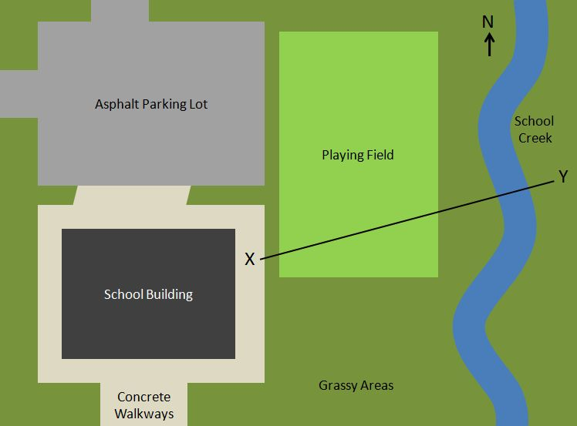
Let’s look at a couple questions:
School map formative assessment.
How did you answer this question?

Slide 5
WWSD? (What would your students do?)
How would your students have answered the school map question?
Let’s look at some real answers to see what students said…page 8 and 9.
In small groups, pick out what you think are the most sophisticated 3 responses and least sophisticated 3 student responses.
Share thoughts!

Slide 6
So now we know where our students are…now what?

Slide 7
Introduction to Water Tools for Reasoning

Slide 8
What Do Tools For Reasoning Help Us Accomplish With Our Students?
Make links and connections through graphic organizer.
Intended to scaffold development of scientific accounts.
Address specific LP-related challenges; students encounter, e.g. …
Considering likelihood of multiple/diverse pathways of water
Attending to driving forces and constraining factors for moving water

Slide 9
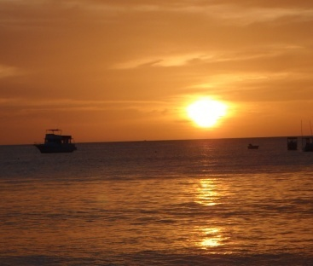
Pathways Tool
Before
After
Before
After
Before
After

Slide 10
Pathways Tool Features
Emphasizes…
Multiple pathways (not just evap., cond., prec.)
Conservation of matter --- water must come from somewhere and go somewhere
Invisible pathways
Connections between systems (atmosphere, surface water and groundwater)
Scaffolds…
Thinking across spans of time and space
Social construction of understanding
Opportunities for scientific argumentation

Slide 11
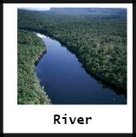
Pathways Tool Example
Before
After
In a Mountain Water pipe heading to my house
In my belly (I caught and ate the fish, but this is not very likely)
Before
In a cloud above Idaho
In the groundwater
Snow on ground in Anaconda
Running off over the ground near Blackfoot River
After
In Clark Fork River near Superior
In a fish in the Clark Fork
In a Mountain Water Well in Missoula
In a cloud above Turah
Before
Falling as rain in E. Missoula
In groundwater near Milltown
Running off over the ground in Clinton
In Rattlesnake Creek
After
In Clark Fork River by Frenchtown
In the atmosphere
In Missoula Aquifer
Instructional Context: Exploration (with maps handy) of where water in the river in our town comes from and goes to

Slide 12
Drivers And Constraints Tool
Where can the water go? What is the process?
What drives or moves the water? How?
Where does the
water start?
What are the constraining factors, and how do they work?

Slide 13
Drivers & Constraints Tool Affordances
Focuses students on scientific explanations for pathways, especially driving forces and constraining variables
Supports developing awareness of system structures, pathways, and processes
Scaffolds social construction of understanding
Scaffolds students in scientific argumentation (e.g., debating processes/likelihoods of possible pathways)

Slide 14
Drivers & Constraints Example
Where can the water go? What is the process?
What drives or moves the water? How?
Where does the
water start?
What are the constraining factors, and how do they work?
Instructional Context: It hasn’t rained in Missoula in over a month. Why is there still water in the Clark Fork River?

Slide 15
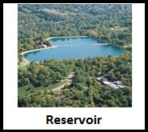
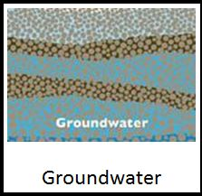
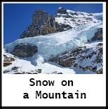
Drivers & Constraints Example
Where can the water go? What is the process?
What drives or moves the water? How?
Where does the
water start?
What are the constraining factors, and how do they work?
Gravity
Topography/elevation - water flows to lower areas.
Floodgates --- opened or closed to manage flow
Discharge
Gravity
Topography and permeability – GW flow follows topography of impermeable layer. In river, water table is above ground.
GW Discharge
Gravity
Temperature --- Water won’t runoff unless it first melts at temperature above 32°F.
Topography – see above.
Runoff

Slide 16
How can you use the tools?
For eliciting and responding to students’ ideas
For supporting student-centered discussion and argumentation about water systems
Drivers & Constraints Tool helps focus lessons on causal explanations (how & why)
Helps students to apply prior knowledge and use that knowledge to make predictions.

Slide 17
So now what?
How can we put this into action?
Can we tag-team formative assessments of students understandings/thinking with the teaching tools to possibly change how we might teach a lesson depending on where our students start from?

Slide 18
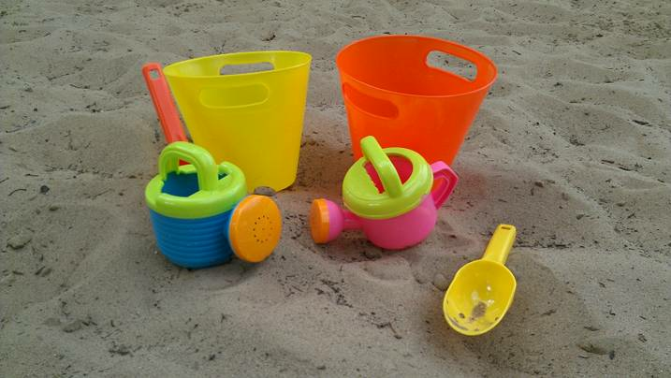
Let’s head outside to the beach…

Slide 19
Let’s try this…
Let’s look at an activity we just did.
Fill out the Pathways and Drivers & Constraints tools the way you think your students would at before the activity.
Fill out the Pathways and Drivers & Constraints tools the way you hope your students would fill them out after the activity (our goal!).

Slide 20
How would you have to adapt this activity for your students?
Look at the activity, and based on where you think your students are starting from:
What strengths would your students bring to the table?
What challenges might they encounter while engaging in the activity?
Use the blank activity description table to describe what the refined activity would look like and how that would support student learning.

Slide 21
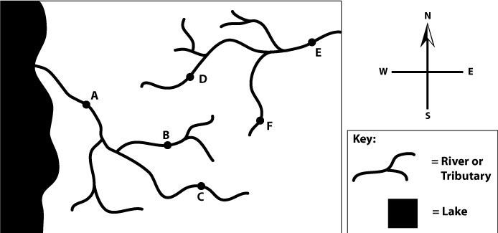
Can pollution in the River get from point B to C?
Why or why not?

Slide 22
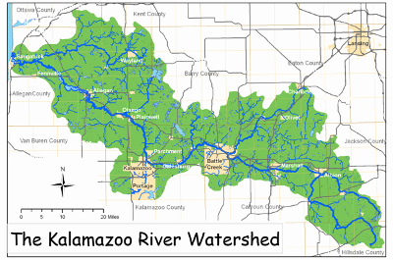
Kalamazoo River Watershed

