Slide 1
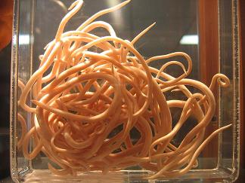
Distribution and Prevalence of Raccoon Roundworm (Baylisascaris procyonis) in Allegan and Barry Counties
Got Worms?
Sara Leonard and Jessica Meppelink
Grand Valley State University

Slide 2
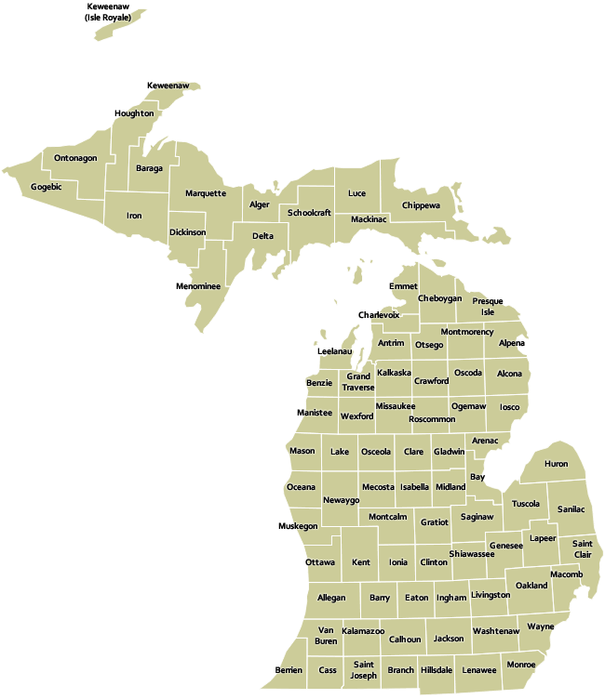
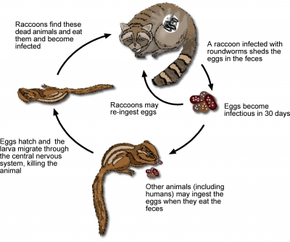
Study Objectives
www.michigan.gov
extension.entm.purdue.edu
Determine the population densities of intermediate hosts near latrines
Determine the prevalence and distribution of raccoon roundworm

Slide 3
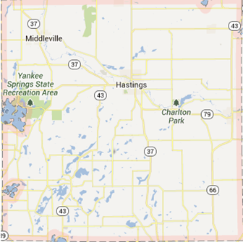
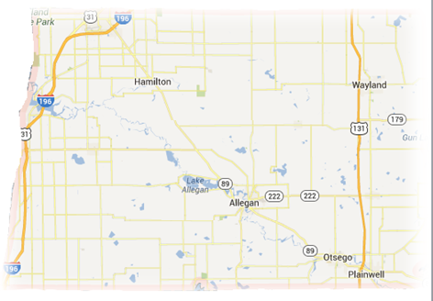
Methods
Allegan County
Barry County
2 Counties
- 5 Sample locations
each
1
2
3
5
1
2
3
4
4
5

Slide 4
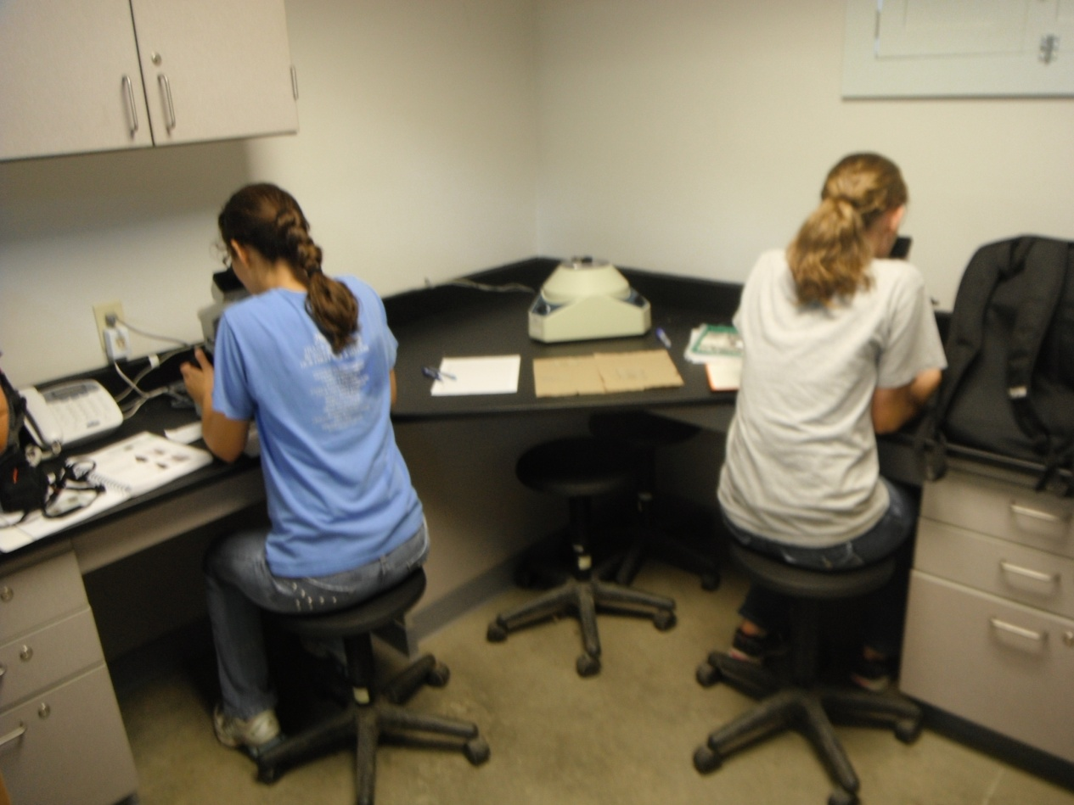
Methods
Fecal Floats
Centrifuge technique
Microscope Identification

Slide 5
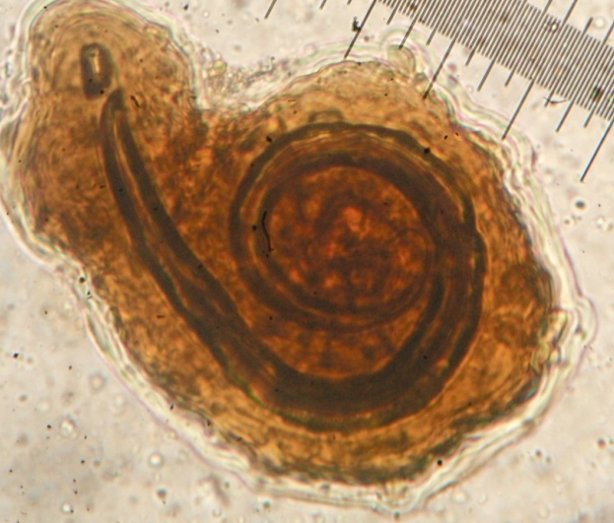
Under the
Microscope

Slide 6
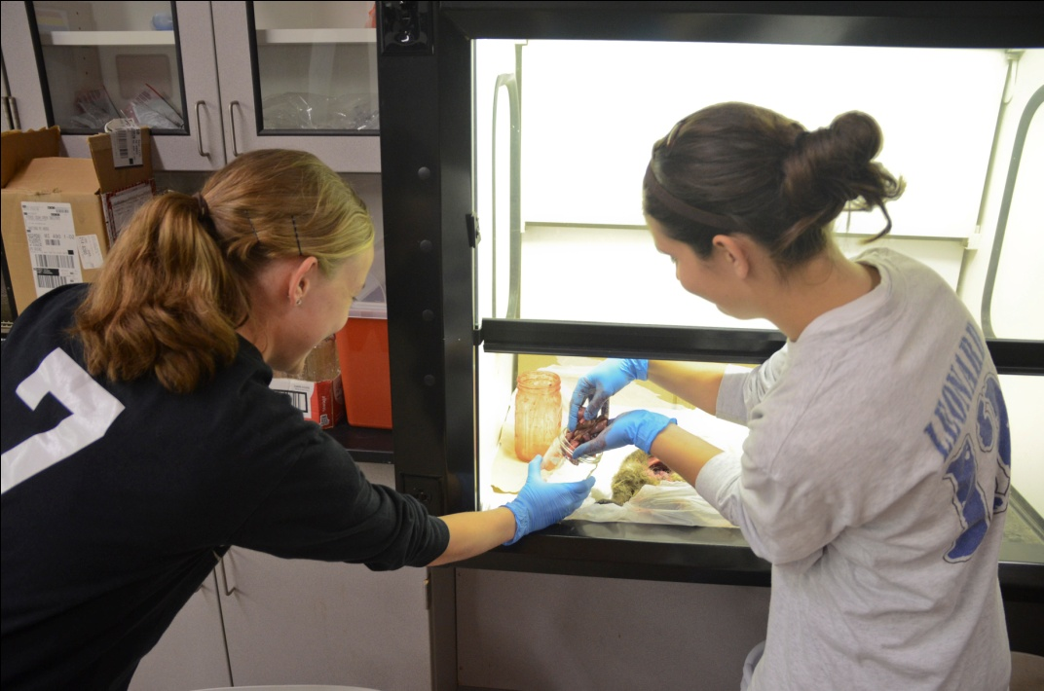
Methods
Necropsies
- Fresh road kill
Prevalence measured as the proportion of:
1) Infected fecal samples
2) Infected individuals

Slide 7
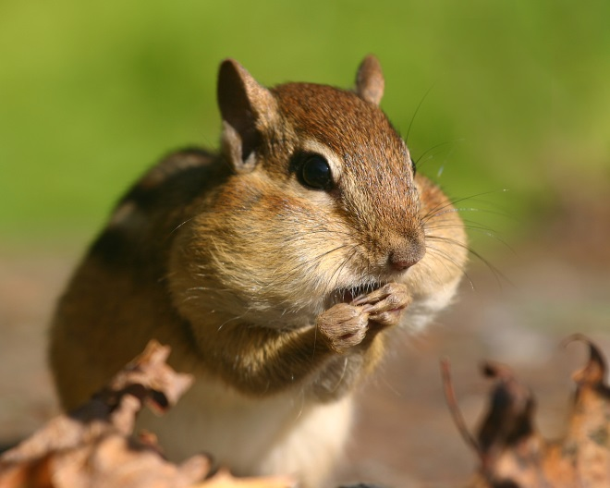
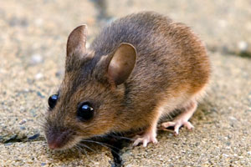
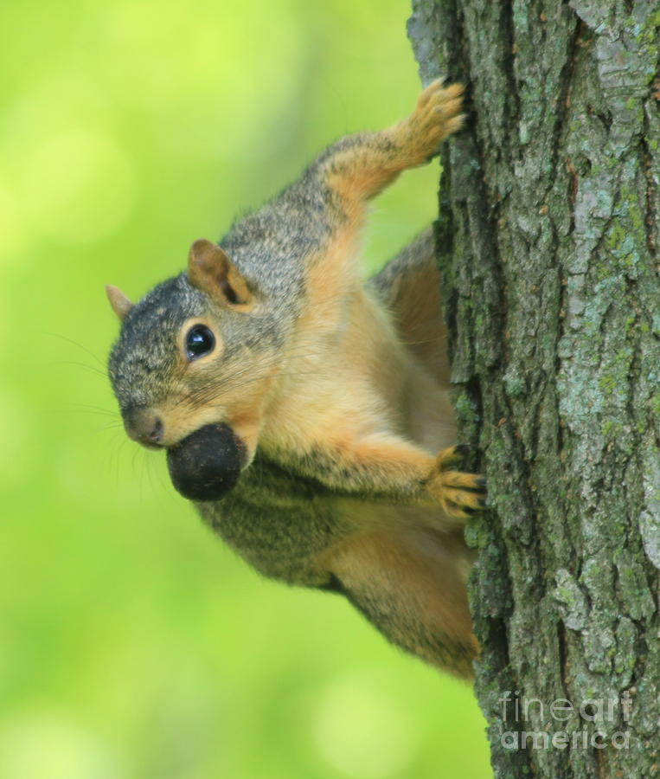
Methods
naturallycuriouswithmaryholland.wordpress.com
Track plates
- 10 positive latrines
- 10 negative latrines
www.kaputproducts.com
Wildlife cameras
fineartamerica.com

Slide 8
Data Collected: Fecal freeloaders

Slide 9
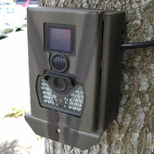
Future Endeavers
Sample Allegan County
Place Track Plates
- Set up wildlife cameras
www.arthursclipart.org
www.bear-tracker.com
www.bear-tracker.com
www.wayfair.com

Slide 10
Questions?
vunzooke.com

